Slide 1


Welcome to the New School Year
A year in Rowan Class
Everyone Experiences Excellence

Slide 2

An exciting new year lies ahead – 180 days of brain power needed!
Everyone Experiences Excellence

Slide 3
In this welcome session we will cover:
The curriculum expectation for the end of year
Our Learning Journey themes and adventures
Home learning and the expectation of a Hudson parent in this class
Communication with families
Important information – how the year has gone so far (in general)
Things we are looking forward to this year
Everyone Experiences Excellence

Slide 4

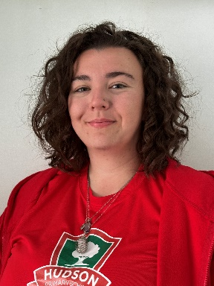
Our Staff

Slide 5
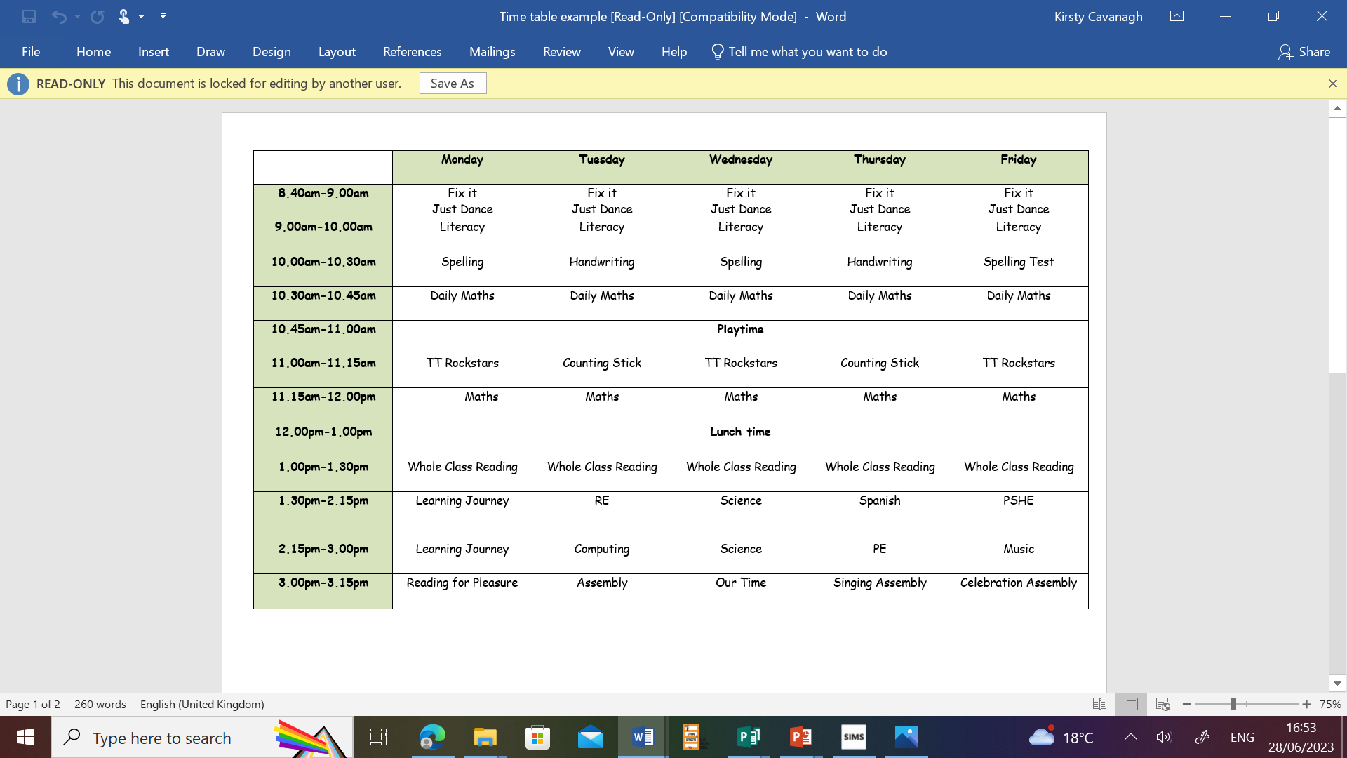
Our Daily Timetable
Did you know that if you’re late by 10 minutes every day for the year it equals 31.5 hours!

Slide 6
Our English books this year
Everyone Experiences Excellence

Slide 7
This year we hope to:
Have guest speakers in class
Go on school trips
Residential Trips
Be good role models to our buddies
Become Head boy or Head girl

Slide 8
Home learning and the expectation of a Hudson parent in this class
Spellings- Test is every Friday
Times tables- weekly tests.
There will be Maths and English work set every Wednesday and should be returned on the following Monday.
Reading books – Children will have an online skills builder book and a reading for pleasure book. It is expected that the children read a minimum of 3 times per week. Adults should sign on each occasion to say that this has happened.

Slide 9
Home learning and the expectation of a Hudson parent in this class
Homework is important for parents because it provides valuable insight into their child's learning progress and helps strengthen the partnership between home and school.
Reinforces learning
Builds responsibility and Independence-
Can Strengthen Bonds between your child and communication with school.
Prepares for future academic success

Slide 10
How Reading Helps Your Child Thrive
Builds Language and Writing Skills
Grows their vocabulary: Reading introduces your child to lots of new words and ways to use them.
Improves grammar and writing: They learn how sentences are made, how punctuation works, and how stories flow—without even realising it.
Boosts Reading Fluency and Understanding
Gets them reading faster: The more they read, the easier it becomes to sound out words and read smoothly.
Helps them understand what they read: Fluent reading leads to better comprehension.
Supports Success in School
Improves grades across subjects: Kids who read often do better not only in reading and writing but also in math, science, and more.
Builds critical thinking: Reading sparks the imagination and strengthens skills like analyzing, questioning, and tackling problems.

Slide 11
How Reading Helps Your Child Thrive
Builds Empathy and Understanding
Stories help kids see life through other people’s eyes, boosting kindness and emotional awareness.
Reduces Stress
Reading can be relaxing, helping children calm down and manage emotions.
Improves Focus
Following a story strengthens attention and concentration over time.
Sparks Imagination and Curiosity
Fiction fuels creativity. Non-fiction inspires interest in the world around them.
Encourages Lifelong Learning
When kids enjoy reading, they’re more likely to stay curious and love learning for life.

Slide 12
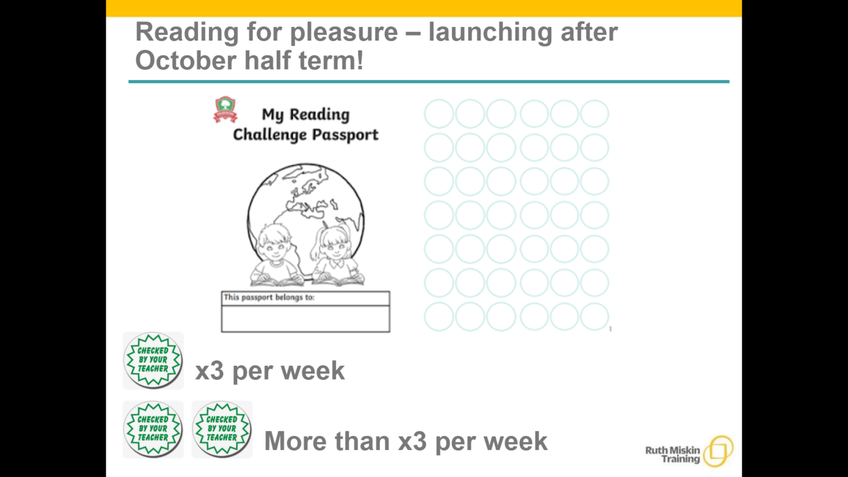

Slide 13


Slide 14
SATS

Slide 15
What are SATs?
SATs is a term people use to refer to End of Key Stage 2 Assessments
They last for four days beginning on Monday 12th May 2025 and ending on Thursday 15th May 2025
Children will sit the following SATs papers:
Grammar, Punctuation and Spelling (Paper 1)
Grammar, Punctuation and Spelling (Paper 2)
Reading
Maths Paper 1 (Arithmetic)
Maths Paper 2 (Reasoning)
Maths Paper 3 (Reasoning)

Slide 16
Writing
There is no Year 6 SATs writing test.
As in recent years, writing will be teacher assessed internally and then moderated by a LEA moderator.
• The revised ‘pupil can’ statements for English writing place a greater emphasis on composition and the statements that relate to the more ‘technical’ aspects of English writing (grammar, punctuation and spelling) have been made less prescriptive.

Slide 17
Writing – Ways to help at home
• Practise and learn weekly spelling lists – make it fun!
• Encourage opportunities for writing such as letters to family or friends, shopping lists, notes or reminders, stories and poems.
• Write together – be a good role model for writing.
• Encourage use of a dictionary to check spelling and a thesaurus to find synonyms and expand vocabulary.
• Remember that good readers become good writers! Identify good writing features when reading (e.g. vocabulary, sentence structure and punctuation)

Slide 18
The Tests
The tests will take place during normal school hours, under exam conditions. Children are not allowed to talk to each other from the moment the assessments are handed out until they are collected after the test has ended.
Statutory tests will be administered in the following subjects:
Punctuation, Vocabulary and Grammar (45 minutes)
Spelling (approximately 15 minutes)
Reading (60 minutes)
Mathematics
- Paper 1: Arithmetic (30 minutes)
- Paper 2: Reasoning (40 minutes)
- Paper 3: Reasoning (40 minutes).
All tests are externally marked.

Slide 19
Specific arrangements for SATs
Children with additional needs, who have similar provision in their day-today learning at school, may be allotted specific arrangements, including:
Additional (extra) time
Tests being opened early to be modified • An adult to read for them
An adult to scribe (write) for them
Written or spoken translations of the mathematics reasoning papers
The use of prompts or rest breaks • Arrangements for children who are ill or injured at the time of the tests
*Pupils with an EHC plan are automatically allowed up to 25% additional time . Pupils who use the modified large print or braille versions of the tests are automatically allowed up to 100% additional time

Slide 20
What sort of results are reported?
Once marked, the tests will be given the following scores:
• A raw score (the total number of marks achieved for each paper)
• A scaled score (which is explained below) • A judgement of whether the National Standard has been met After marking each test, the external markers will convert each raw score into a scaled score to show whether each child is working below, at or above the national standard.
When the scaled score is given, it is given in a range from 80 to 120. A scaled score of 100 or more is meeting the national standard.
There are no separate tests for higher achieving pupils; however, a scaled score close to 120 would show that a child is working above the national standard.

Slide 21
Grammar, Punctuation and Spelling (Paper 1)
Grammar, Punctuation and Spelling (Paper 1) is the longer paper lasting 45 minutes.
The children will be prepared so they are equipped with a good knowledge of the technical vocabulary needed to identify and describe various aspects of grammar and punctuation marks.
• Grammar, Punctuation and Spelling (Paper 1) focuses on the following areas:
Grammatical terms/word classes
Functions of sentences
Combining words, phrases and clauses
Verb forms, tenses and consistency
Punctuation
Vocabulary
Standard English and formality

Slide 22
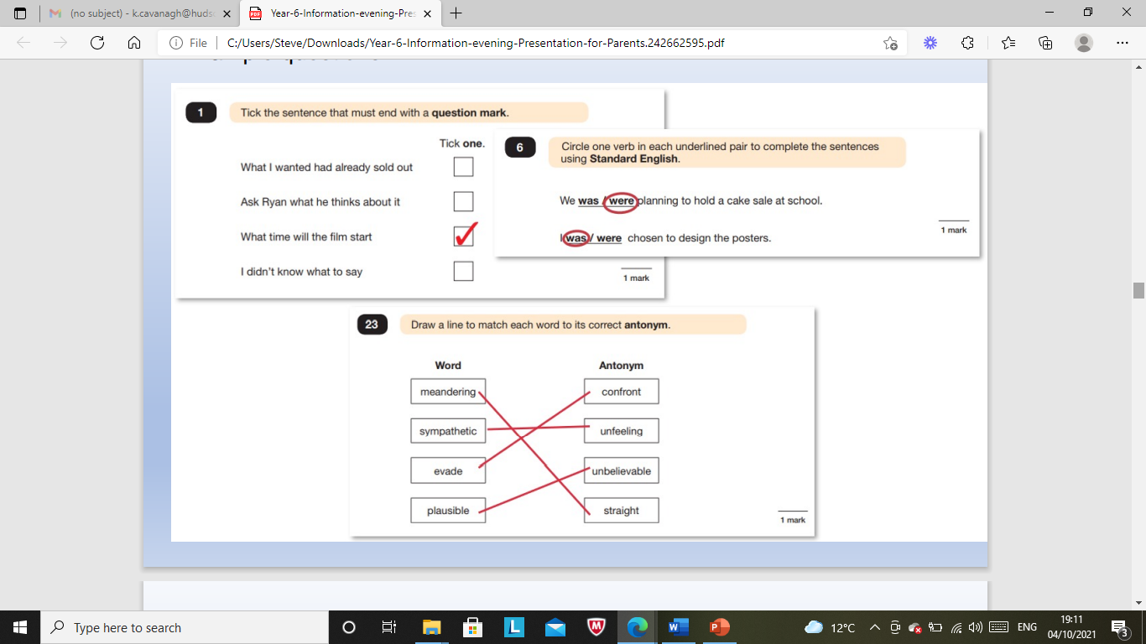
Grammar, Punctuation and Spelling (Paper 1)

Slide 23
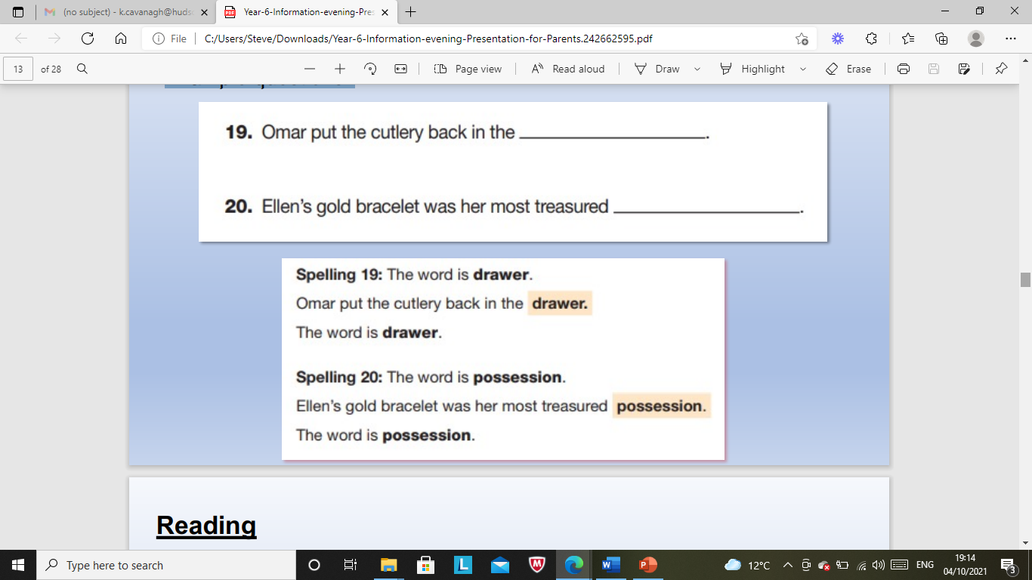
Grammar, Punctuation and Spelling (Paper 2)
Grammar, Punctuation and Spelling (Paper 2) is the shorter paper lasting 15 minutes. Example questions:

Slide 24
Reading
The Year 6 Reading SATs paper has been designed to measure whether children’s comprehension of age-appropriate reading material meets the national standard.
It has a standard timing of 60 minutes, including reading the texts and answering questions.
There are three different set texts for the children to read, which could be any combination of non-fiction, fiction and/or poetry.
The paper requires a range of answering styles, including responding to multiple choice questions, one-word answers, and multiple mark questions which require more formal paragraph-length answers.

Slide 25
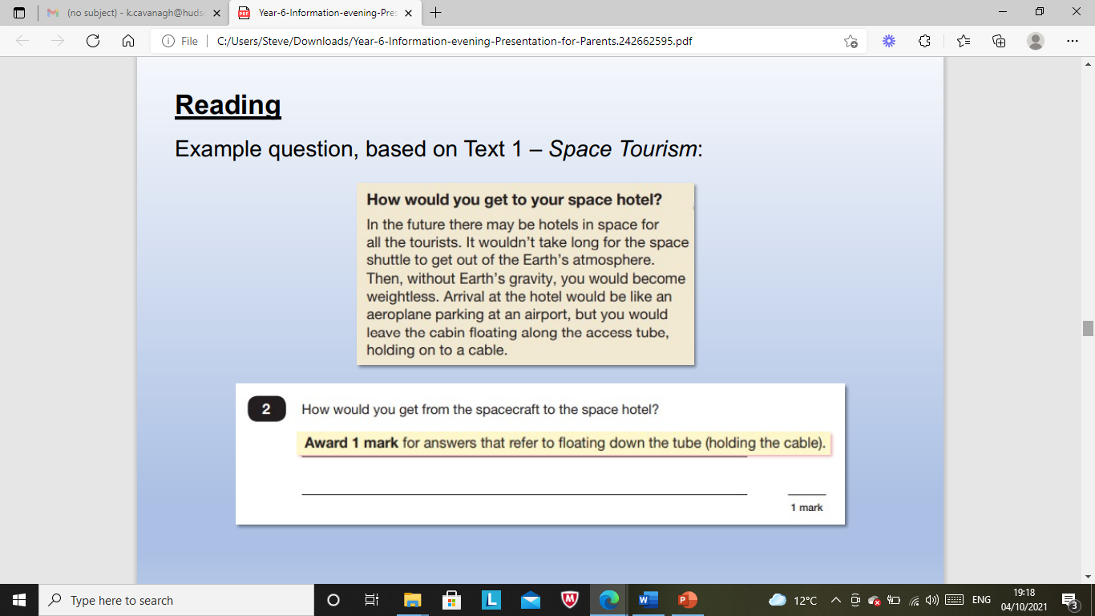
Example question, based on Text 1 – Space Tourism:

Slide 26
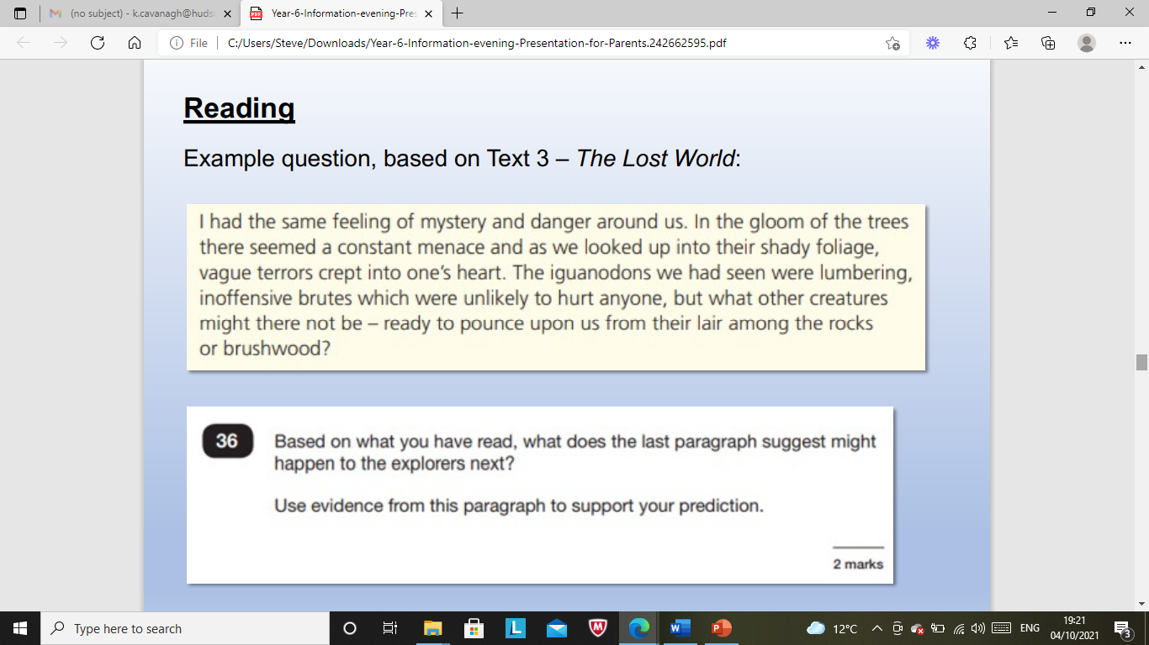
Example question, based on Text 3 – The Lost World:

Slide 27
Reading – Ways to help at home
Listening to your child read can take many forms.
First and foremost, focus developing an enjoyment and love of reading.
Enjoy stories together – reading stories to your child at KS1 and KS2 is equally as important as listening to your child read.
Read a little at a time but often, rather than rarely but for long periods of time! Children should be reading for at least 20 minutes at home every day, from a wide variety of text types.
All reading is valuable – it doesn’t have to be just stories. Reading can involve anything: fiction, non-fiction, poetry, newspapers, magazines, football programmes and TV guides.
Visit the local library - it’s free.
Look up definitions of words together – you could use a dictionary, the Internet or an app on a phone or tablet.
Talk about the story before, during and afterwards – discuss the plot, the characters, their feelings and actions, how it makes you feel, predict what will happen and encourage your child to have their own opinions

Slide 28
Reading Plus- Our New Online reading platform
We’re excited to introduce Reading Plus as our new online reading platform! This tool is designed to support and improve your child’s reading fluency, comprehension, and confidence.
🔹 What’s expected:
Children are expected to use Reading Plus at least 3 times per week for 30 minutes. Their usage will be monitored by teachers through the platform and through reading records. .
🔹 Rewards and motivation:
To encourage regular reading, we’ll be celebrating progress with certificates, points, and prizes!
🔹 How it works:
Reading Plus adapts to your child’s reading level, providing personalised texts and questions. It coaches them through reading strategies, tracks their progress, and helps build stamina and understanding.
With your support, we can help make reading a fun and successful habit for every student

Slide 29
Maths Papers
Maths Paper 1 (Arithmetic) has a standard timing of 30 minutes and is worth a total of 40 marks.
It covers the four operations (division, multiplication, addition, subtraction and mixed operation calculations requiring BODMAS), as well as number properties, calculating percentages of amounts, calculations using decimals, and calculations using fractions.
This is the easiest way for a child to gain a higher proportion of marks so we focus daily on their arithmetic skills.

Slide 30
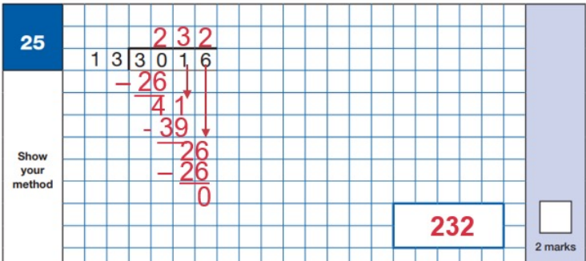
Maths Paper 1 (Arithmetic)
Example question:

Slide 31
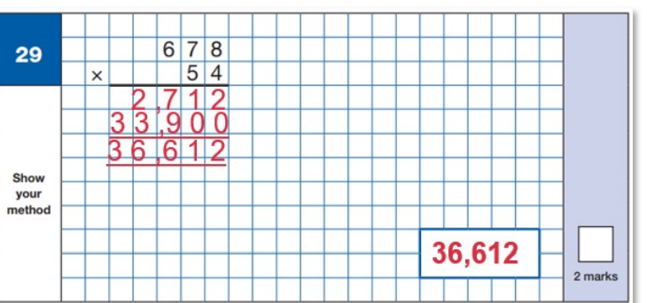
Maths Paper 1 (Arithmetic)
Example question:

Slide 32
Maths Papers
Maths Paper 2 (Reasoning) and Maths Paper 3 (Reasoning) both have standard timings of 40 minutes and are worth 35 marks each. Papers 2 and 3 require children to demonstrate their mathematical knowledge and skills, as well as their ability to solve problems and their mathematical reasoning.
Questions focus on the following Mathematical topic areas:
- Number and place value
– including Roman Numerals;
- Addition, subtraction, multiplication and division (calculations);
Geometry
Properties of shapes;
Geometry
Position and direction;
Statistics;
Measurement
Including length, perimeter, mass (weight), volume, time and money;
Algebra;
- Ratio and proportion;
Fractions, decimals and percentages.

Slide 33
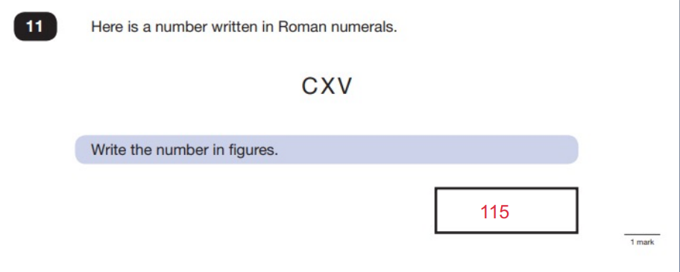
Maths question example

Slide 34
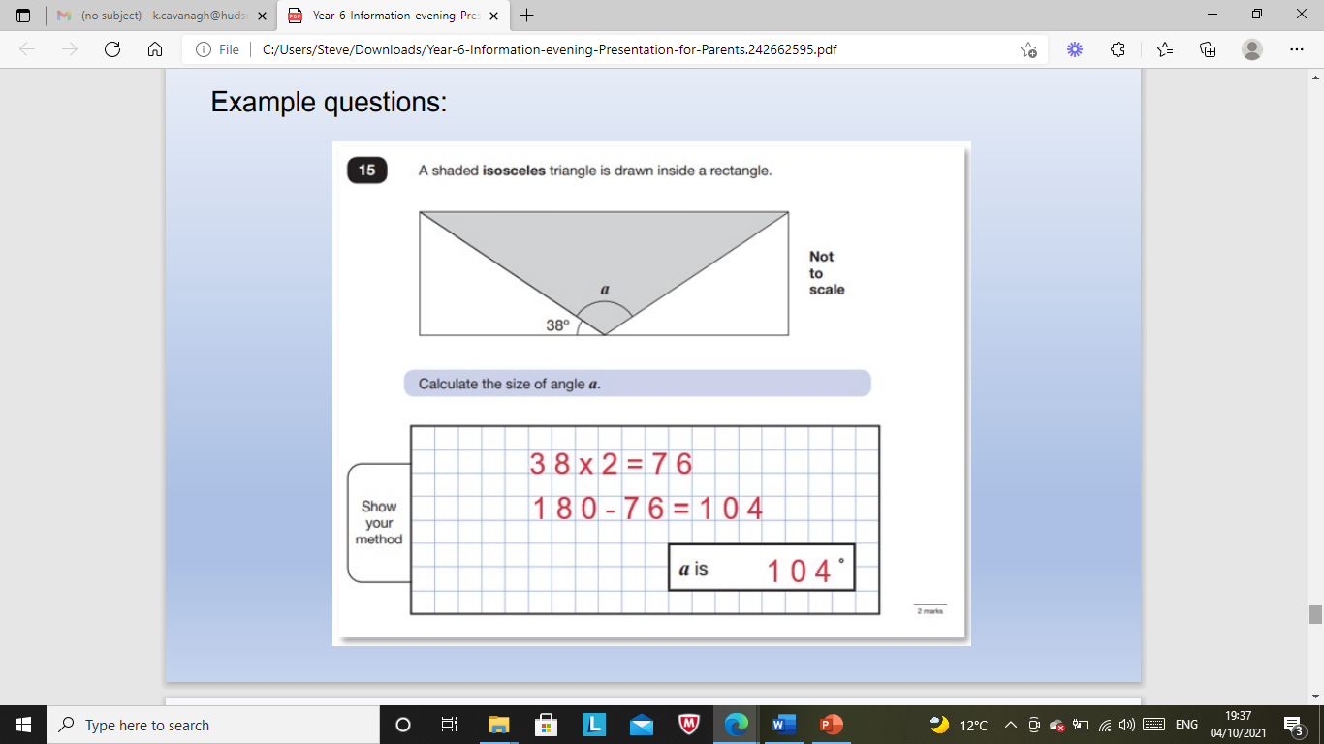
Maths question example

Slide 35
Maths – Ways to help at home
Play times tables games.
• Play mental maths games including counting in different amounts, forwards and backwards.
• Encourage opportunities for telling the time.
• Encourage opportunities for counting coins and money; finding amounts or calculating change when shopping.
• Look for numbers on street signs, car registrations and anywhere else!
• Look for examples of 2D and 3D shapes around the home.
• Identify, weigh or measure quantities and amounts in the kitchen or in recipes.
• Play games involving numbers or logic, such as dominoes, card games, darts, draughts and chess

Slide 36
How can I support my child in preparing for their SATs?
Firstly, a positive attitude goes a long way – so as much encouragement and support as possible.
Ensure your child has the best possible attendance at school.
Try to provide a quiet corner of the house for homework and study, that’s as free from distractions as possible and support your child with any homework tasks.
Reading, spelling and arithmetic (e.g. times tables) are always good to practise.
Talk to your child about what they have learnt at school and what book(s) they are reading (the character, the plot, their opinion).
Make sure your child has a good sleep and healthy breakfast every morning.
Direct any questions or concerns you have about to your child’s teacher

Slide 37
How can I support my child in preparing for their SATs?
Encourage your child to talk to their teacher or another adult they trust if they express persisting anxieties about SATs. Remember that a small amount of anxiety is normal and not harmful.
If you feel it would be useful, create a revision timetable that works for you and your child – for some children and families, a couple of 10 – 20 minute activities a day works best; for others, a longer study session on a Saturday or Sunday might be better.
There are plenty of inexpensive or free SATs practice materials for parents - matr.org is a good place to start
Keep it light – practice key skills like times tables and practice mental maths in real world scenarios, like adding up prices in the shops, working out discount deals, and asking questions like, “If there are 1,300 grams of flour in this pack, what is that in kilograms?
Boosters/tutoring - not essential but of great benefit

Slide 38

Key Dates
Closing dates for Secondary School applications is 31st October 2025
Placement offer date is 2nd March 2026

Slide 39
Transition
The children will have a transition day at their chosen secondary school. On that day they will not attend Hudson but go straight to their school.
The day usually consists of a tour, meeting the teachers and some getting to know you activities.
During transition week at Hudson the children will take part in a week of preparing for secondary school activities. These include, using a planner and what to do if you get lost.

Slide 40

Communicating with families
* Please ensure that all end of day collection arrangements are communicated via telephone through the main school line.
Everyone Experiences Excellence

