Slide 1


Welcome to the New School Year – A Year in Oak Class
Everyone Experiences Excellence

Slide 2

An exciting new year lies ahead – 180 days of brain power needed!
Everyone Experiences Excellence

Slide 3
In this welcome session we will cover:
The curriculum expectation for the end of year
Home learning and the expectation of a Hudson parent in this class
Communication with families
Important information – how the year has gone so far (in general)
Things we are looking forward to this year
Everyone Experiences Excellence

Slide 4

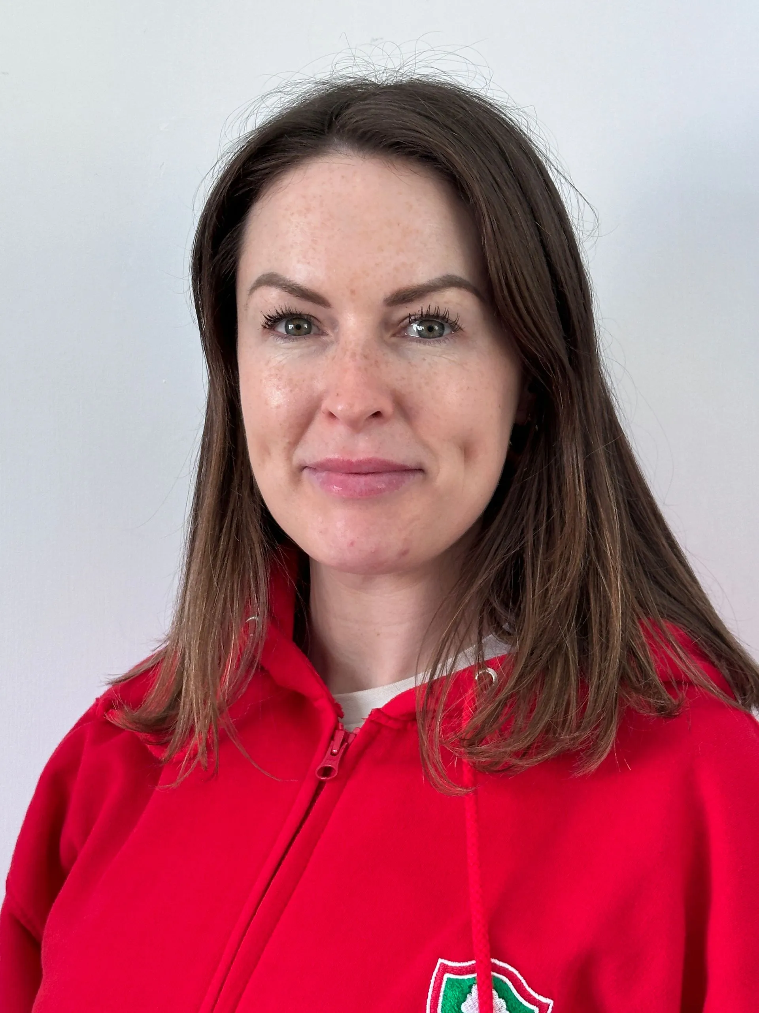
Our Staff
Mr. Roberts
Mrs. Casson

Slide 5
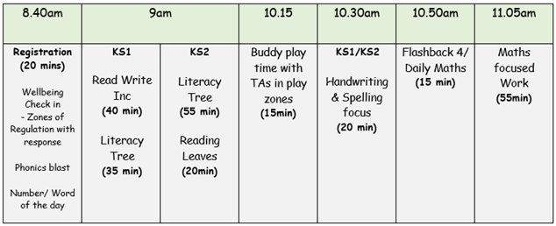
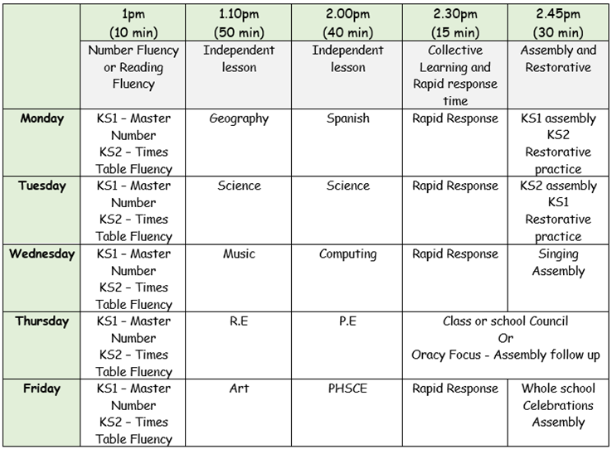
Year 5 Routine

Slide 6





Some of our English topics…
Everyone Experiences Excellence

Slide 7
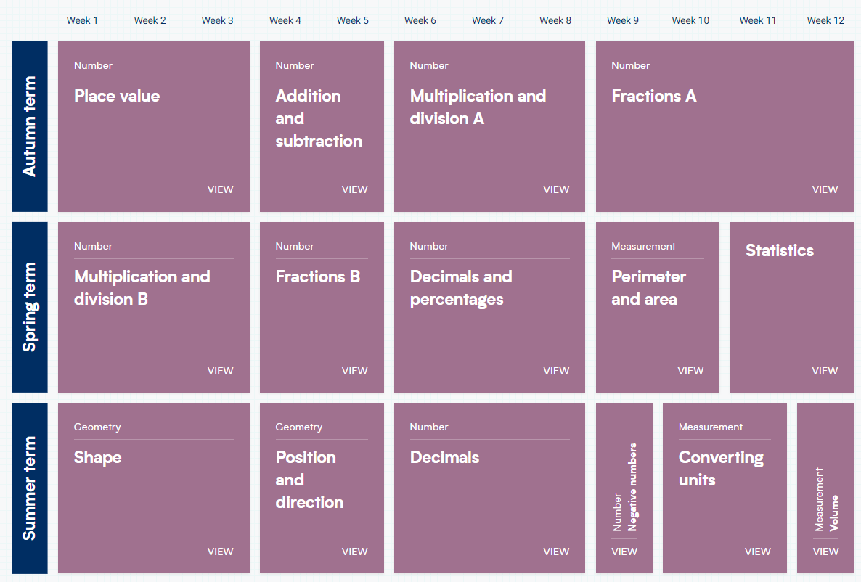
White Rose Maths – Year 5
Everyone Experiences Excellence

Slide 8
Home learning and the expectation of a Hudson parent in this class
Spellings- Test is every Friday.
Home Learning - Set on a 4 weekly basis with a must and could activity.
Times tables - Weekly tests.
Reading books – Children will have an online skills builder book and a reading for pleasure book. It is expected that the children read a minimum of 3 times per week. Adults should sign on each occasion to say that this has happened.

Slide 9
Home learning and the expectation of a Hudson parent in this class
Homework is important for parents because it provides valuable insight into their child's learning progress and helps strengthen the partnership between home and school.
Reinforces learning
Builds responsibility and Independence-
Can Strengthen Bonds between your child and communication with school.
Prepares for future academic success

Slide 10
Why is Reading so Important?
Improves Literacy and Language Skills
Vocabulary expansion and improved Grammar and writing:
Regular exposure to well-written texts helps children understand sentence structures, punctuation, and writing techniques.
Reading Fluency: The more children read, the better they become at decoding words, improving their reading fluency and comprehension.
Boosts Academic Success
Better Performance Across Subjects: Children who read for pleasure often perform better not just in reading and writing, but across all subjects, including math and science.
Critical Thinking: Reading fosters imagination and helps children think critically, analyze texts, and solve problems.

Slide 11
Why is Reading so Important?
Enhances Emotional and Social Development Empathy and Understanding: Through stories, children learn about different cultures, perspectives, and experiences, helping them develop empathy and emotional intelligence.
Stress Reduction: Reading can serve as a calming activity, helping children manage stress and emotions by escaping into imaginative worlds or relatable stories.
Improves Focus and Concentration : Engaging with a book helps improve focus and concentration as children must follow the storyline and keep track of characters and events. Over time, this helps them develop greater attention spans.
Inspires Imagination and Creativity :Reading fiction encourages children to imagine new worlds, people, and ideas, fueling their creativity. Non-fiction books can spark curiosity about the world and different fields of knowledge.
Encourages Lifelong Learning: When children read for pleasure, they begin to associate reading with enjoyment rather than a task. This positive association fosters a habit of lifelong learning, curiosity, and intellectual growth

Slide 12
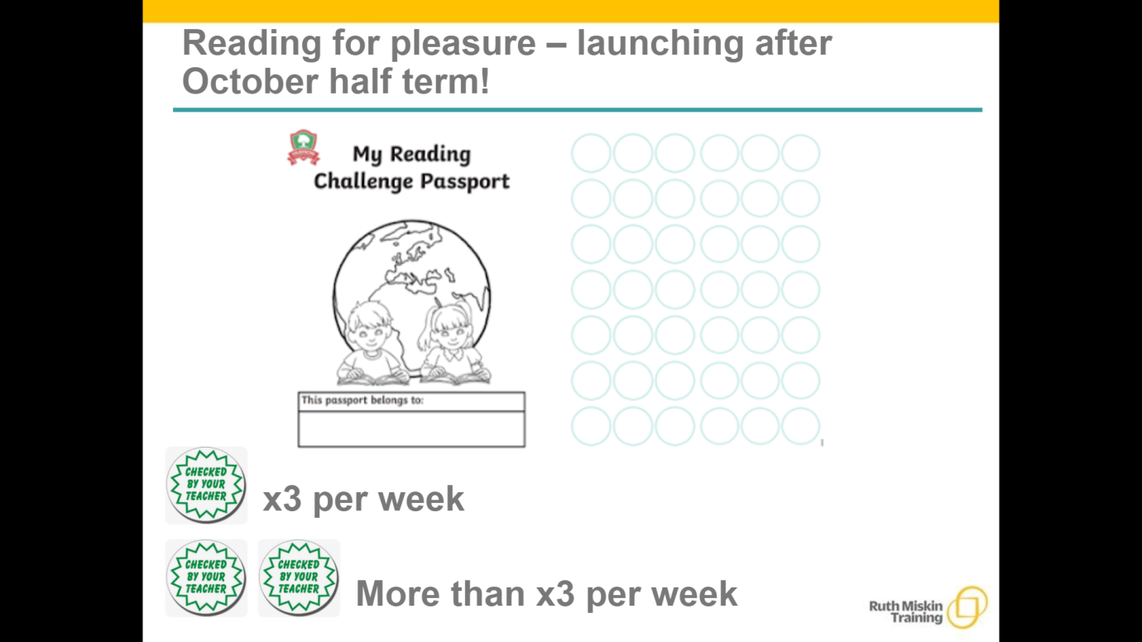
Reading for pleasure – launching after October half term!

Slide 13
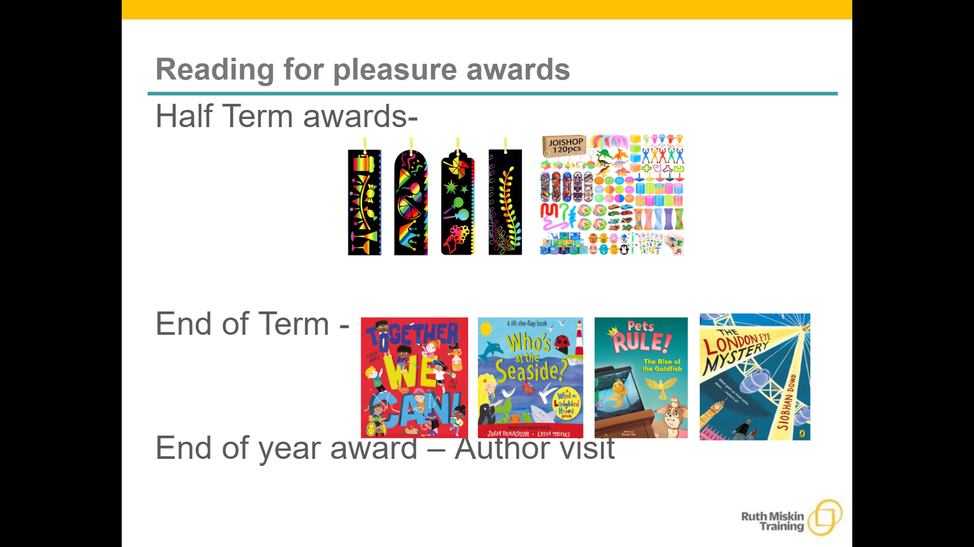

Slide 14
Writing – Ways to help at home
• Practice and learn weekly spelling lists – make it fun!
• Encourage opportunities for writing such as letters to family or friends, shopping lists, notes or reminders, stories and poems.
• Write together – be a good role model for writing.
• Encourage use of a dictionary to check spelling and a thesaurus to find synonyms and expand vocabulary.
• Remember that good readers become good writers! Identify good writing features when reading (e.g. vocabulary, sentence structure and punctuation)

Slide 15
Maths – Ways to help at home
Play times tables games.
• Play mental maths games including counting in different amounts, forwards and backwards.
• Encourage opportunities for telling the time.
• Encourage opportunities for counting coins and money; finding amounts or calculating change when shopping.
• Look for numbers on street signs, car registrations and anywhere else!
• Look for examples of 2D and 3D shapes around the home.
• Identify, weigh or measure quantities and amounts in the kitchen or in recipes.
• Play games involving numbers or logic, such as dominoes, card games, darts, draughts and chess

Slide 16

Rewards
At Hudson we use class dojo to reward the children. The children can earn a dojo for a range of things such as working hard, having a calm classroom, being helpful and outstanding work
Children also have a chance to achieve either an Everyone Experiences Excellence award or a Charter Champion award every Friday in assembly
Verbal praise
Recognition

Slide 17
Communicating with families
Parents can communicate using with teachers using our designated communication lead by either emailing on enquiries@hudsonprimary.co.uk or by calling the office on - 0151 526 1568
Class dojos are uploaded every week showing some of that week’s learning and sending out any messages for that week.
Everyone Experiences Excellence

Slide 18
Things Oak class are looking forward to…
Trips/ own clothes days
Playtimes
Getting a handwriting pen
Class trips
PGL
Clubs and matches against other schools
Dojo parties
Christmas play
Swimming
P.E
Tough maths questions

Slide 19
Thank you for listening

