Slide 1


Welcome to the New School Year
A year in Rowan Class
Everyone Experiences Excellence

Slide 2

An exciting new year lies ahead – 180 days of brain power needed!
Everyone Experiences Excellence

Slide 3
In this welcome session we will cover:
The curriculum expectation for the end of year
Our Learning Journey themes and adventures
Home learning and the expectation of a Hudson parent in this class
Communication with families
Important information – how the year has gone so far (in general)
Things we are looking forward to this year
Everyone Experiences Excellence

Slide 4
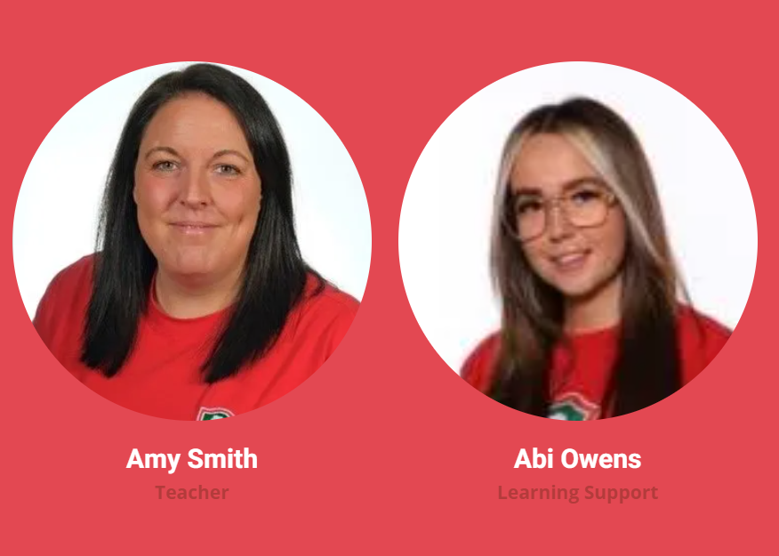
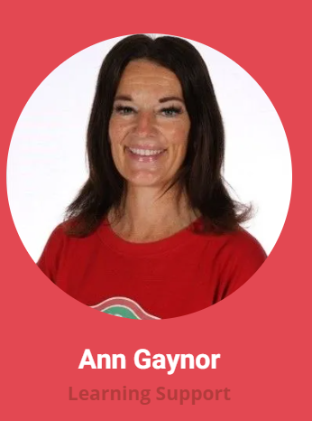
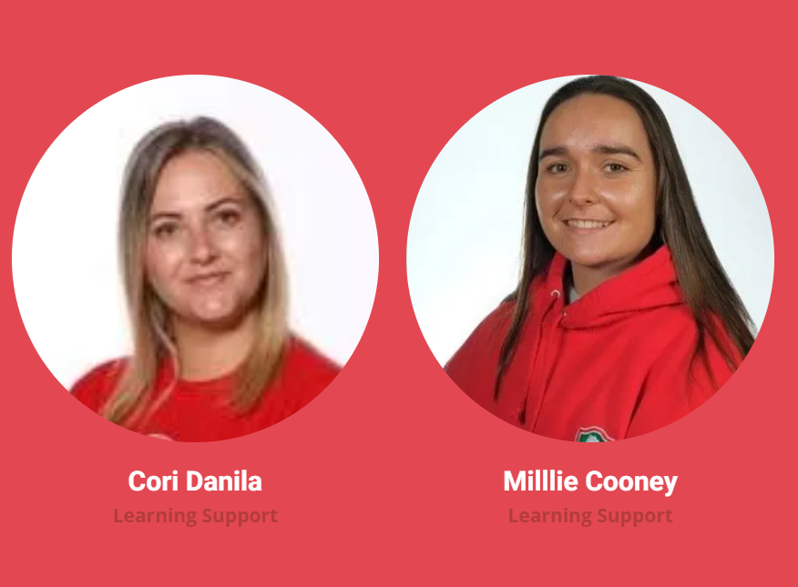
Our Staff

Slide 5
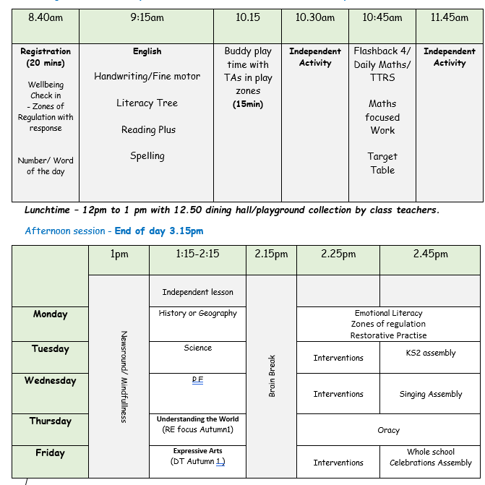
Our Daily Timetable
Did you know that if you’re late by 10 minutes every day for the year it equals 31.5 hours!

Slide 6






Our English books this year
Everyone Experiences Excellence

Slide 7
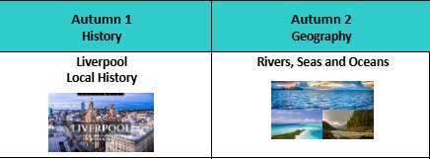
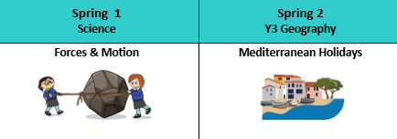
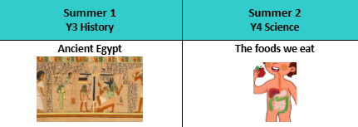
Our Curriculum this year
Everyone Experiences Excellence

Slide 8
This year we hope to:
Have visitors into class
Go on school trips
Be good role models to our nursery buddies
Go swimming
Experience different foods
Build our friendships across school
Take part in challenges across school

Slide 9
Home learning and the expectation of a Hudson parent in this class
Spellings- Quiz is every Friday
Times tables- weekly 15 minutes on TTRS.
Complete learning journey homework.
Reading books – Children will have an online skills builder book and a reading for pleasure book. It is expected that the children read a minimum of 3 times per week. Adults should sign on each occasion to say that this has happened.

Slide 10
Homework is important for parents because it provides valuable insight into their child's learning progress and helps strengthen the partnership between home and school.
Reinforces learning
Builds responsibility and Independence-
Can strengthen bonds between your child and communication with school.
Prepares for future academic success

Slide 11
How Reading Helps Your Child Thrive
Builds Language and Writing Skills
Grows their vocabulary: Reading introduces your child to lots of new words and ways to use them.
Improves grammar and writing: They learn how sentences are made, how punctuation works, and how stories flow—without even realising it.
Boosts Reading Fluency and Understanding
Gets them reading faster: The more they read, the easier it becomes to sound out words and read smoothly.
Helps them understand what they read: Fluent reading leads to better comprehension.
Supports Success in School
Improves grades across subjects: Kids who read often do better not only in reading and writing but also in math, science, and more.
Builds critical thinking: Reading sparks the imagination and strengthens skills like analyzing, questioning, and tackling problems.

Slide 12

Reading Plus
📘 What is Reading Plus?
- An online reading programme designed to improve comprehension, fluency, and vocabulary.
✅ Expectations:
- Read at least 3 times per week.
- Stay consistent to build strong habits.
-Grown ups should sign reading records to acknowledge efforts.
🌟 Why is it important?
- Strengthens comprehension and speed.
- Builds stamina and confidence.
Valuable even for fluent readers to refine skills.
🏆 Weekly certificates awarded for effort and progress

Slide 13

Voice 21- Developing Oracy
Why is it important?
• Improves speaking, listening and teamwork skills.
• Supports learning across all subjects.
• Builds confidence for presentations, discussions and daily life.
How can you help at home?
• Encourage your child to explain their ideas and opinions.
• Ask open questions (e.g. ‘Why do you think that?’).
• Practise speaking in full sentences.
• Take turns in conversations at the dinner table or during family time.

Slide 14
Writing – Ways to help at home
• Practise and learn weekly spelling lists – make it fun!
• Encourage opportunities for writing such as letters to family or friends, shopping lists, notes or reminders, stories and poems.
• Write together – be a good role model for writing.
• Encourage use of a dictionary to check spelling and a thesaurus to find synonyms and expand vocabulary.
• Remember that good readers become good writers! Identify good writing features when reading (e.g. vocabulary, sentence structure and punctuation)

Slide 15
Reading – Ways to help at home
Listening to your child read can take many forms.
First and foremost, focus developing an enjoyment and love of reading.
Enjoy stories together – reading stories to your child at KS1 and KS2 is equally as important as listening to your child read.
Read a little at a time but often, rather than rarely but for long periods of time! Children should be reading for at least 20 minutes at home every day, from a wide variety of text types.
All reading is valuable – it doesn’t have to be just stories. Reading can involve anything: fiction, non-fiction, poetry, newspapers, magazines, football programmes and TV guides.
Visit the local library - it’s free.

Slide 16
Maths – Ways to help at home
Play times tables games.
• Play mental maths games including counting in different amounts, forwards and backwards.
• Encourage opportunities for telling the time.
• Encourage opportunities for counting coins and money; finding amounts or calculating change when shopping.
• Look for numbers on street signs, car registrations and anywhere else!
• Look for examples of 2D and 3D shapes around the home.
• Identify, weigh or measure quantities and amounts in the kitchen or in recipes.
• Play games involving numbers or logic, such as dominoes, card games, darts, draughts and chess

Slide 17
Transition
The children will have a transition day at their chosen secondary school. On that day they will not attend Hudson but go straight to their school.
The day usually consists of a tour, meeting the teachers and some getting to know you activities.
During transition week at Hudson the children will take part in a week of preparing for secondary school activities. These include, using a planner and what to do if you get lost.

Slide 18

Communicating with families
* Please ensure that all end of day collection arrangements are communicated via telephone through the main school line.
Everyone Experiences Excellence

