Slide 1


Welcome to the New School Year
A year in Elder Class
Everyone Experiences Excellence

Slide 2

An exciting new year lies ahead – 180 days of brain power needed!
Everyone Experiences Excellence

Slide 3
In this welcome session we will cover:
The curriculum expectation for the end of year
Home learning and the expectation of a Hudson parent in this class
Communication with families
Important information
Things we are looking forward to this year
Everyone Experiences Excellence

Slide 4

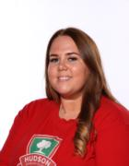
Our Staff
Miss Dower
Class Teacher
Miss Wynne
Teaching Assistant
Mrs McKenna
Teaching Assistant

Slide 5
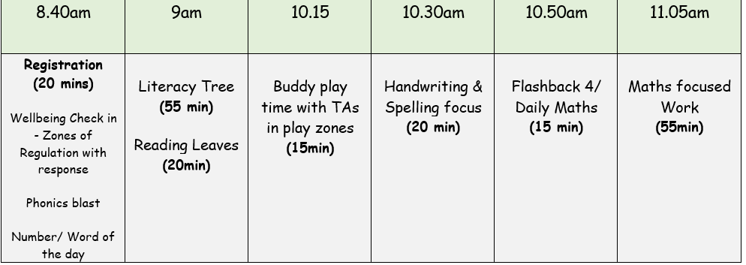
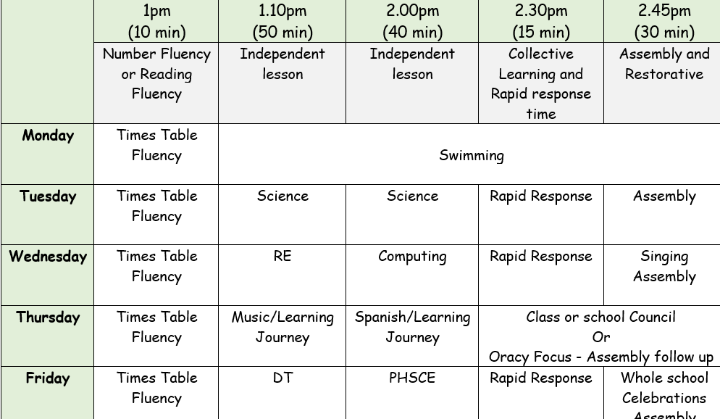
Our Daily Timetable
Did you know that if you’re late by 10 minutes every day for the year it equals 31.5 hours!

Slide 6












Our English texts…

Slide 7






These are our Shared Reading texts.
As you can see, we have lots to cover in English, alone!

Slide 8
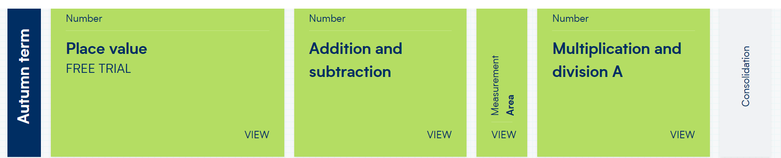
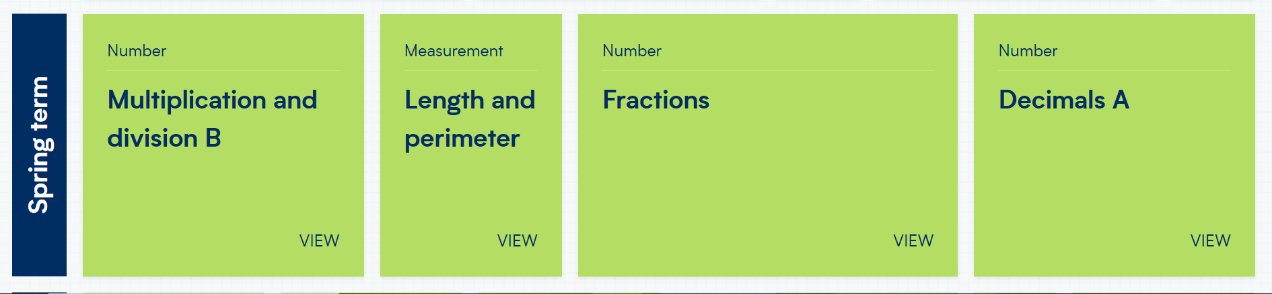
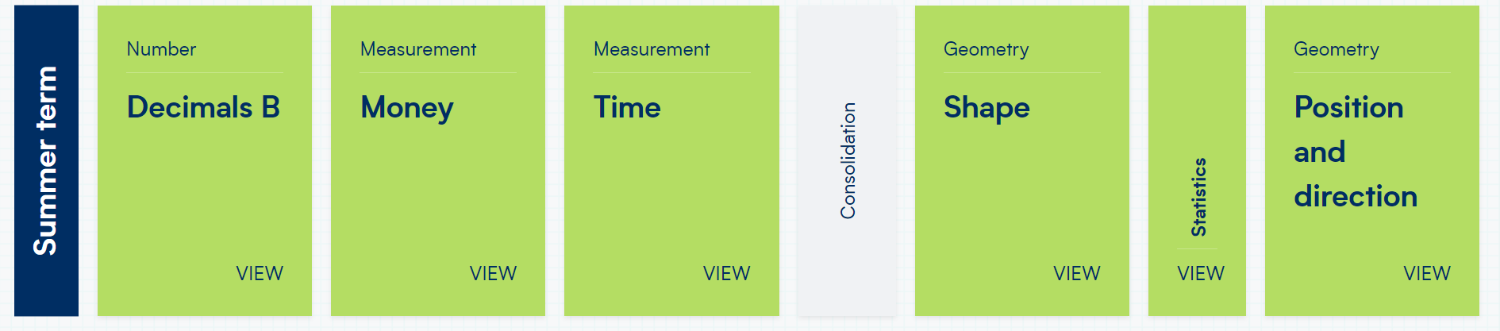
Year 4 Maths delivery – White Rose Maths

Slide 9
This year we hope to:
Have guest speakers in class
Go on school trips
Residential Trips
Be good role models to our buddies
Join Class Council
Be part of school clubs
Represent school as part of a team or performance

Slide 10
Roles and Responsibilities
This will be voted on in the next few weeks. This is a democratic vote made by the children and gives them the opportunity to support our school and teacher and be the voice of the children.
Class Council
Children will be finding out very soon if they have been given a job as a pupil volunteer. These jobs have been reduced this year so are very coveted.
Pupil Volunteers

Slide 11
Rewards
At Hudson we use class dojo to reward the children. The children can earn a Dojo for a range of things such as working hard, having a calm classroom, being helpful and outstanding work and following our Ready, Respectful, Safe rules
Children also have a chance to achieve either an Everyone Experiences Excellence award or a Charter Champion award every Friday in assembly
Verbal praise
Recognition

Slide 12
Home learning and the expectation of a Hudson parent in this class
Spellings - Test is every Friday
Times Tables – Test is every Friday
Homework Projects will be set for children to complete. There will be three types of activity, Creative Task, Research and Write and Present and Do. Children should complete at least one.
Home Reading – Children complete a minimum of three reads each week with an adult. This should be recorded in their reading record.

Slide 13
Home learning and the expectation of a Hudson parent in this class
Homework is important for parents because it provides valuable insight into their child's learning progress and helps strengthen the partnership between home and school.
Reinforces learning
Builds responsibility and independence
Can strengthen bonds between your child and communication with school.
Prepares for future academic success

Slide 14
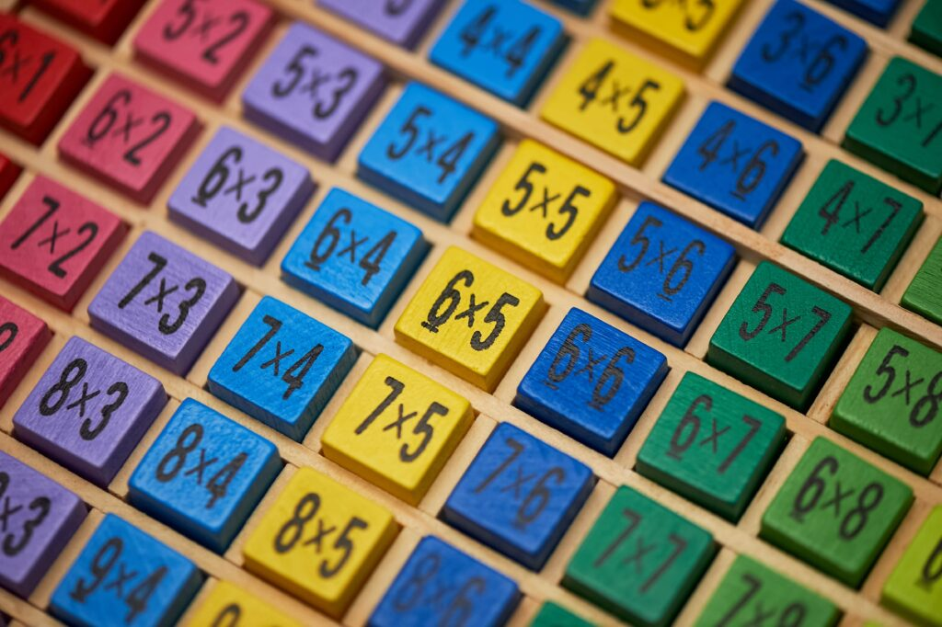
Statutory Multiplication Skills Check – June 2026
The test is a statutory, online multiplication test. Research shows that children that do not know their times tables from 2-12 by the end of Year 4 will go on to struggle with more challenging maths both in primary and secondary school.
The test consists of 25 questions. Children have 6 seconds to answer each question and a 3 second gap between each question. The average mark has been 20/25 nationally.
We have a practice test every Friday but TTRS shows fantastic results in terms of progress.

Slide 15
How Reading Helps
Your Child Thrive
Builds Language and Writing Skills
Grows their vocabulary: Reading introduces your child to lots of new words and ways to use them.
Improves grammar and writing: They learn how sentences are made, how punctuation works, and how stories flow—without even realising it.
Boosts Reading Fluency and Understanding
Gets them reading faster: The more they read, the easier it becomes to sound out words and read smoothly.
Helps them understand what they read: Fluent reading leads to better comprehension.
Supports Success in School
Improves grades across subjects: Kids who read often do better not only in reading and writing but also in math, science, and more.
Builds critical thinking: Reading sparks the imagination and strengthens skills like analyzing, questioning, and tackling problems.

Slide 16
Builds Empathy and Understanding
Stories help kids see life through other people’s eyes, boosting kindness and emotional awareness.
Reduces Stress
Reading can be relaxing, helping children calm down and manage emotions.
Improves Focus
Following a story strengthens attention and concentration over time.
Sparks Imagination and Curiosity
Fiction fuels creativity. Non-fiction inspires interest in the world around them.
Encourages Lifelong Learning
When kids enjoy reading, they’re more likely to stay curious and love learning for life.

Slide 17
Maths – Ways to help at home
Play mental maths games including counting in different amounts, forwards and backwards.
Encourage opportunities for telling the time.
Encourage opportunities for counting coins and money; finding amounts or calculating change when shopping.
Look for numbers on street signs, car registrations and anywhere else!
Look for examples of 2D and 3D shapes around the home.
Identify, weigh or measure quantities and amounts in the kitchen or in recipes.
Play games involving numbers or logic, such as dominoes, card games, darts, draughts and chess
Play times tables games.

Slide 18
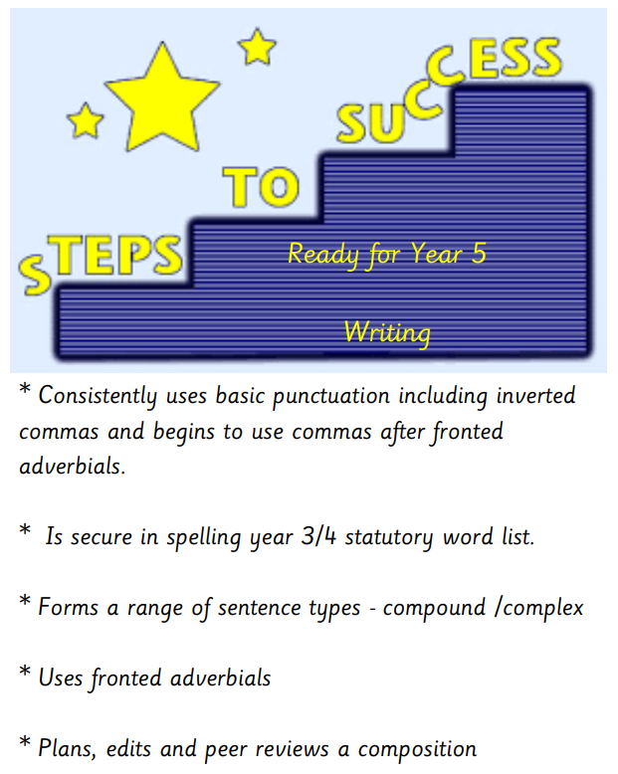
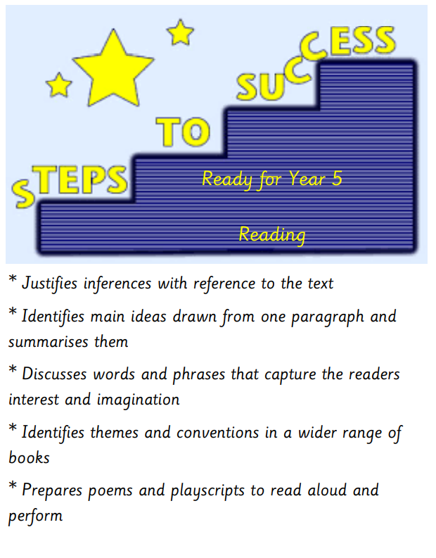
Writing & Reading – End of Year 4 Expectations
Everyone Experiences Excellence

Slide 19

Maths – End of Year 4 Expectations
Everyone Experiences Excellence

Slide 20
Nursery to Year 5 Girls
Red polo shirt
School navy V neck sweatshirt / cardigan
Grey skirt or trousers
Low heeled, dark coloured footwear that is a full shoe with a back on
Dark coloured tights or socks
Red/white checked summer dress can be worn in the summer term with a full shoe.
Nursery to Year 5 Boys
Red polo shirt
School V neck sweatshirt
Grey trousers or shorts
Dark coloured footwear – no trainers thank you
PE kit - (indoor)
Navy shorts
Red t-shirt
Black pumps
Uniform
PE (outdoor)
Dark tracksuit bottoms
Red t-shirt
Trainers

Slide 21

Communicating with families
Parents can contact school with general enquiries: enquiries@hudsonprimary.co.uk
0151 5261568
Contact on the door has been reduced to limit the time teachers are away from the class in the morning. Dojos are checked in the morning and before the end of the day, if possible. If urgent, please contact the office.

Slide 22
Communicating with families
* Please ensure that all end of day collection arrangements are communicated via telephone through the main school line.
Everyone Experiences Excellence

