Slide 1
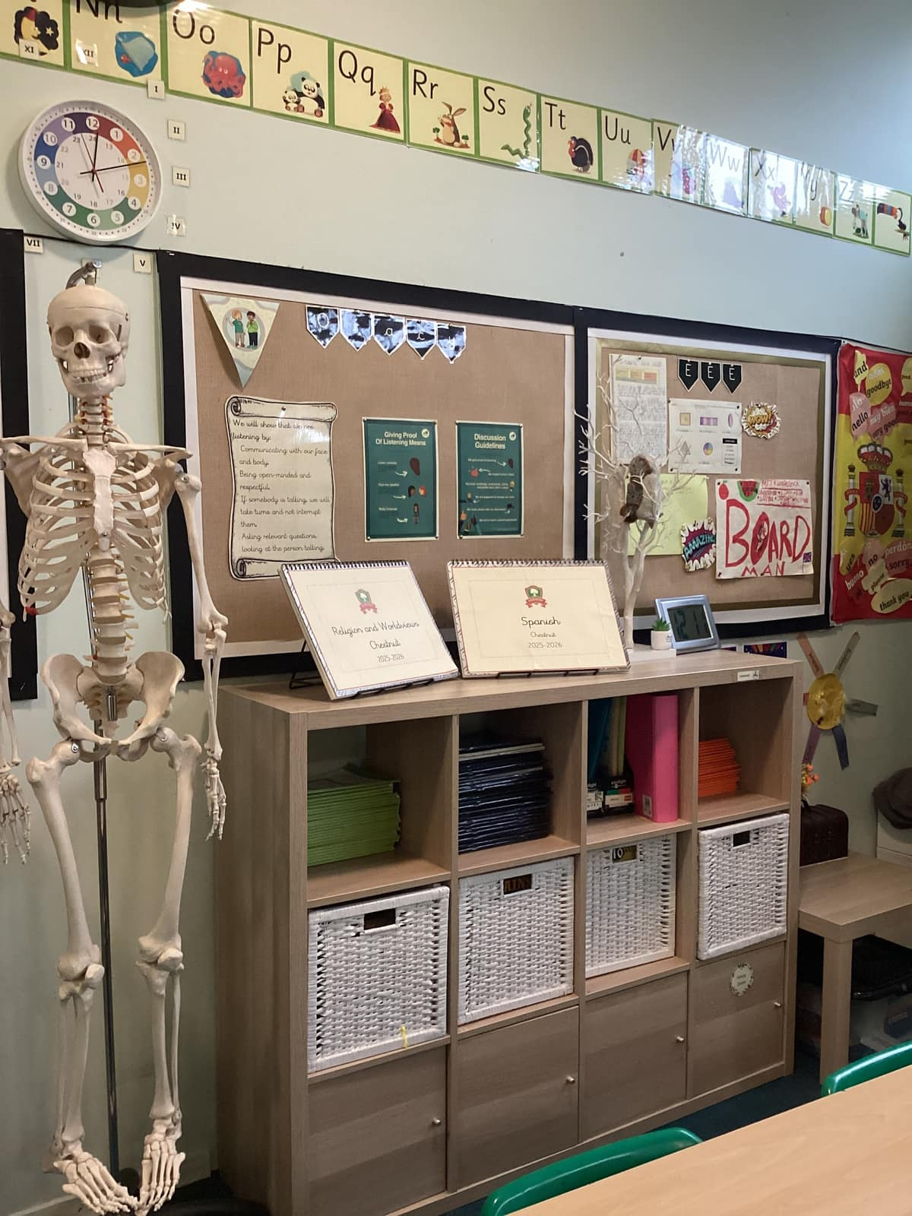

Welcome to the New School Year
A year in Chestnut class
Everyone Experiences Excellence

Slide 2

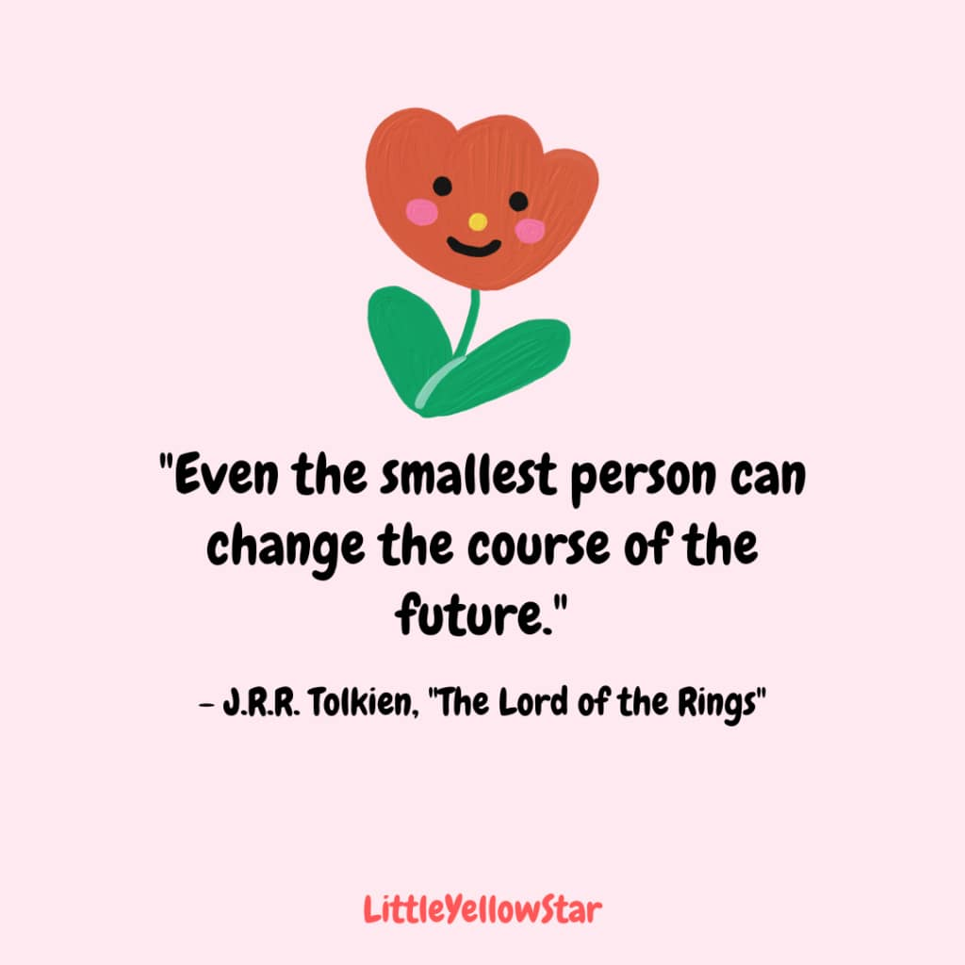
An exciting new year lies ahead – 180 days of brain power needed!

Slide 3
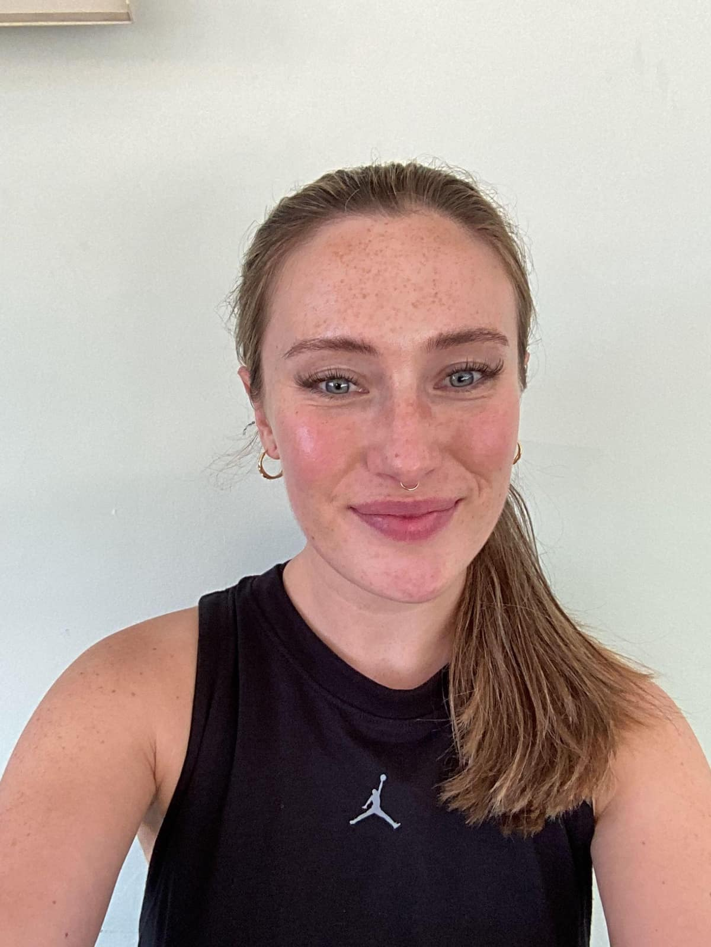
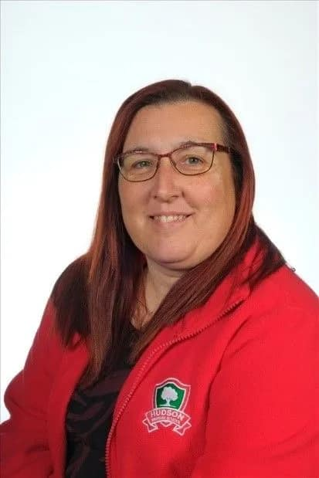
Welcome to Year 3!
Welcome! My name is Mrs Kilpatrick. I have only been at Hudson since January 2025 and I have already felt so welcome here! I have really enjoyed teaching year three and I am looking forward to teaching year 3 again in September for some more fun learning!

Slide 4
In this welcome session we will cover:
Our themes and adventures
The usual routine in class
Settling in information – how the year has gone so far (in general)
Rewards for our wonderful children
Home learning and the expectation of a Hudson parent in this class
Communication with families
The curriculum expectation for the end of year
Things we are looking forward to this year

Slide 5
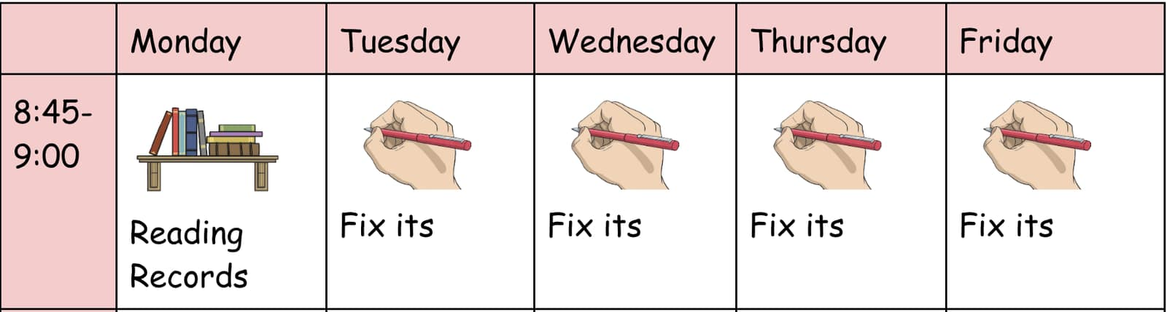
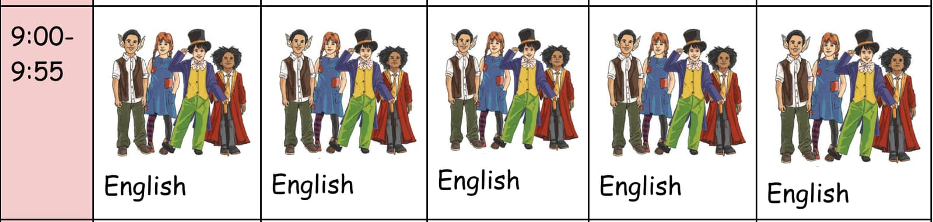
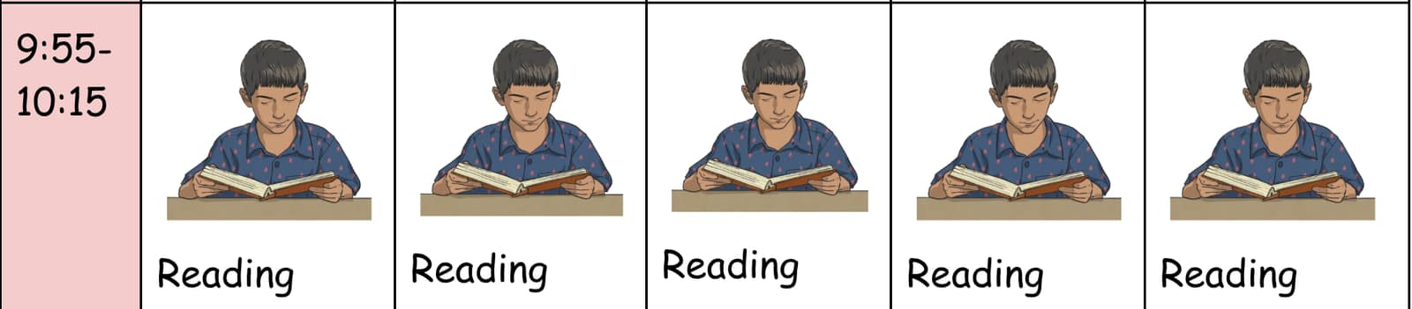
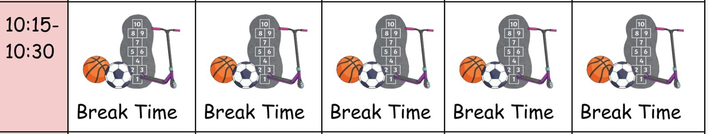
Chestnut Class Routine (AM)

Slide 6
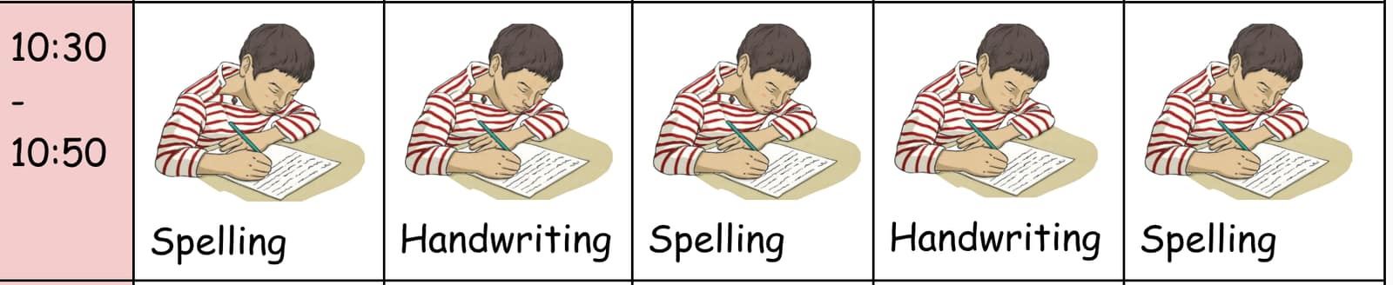
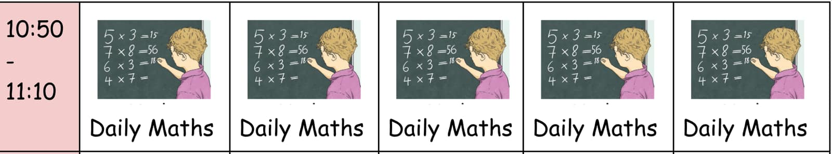
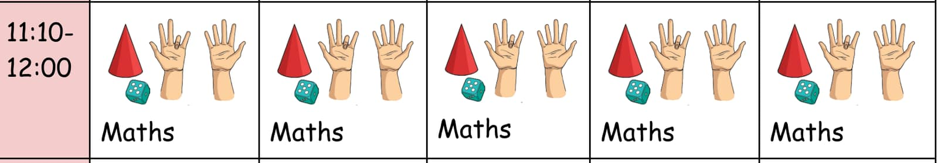
Chestnut Class Routine (AM)

Slide 7
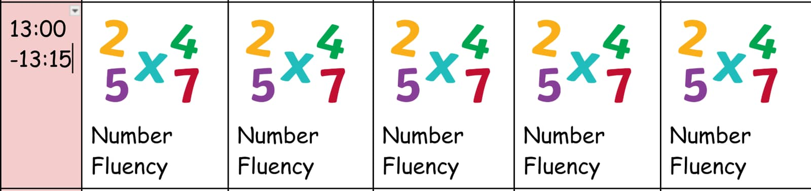

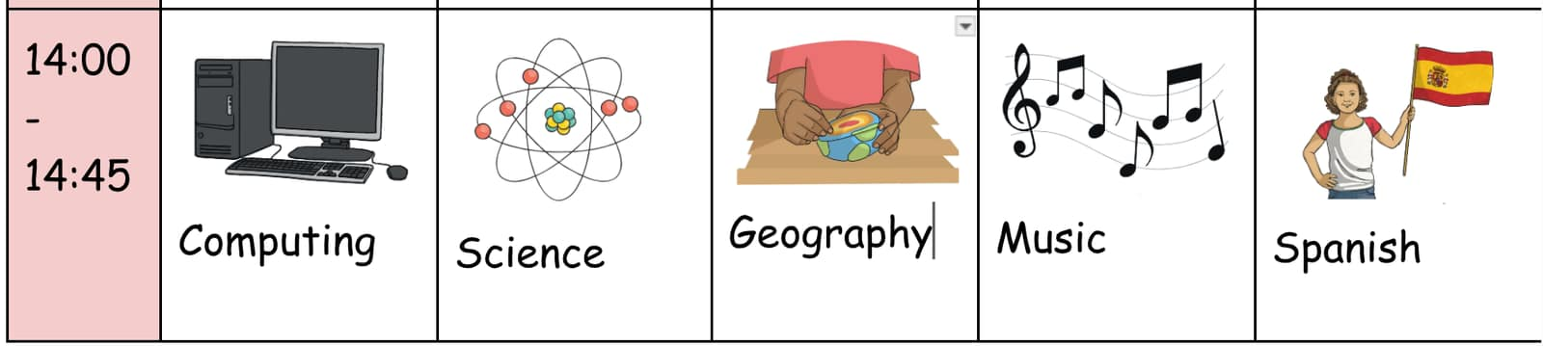
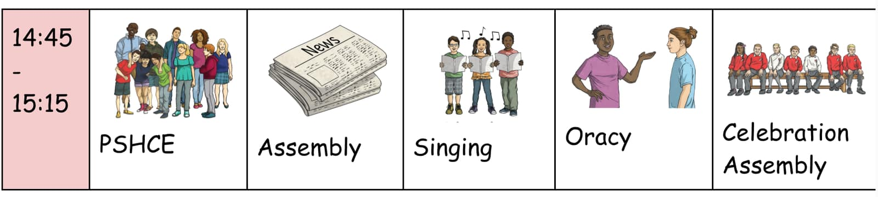
Chestnut Class Routine (PM)

Slide 8



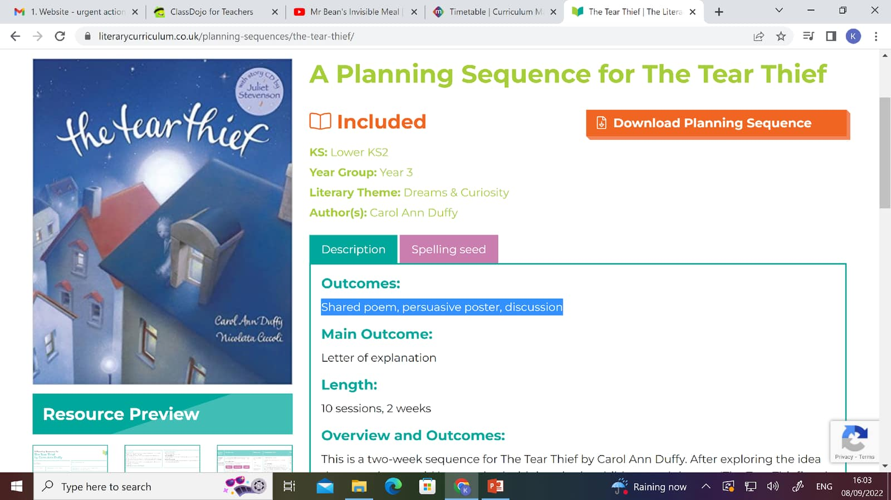
Our English Units
Leon and the place between, own version of a fantasy narrative. | The first drawing, own historical narrative.
The Tin Forest, persuasive information. | Tear Thief, Shared poem, persuasive poster, discussion
Our Autumn texts!

Slide 9


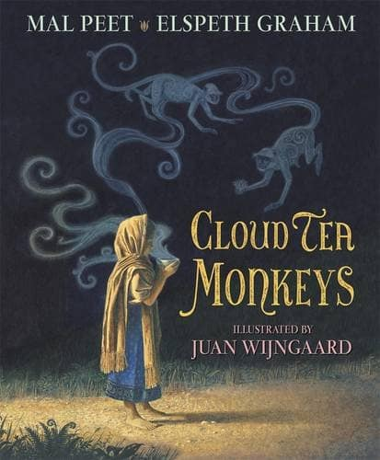

Our English Units
The Pied Piper of Hamlin, our version of myths and legends. | Escape from Pompeii, newspaper report.
Cloud Tea Monkeys, non chronological reports. | Own version of traditional tale
Our spring texts!

Slide 10
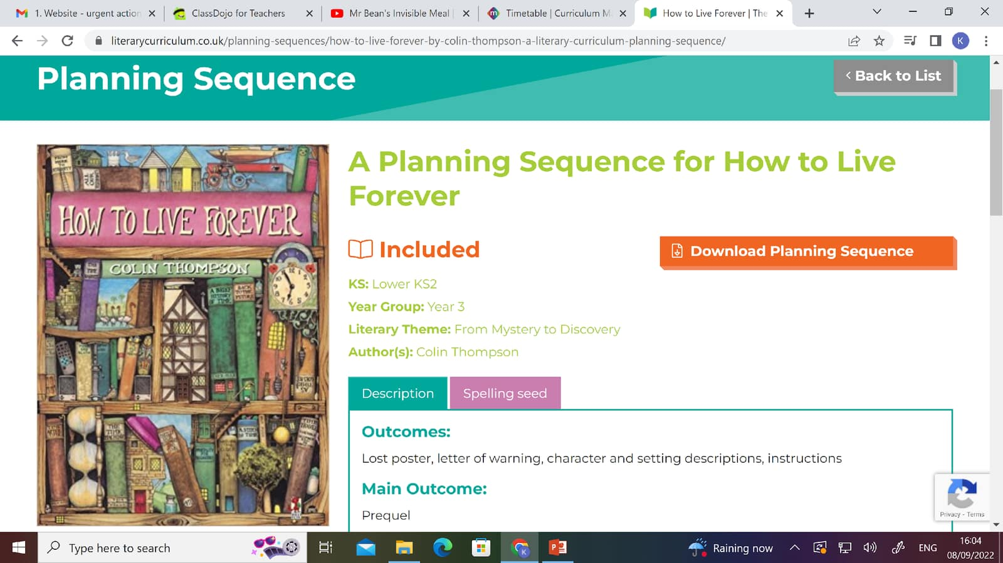



Our English Units
The Mysteries of Harris Burdick, own version mystery narrative. | How to Live Forever, Prequel
Jim, A Cautionary Tale, own narrative poem. | An adventure in the style of the author.
Our summer texts!

Slide 11


Whole class reading
Whole class reading gives children the opportunity to discuss texts.
The text is read on an iPad as a whole class.
The teacher can ask comprehension texts.

Slide 12
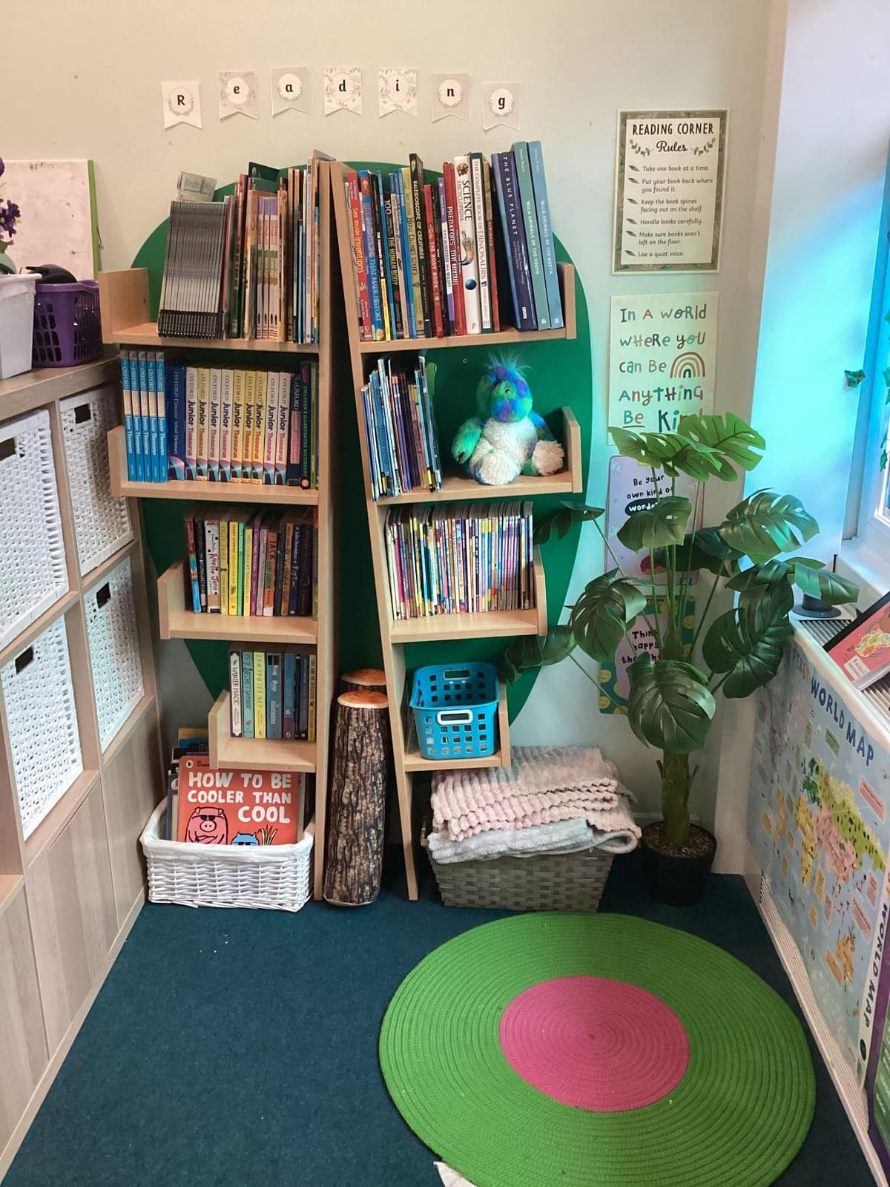
Reading – end of year 3 expectations
  Reads adhering to punctuation, using some appropriate expression when reading dialogue
  Discusses what they have read/heard with others, listening to their opinions and stating their own
  Retells a story orally

Slide 13
Writing – end of year 3 expectations
  Uses capital letters and full stops to demarcate simple sentences correctly, generally using question marks, exclamation marks and commas for lists without prompting
  Checks for spelling and basic punctuation errors, and suggests alternative vocabulary choices to enhance meaning/description
  Demonstrates attempt to follow plan and organise writing into basic paragraphs, but may add superfluous detail/plot movements

Slide 14
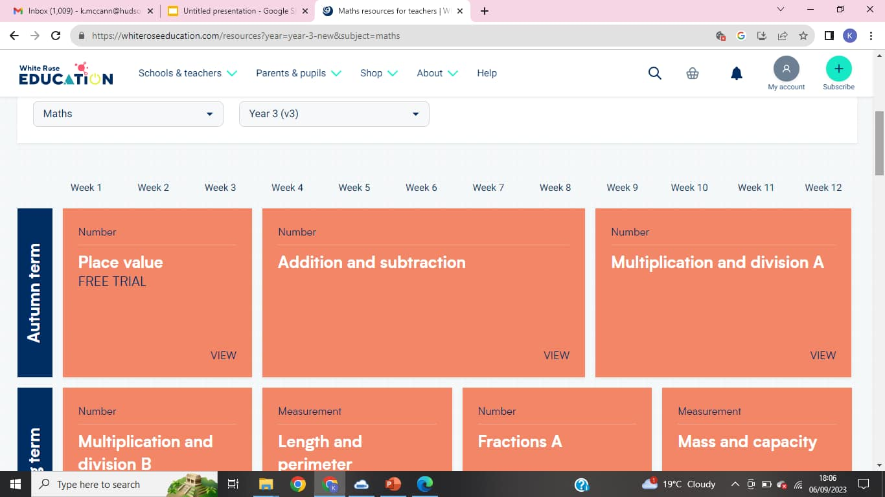
White Rose Maths Units

Slide 15
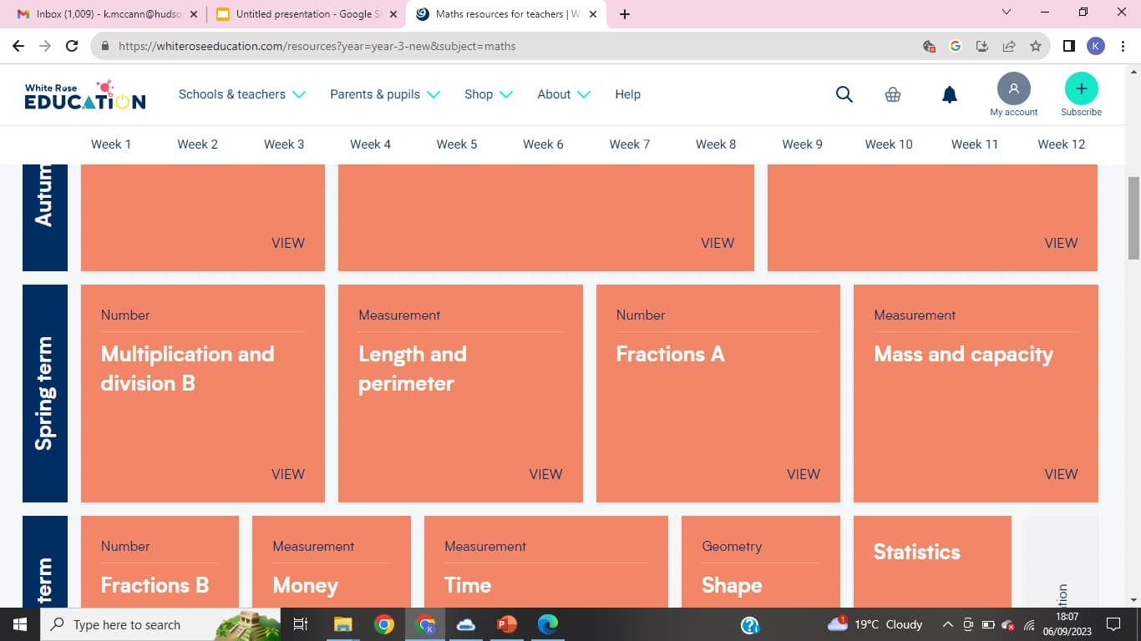
White Rose Maths Units

Slide 16
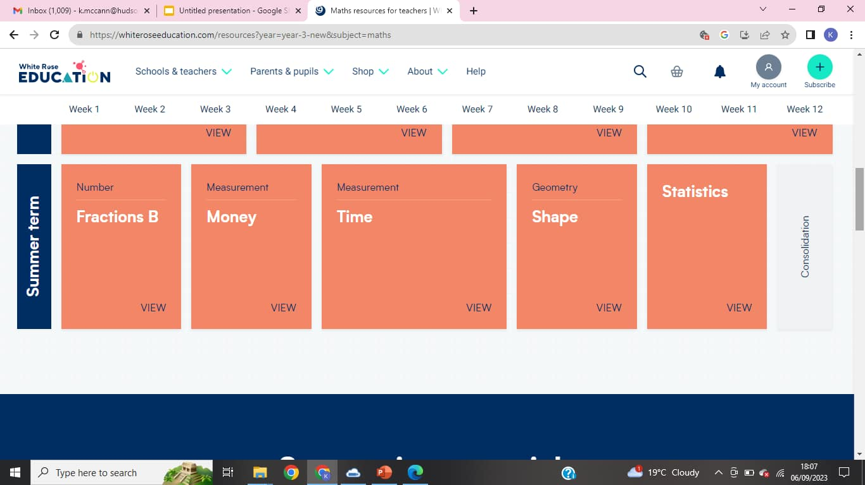
White Rose Maths Units

Slide 17
Maths – end of year 3 expectations
  Counts from 0 in multiples of 4 & 8
  Counts from 0 in multiples of 50 & 100
  Finds 10 more and less than a given number
  Finds 100 more and less than a given number
  Adds and subtracts numbers with up to 3 digits, using formal written methods
  Demonstrates understanding that a tenth is one part of a whole that has been divided into ten equal parts

Slide 18

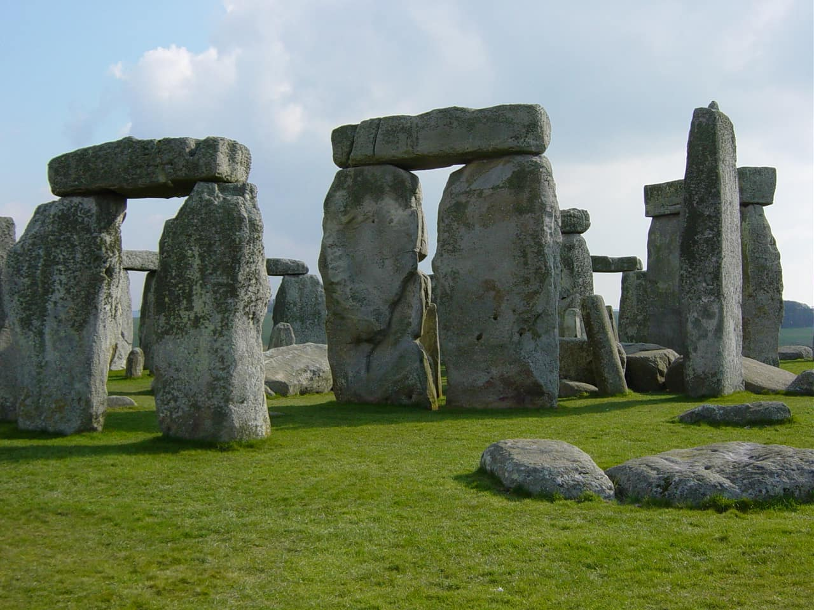

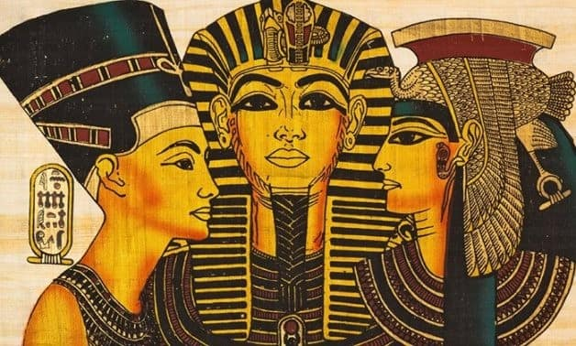


Humanities Projects
Autumn 1 | Autumn 2 | Spring 1 | Spring 2 | Summer 1 | Summer 2
Geography: The United Kingdom | European History: Prehistoric Britain | Geography: Volcanos + Mountains | African History: Ancient Egypt | Looking at Europe and Tourism | European History: Ancient Greece

Slide 19
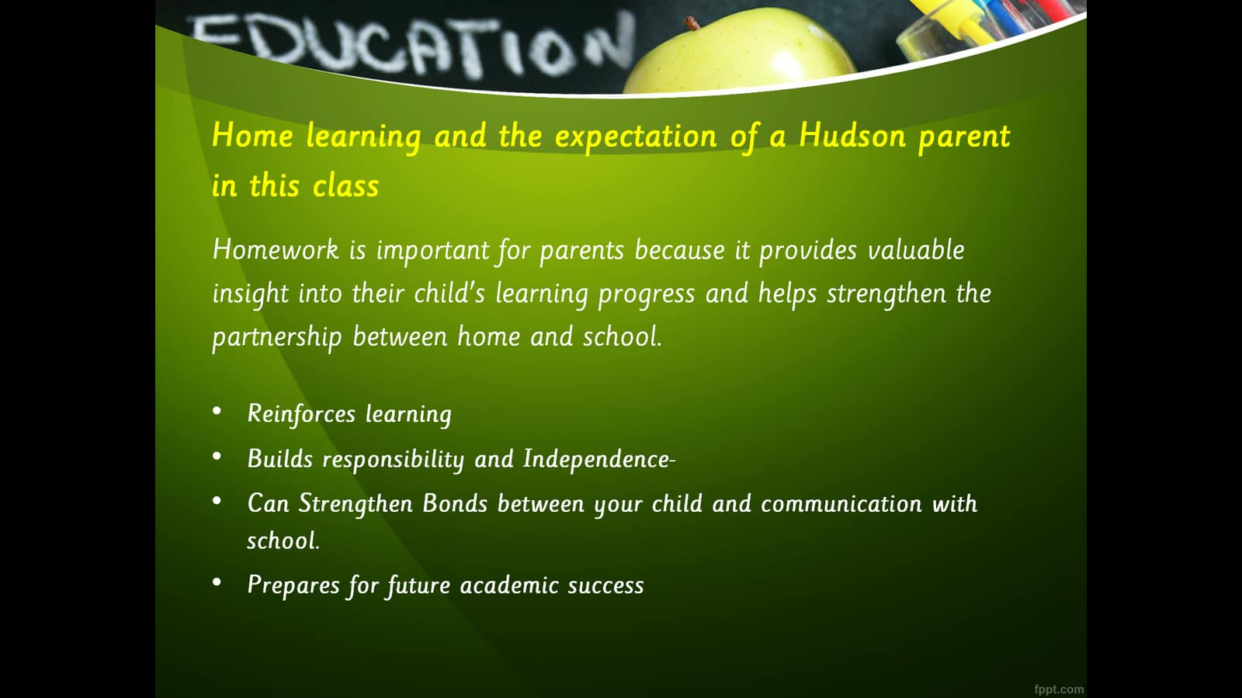

Slide 20
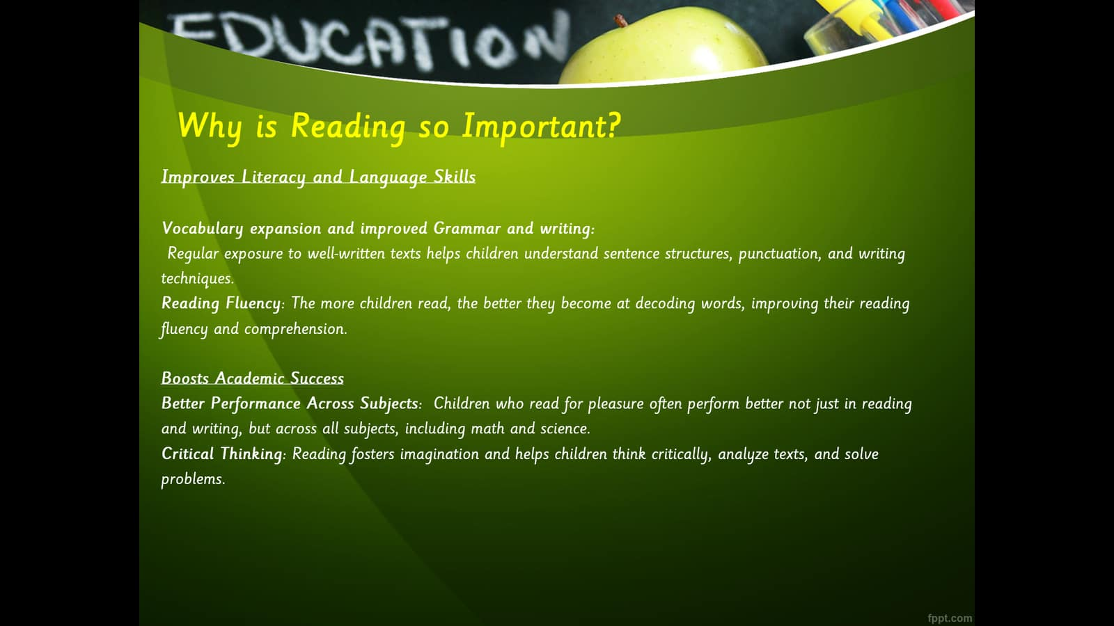

Slide 21
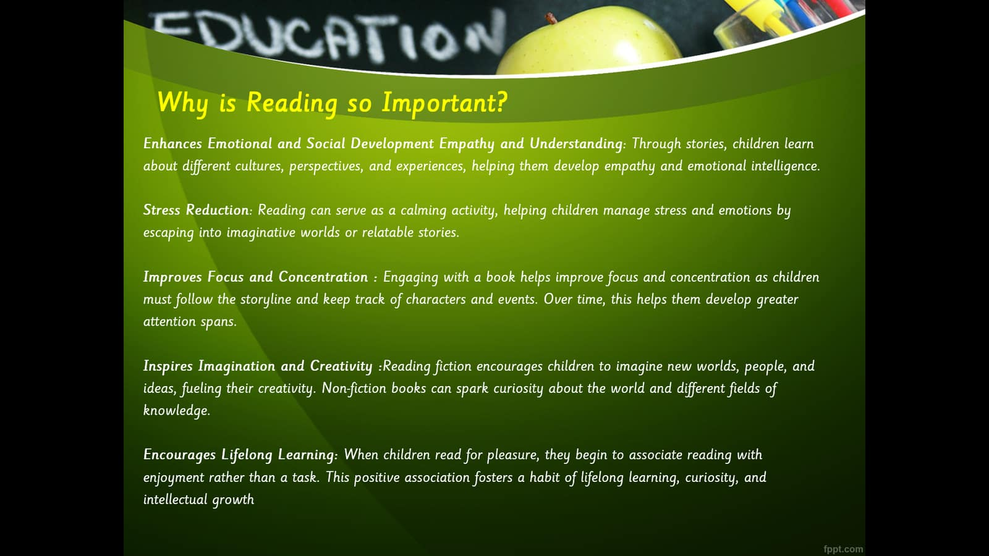

Slide 22
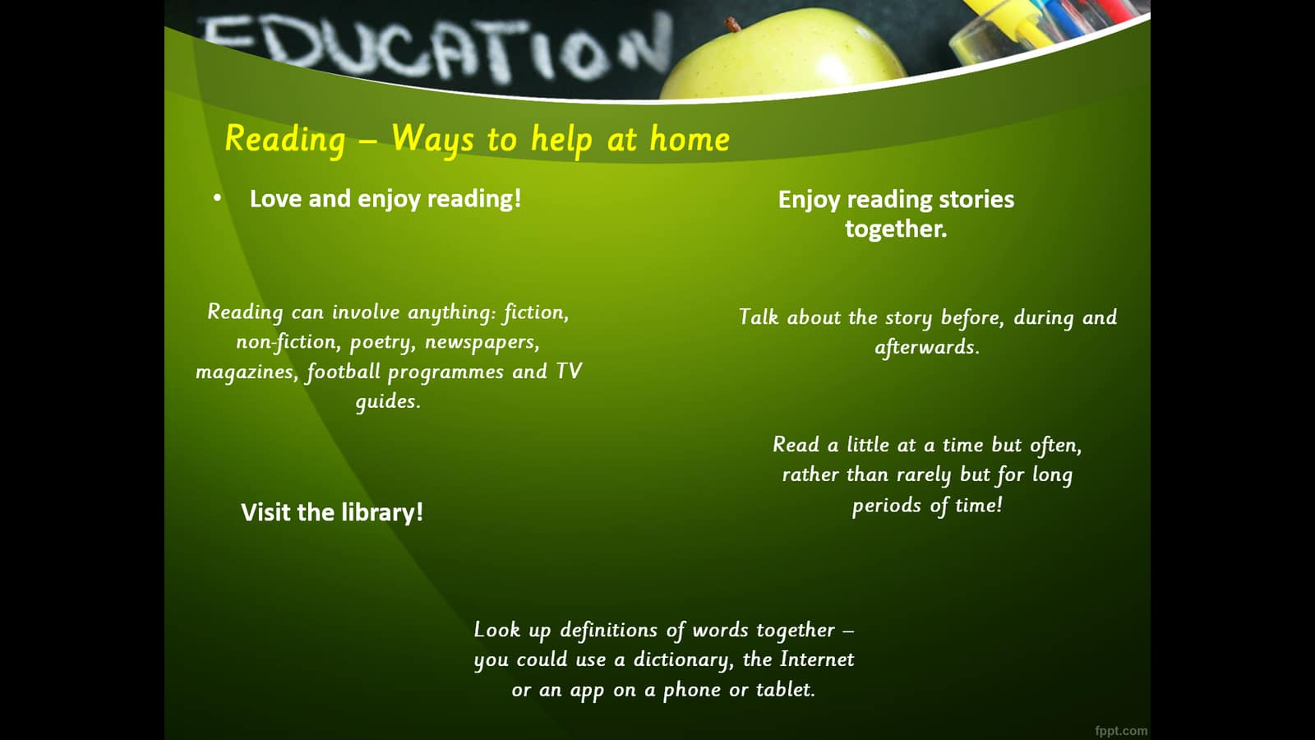

Slide 23
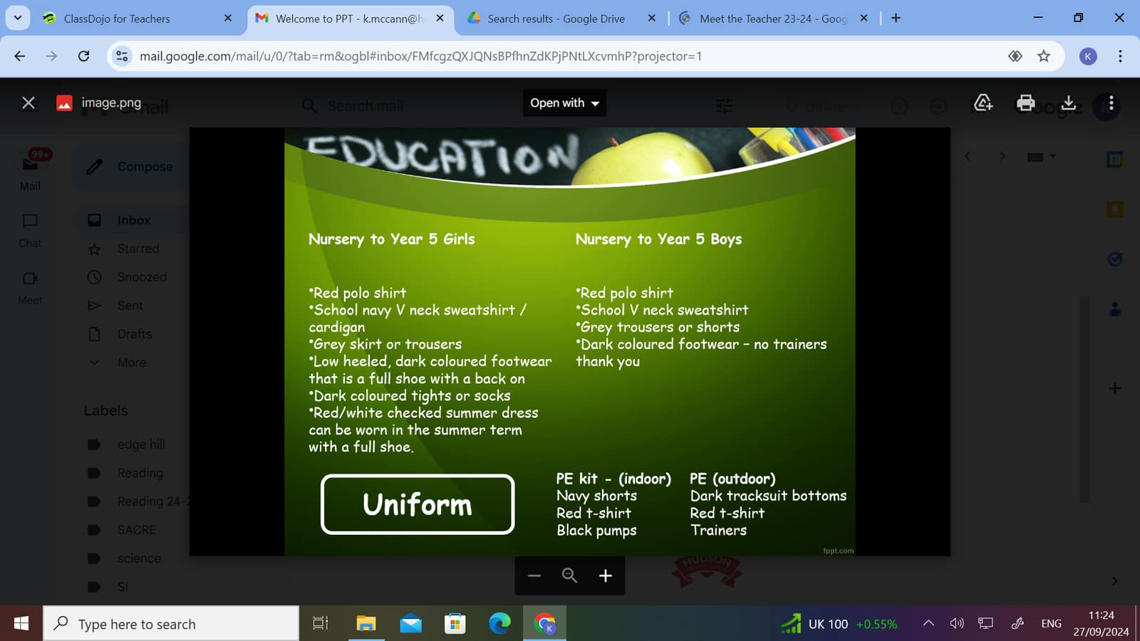

Slide 24
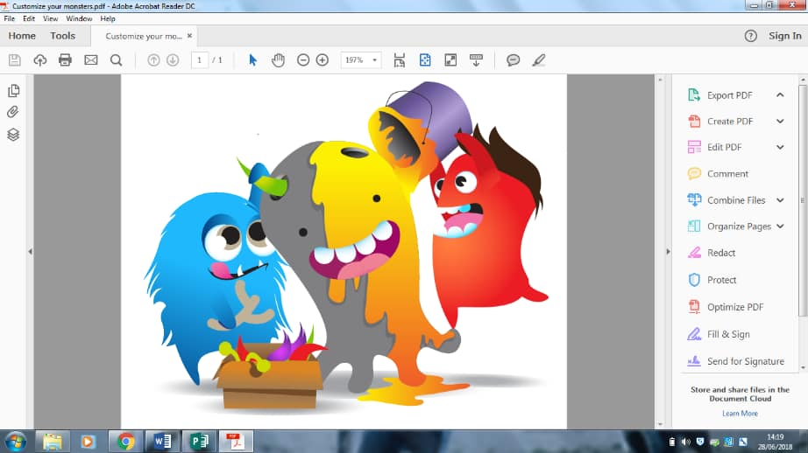
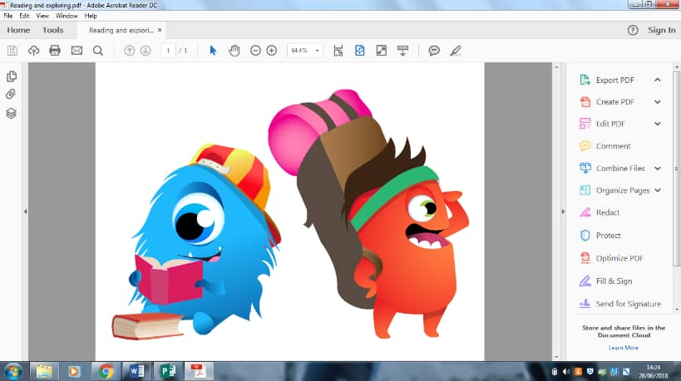
Rewards
Attendance
Good work in a lesson
Good behaviour in a lesson
Reading homework
Spelling effort
Timetable effort
Learning Journey return:
5 outstanding effort and enthusiasm
4 good response
3 minimum return
Reward for behaviour in corridor
Reward for behaviour in assembly
Reward for behaviour in lunchroom
Reward for behaviour in playground
Reward for behaviour in breakfast and afterschool club or Hudson’s University clubs

Slide 25
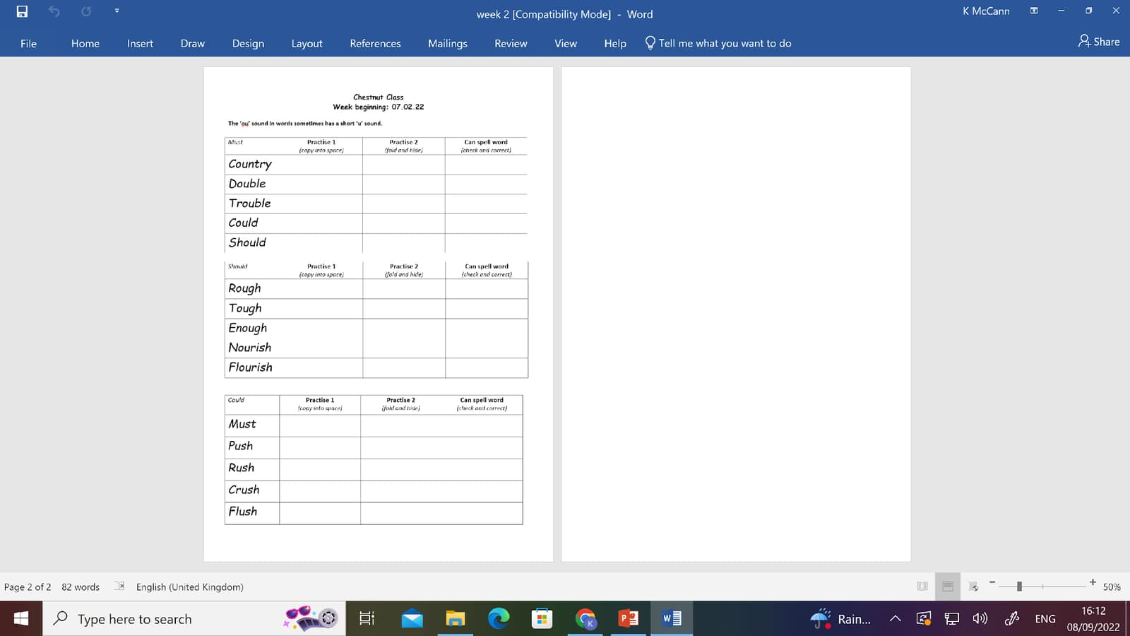


Home Learning
Spelling homework will be set each week.
Children will have access to Ebooks, school library books and TTRS.
Learning Journey projects will also be set every three weeks.
Children should be reading 3 times a week.

Slide 26

Communicating with families
Parents can communicate through the office.
Dojo is still used to share learning and happy moments!
The app can be downloaded onto all androids and iPhones.
Class dojos are uploaded every week showing some of that week’s learning and homework points.

Slide 27
Questions

