Slide 1



Welcome to the New School Year
A year in Sycamore Class
Everyone Experiences Excellence

Slide 2
In this welcome session we will cover:
The curriculum expectation for the end of year
Our Learning Journey themes and adventures
The usual routine in class
Rewards for our wonderful children
Home learning and the expectation of a Hudson parent in this class
Communication with families
Settling in information – how the year is going so far (in general)
Things we are looking forward to this year
Everyone Experiences Excellence

Slide 3
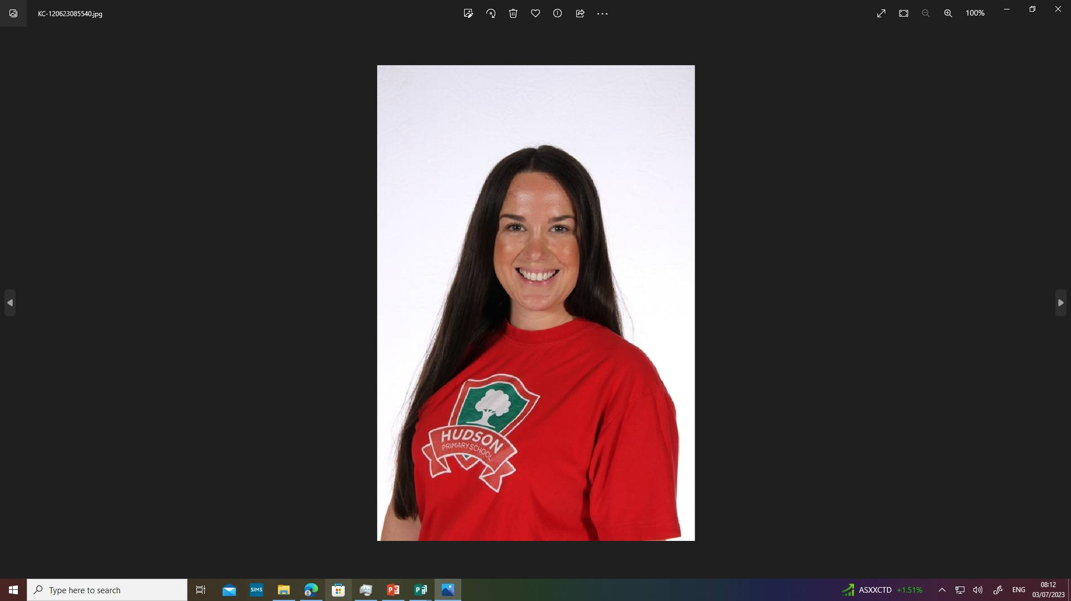
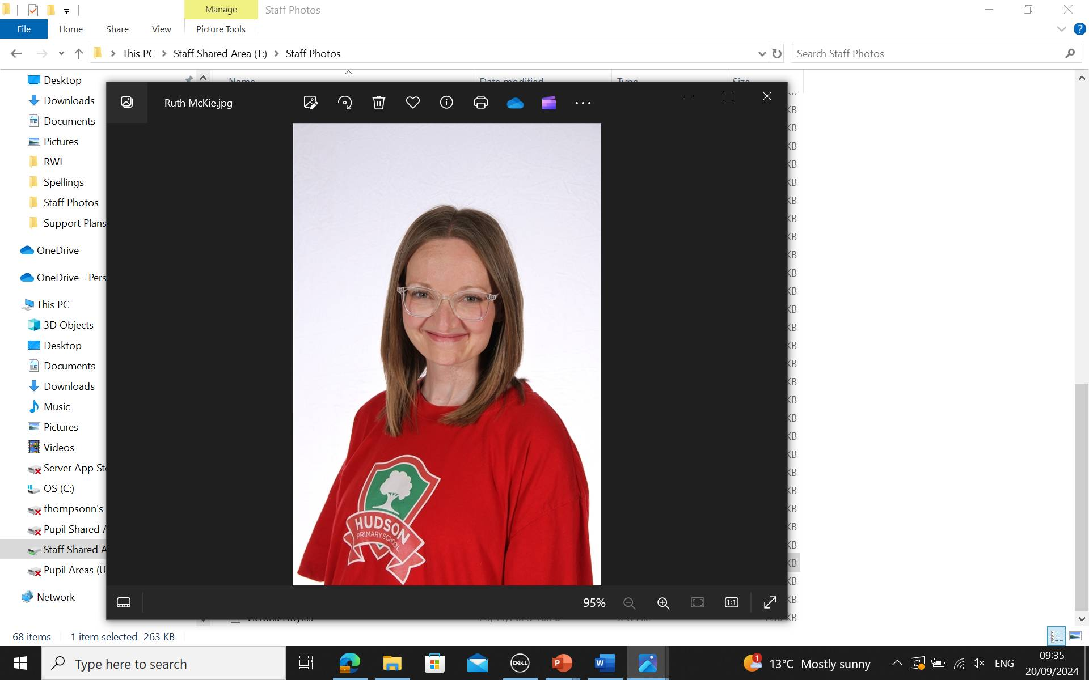
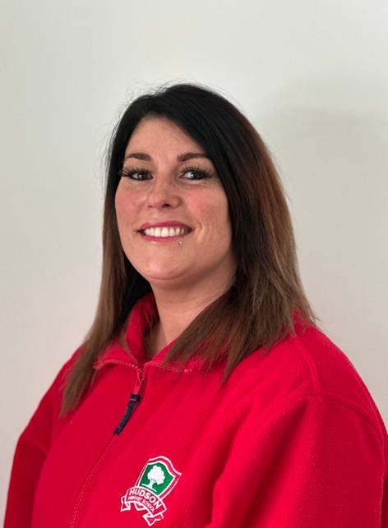
Year 1 is my favourite year to teach. I’ve been teaching for twwlve years now and I’ve taught in years 1,2 and 4 but my most favourite year is definitely Y1. I like your age, little personalities and how your independence develops throughout the year! Mrs Mckie and Miss Houston will be in class with us everyday.
Year 1 is such an exciting year; from the challenge of our quick paced fun lessons and being that positive role model and buddy to Reception, through to watching you move onto Year 2 and creating many beautiful memories.
In Year 1, we only ever ask you to try your very best. We will make sure that you all get the help you need and that we will be there with you to make sure that you feel confident and relaxed throughout the year- we will tackle any challenge together and are here to support you every step of the journey.
Everyone Experiences Excellence

Slide 4
Sycamore’s routine
Children arrive 8:40am
Class registration & handwriting
RWI
Literacy
Break time
Daily Maths and Maths
Lunch 12:00pm – 1:00pm
Afternoon starts 1:00pm – Class registration
Phonics Blast 1:00-1:30pm
Learning Journey, foundation subjects and interventions
Assembly & singing practise 2:45-3:15pm
Home time – 3:15pm.

Slide 5
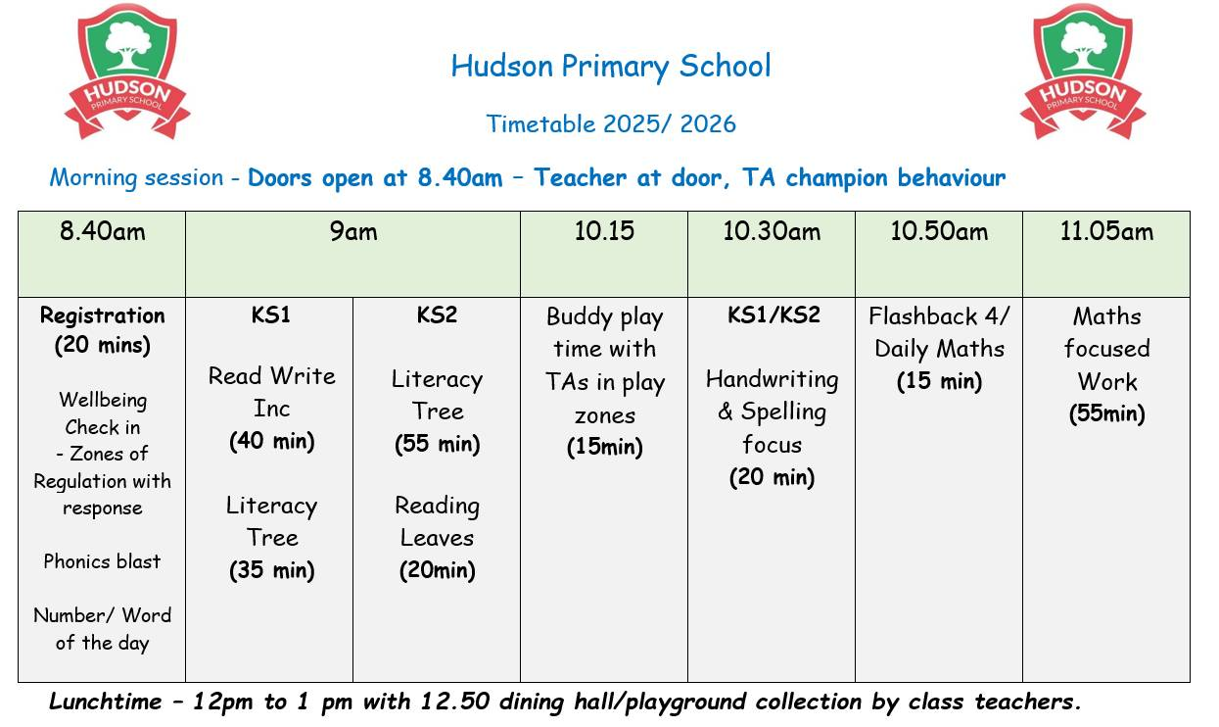
Our morning routine
Did you know that if you’re late by 10 minutes every day for the year it equals 31.5 hours!

Slide 6
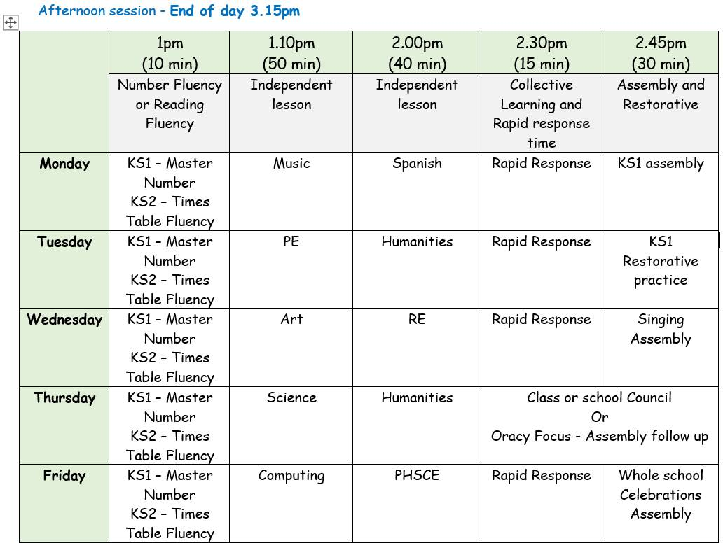
Our afternoon routine

Slide 7
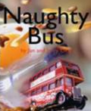




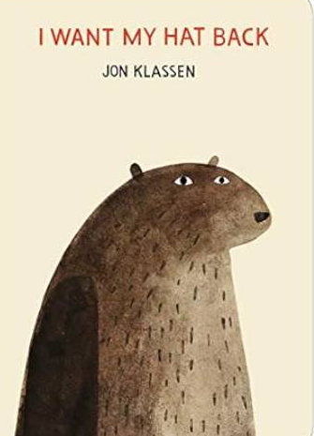
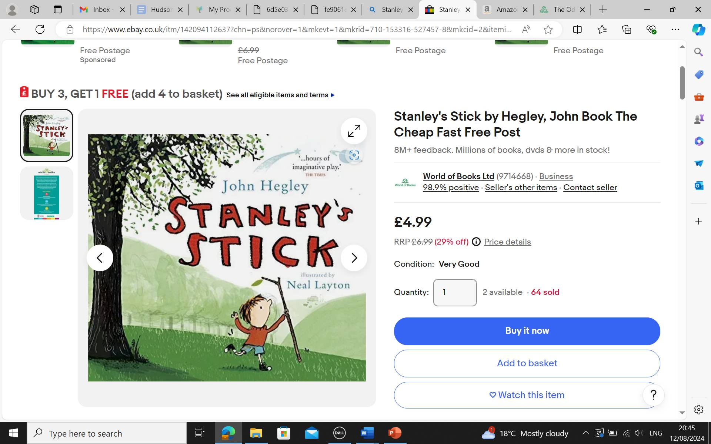

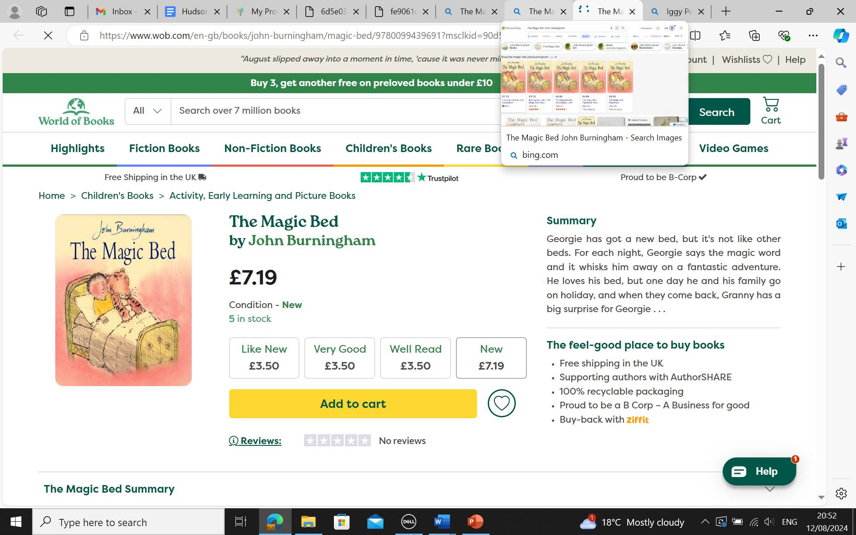
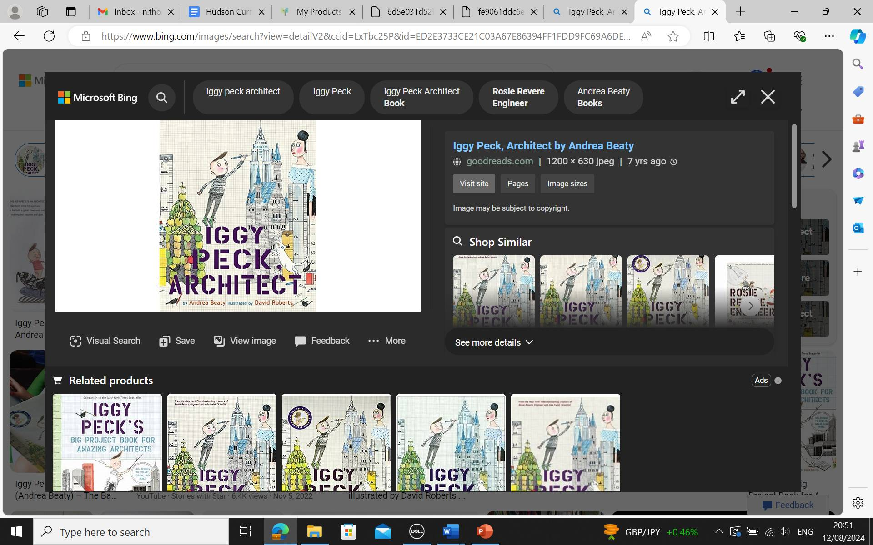
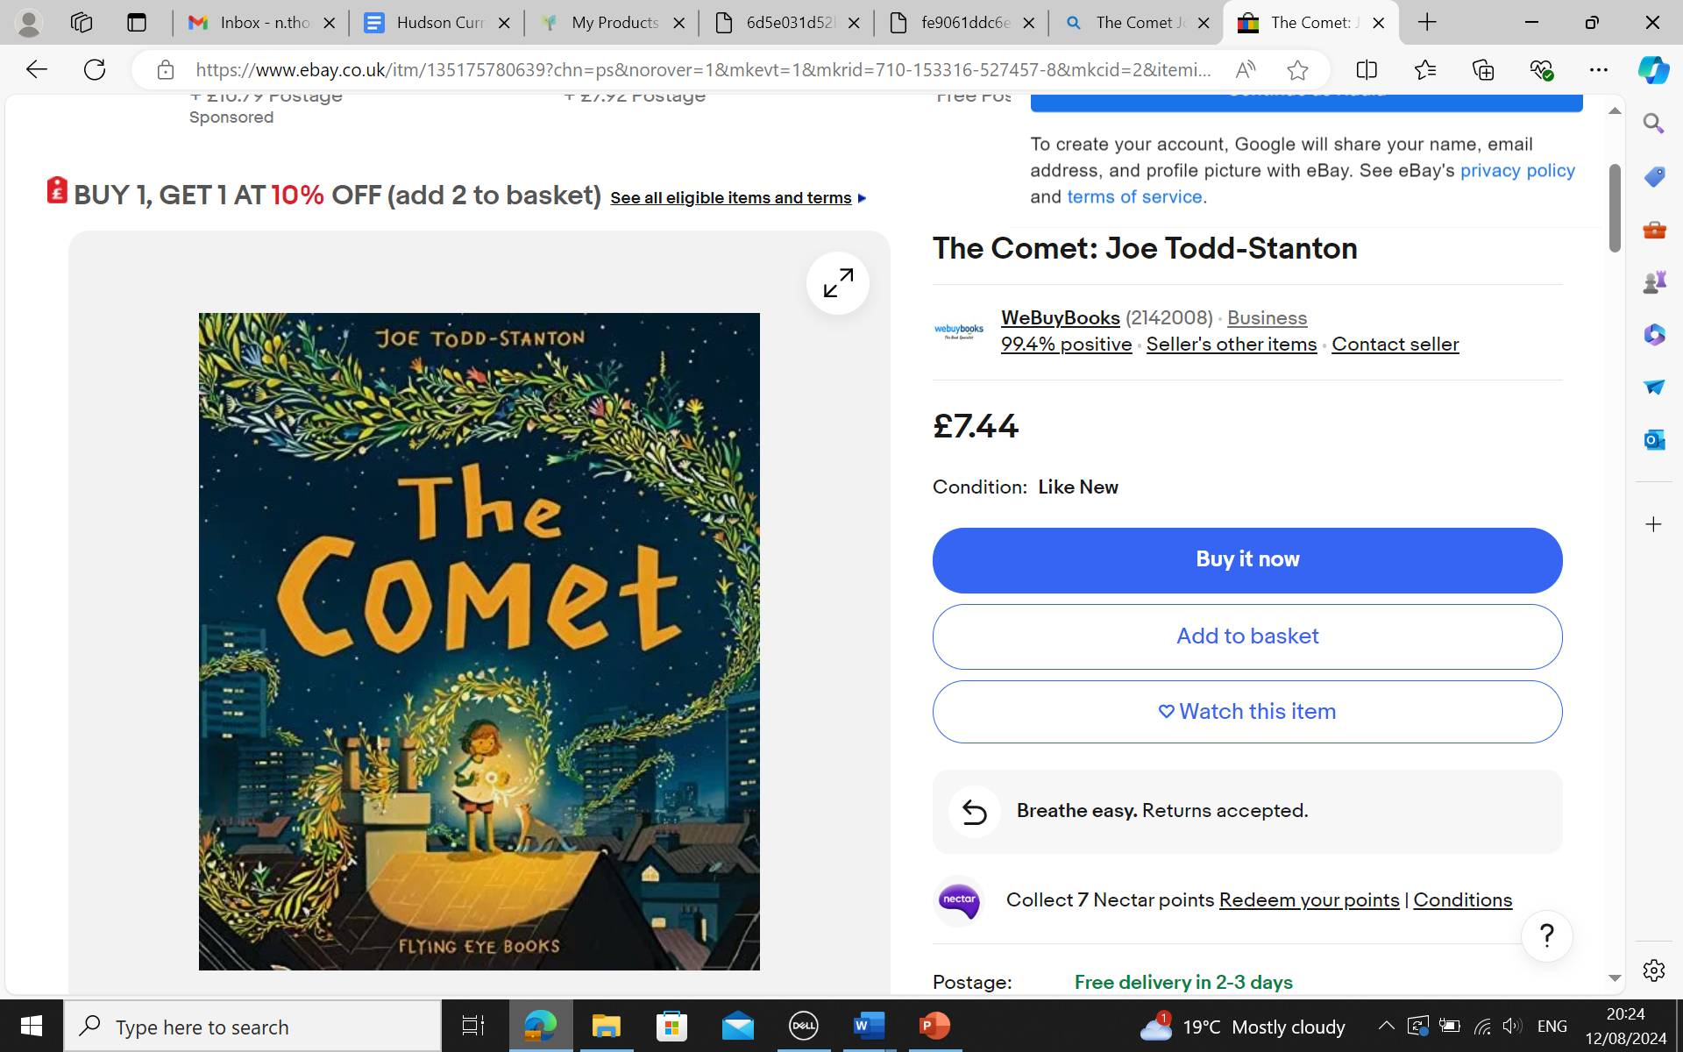
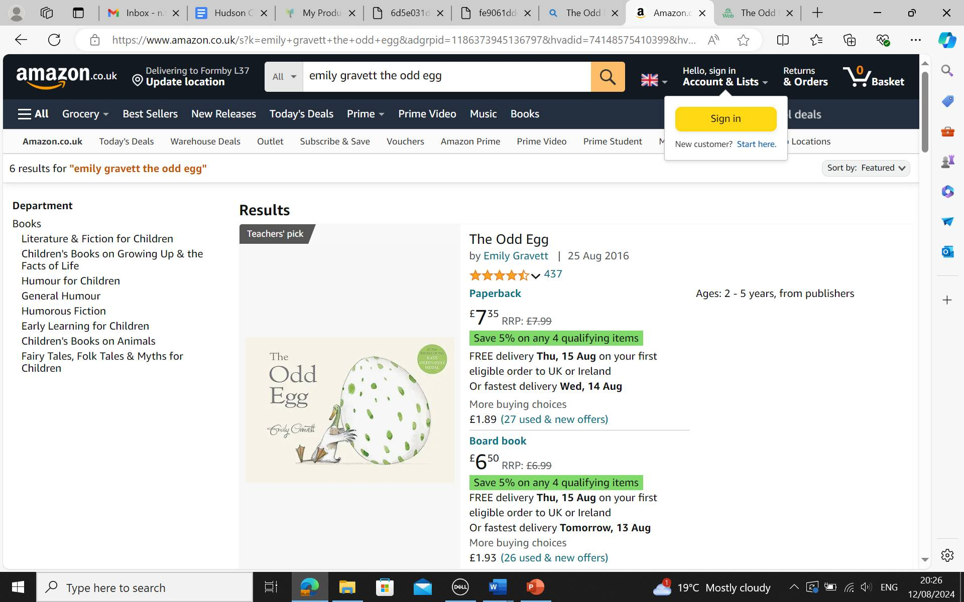
A range of our Literacy Texts

Slide 8
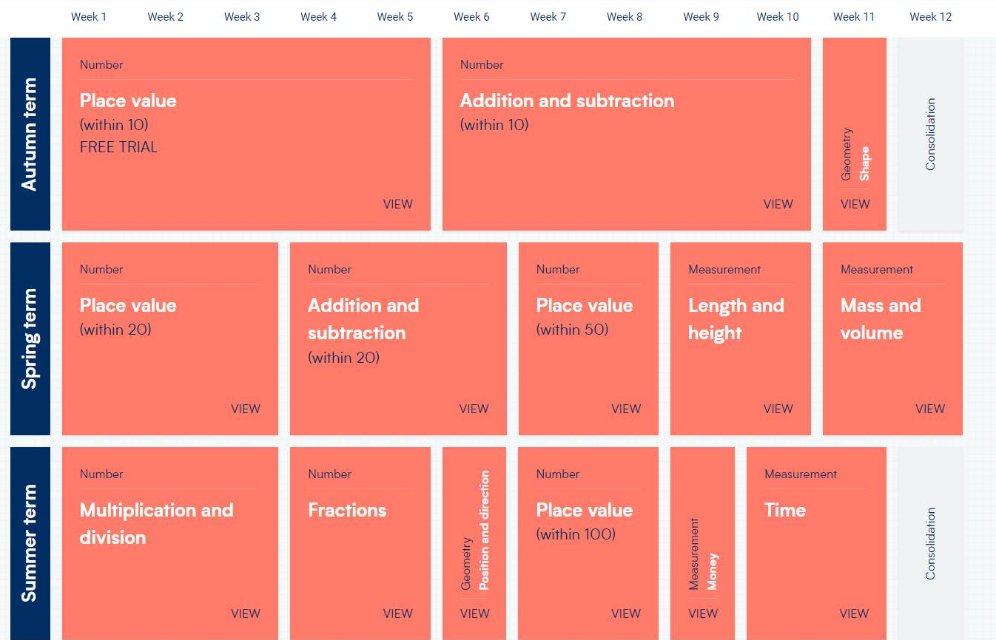
Our Maths Overview

Slide 9
Homework
Home
Learning
Reading
Children will have a skill builder book and a reading for pleasure book. It is expected that the children read a minimum of 3
times per week. Adults should sign on each occasion .Records will be checked each week in class.
Tasks are set every 3 to 4 weeks. Please keep up with Class Dojo for set dates.
Spellings after Christmas
Reading for Pleasure
Reading Passport
PurpleMash

Slide 10
Home learning and the expectation of a Hudson parent in this class
Homework is important for parents because it provides valuable insight into their child's learning progress and helps strengthen the partnership between home and school.
Reinforces learning
Builds responsibility and Independence-
Can Strengthen Bonds between your child and communication with school.
Prepares for future academic success

Slide 11
Why is Reading so Important?
Improves Literacy and Language Skills
Vocabulary expansion and improved Grammar and writing:
Regular exposure to well-written texts helps children understand sentence structures, punctuation, and writing techniques.
Reading Fluency: The more children read, the better they become at decoding words, improving their reading fluency and comprehension.
Boosts Academic Success
Better Performance Across Subjects: Children who read for pleasure often perform better not just in reading and writing, but across all subjects, including math and science.
Critical Thinking: Reading fosters imagination and helps children think critically, analyze texts, and solve problems.

Slide 12
Why is Reading so Important?
Enhances Emotional and Social Development Empathy and Understanding: Through stories, children learn about different cultures, perspectives, and experiences, helping them develop empathy and emotional intelligence.
Stress Reduction: Reading can serve as a calming activity, helping children manage stress and emotions by escaping into imaginative worlds or relatable stories.
Improves Focus and Concentration : Engaging with a book helps improve focus and concentration as children must follow the storyline and keep track of characters and events. Over time, this helps them develop greater attention spans.
Inspires Imagination and Creativity :Reading fiction encourages children to imagine new worlds, people, and ideas, fueling their creativity. Non-fiction books can spark curiosity about the world and different fields of knowledge.
Encourages Lifelong Learning: When children read for pleasure, they begin to associate reading with enjoyment rather than a task. This positive association fosters a habit of lifelong learning, curiosity, and intellectual growth

Slide 13
Reading – Ways to help at home
Love and enjoy reading!
Enjoy reading stories together.
Reading can involve anything: fiction, non-fiction, poetry, newspapers, magazines, football programmes and TV guides.
Talk about the story before, during and afterwards.
Visit the library!
Read a little at a time but often, rather than rarely but for long periods of time!
Look up definitions of words together – you could use a dictionary, the Internet or an app on a phone or tablet.

Slide 14
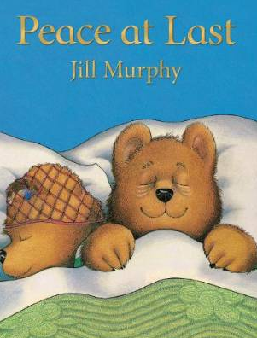
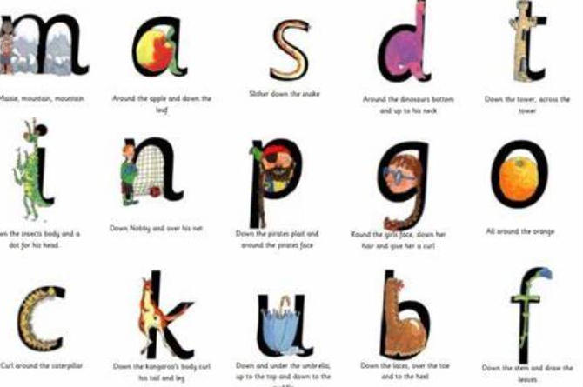
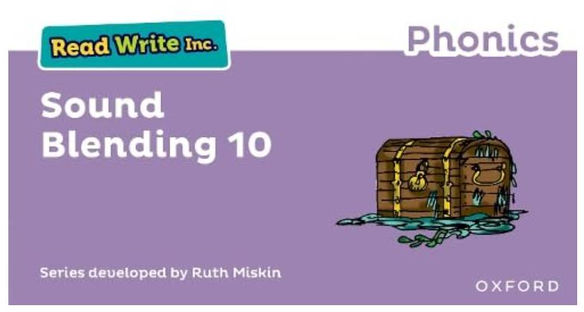
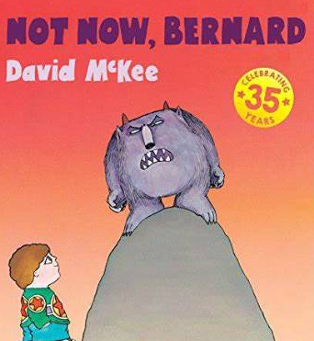
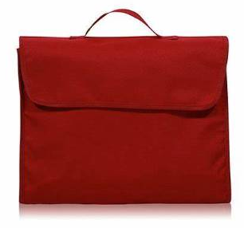
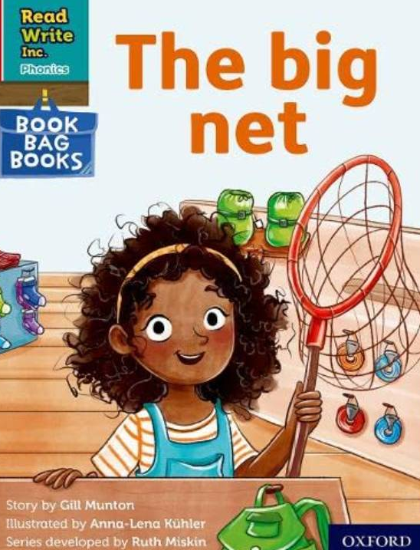

Reading at home
Where will my child begin?
CVC words
Reading for pleasure
Sounds to practise
What’s next?
Book of the week
Book Bag Book
Reading for pleasure
Reading online
Notes:
So after the third read in class, children bring the same Storybook home in their book bag.
They love this book!
They can read it like a storyteller and can’t wait to read it to you, their grandparents or even their teddy bear.
Please avoid saying, “This book is too easy for you!” but instead say “I love how well you can read this book!”
They are meant to be able to read all of the words as the book is at the correct level.
Encourage them to share their enjoyment of the story with you and read it in their storyteller voice – again and again.

Slide 15
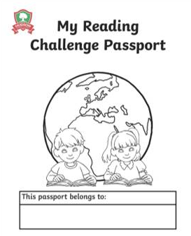

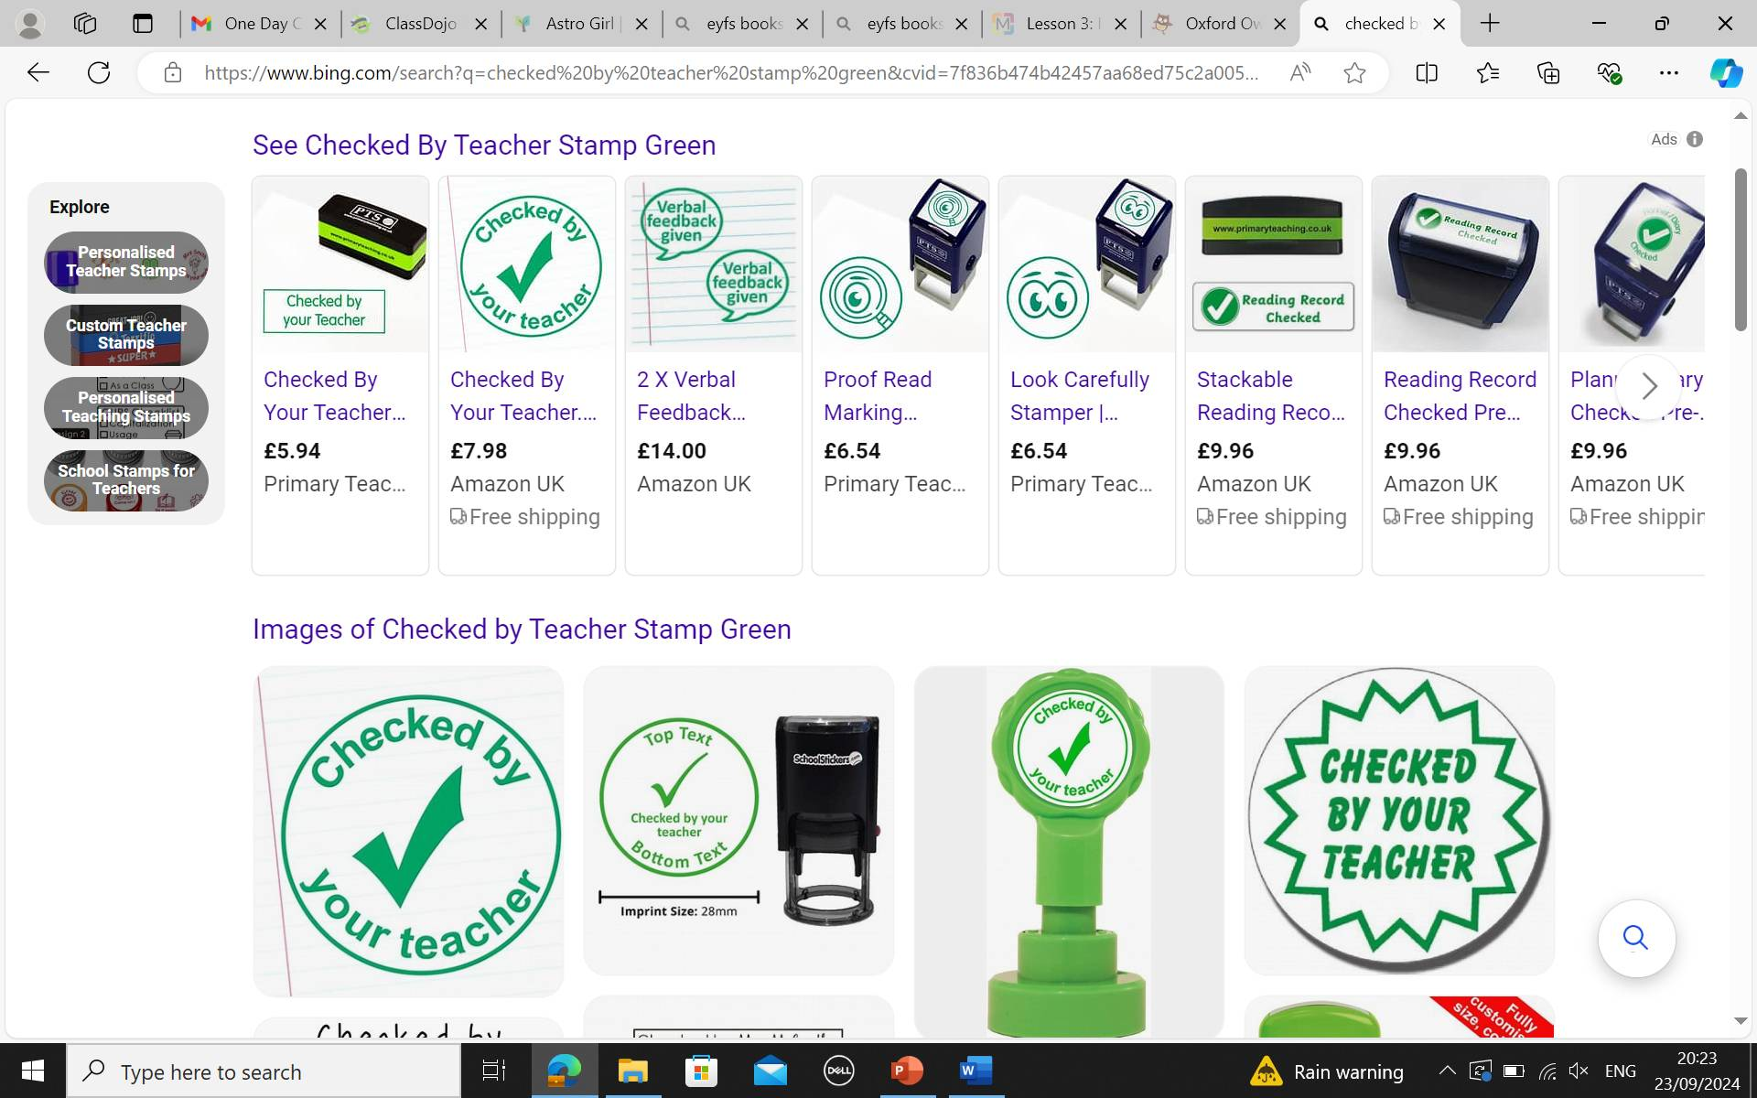
Reading for pleasure – launching after October half term!
X3 reads per week
More than x3 reads per week
Notes:
3 reads per week – 1 stamp
3 or more – 2 stamps
Half term, end of term are per class and the end of year award will be provided to the class with the most amount of stamps.

Slide 16
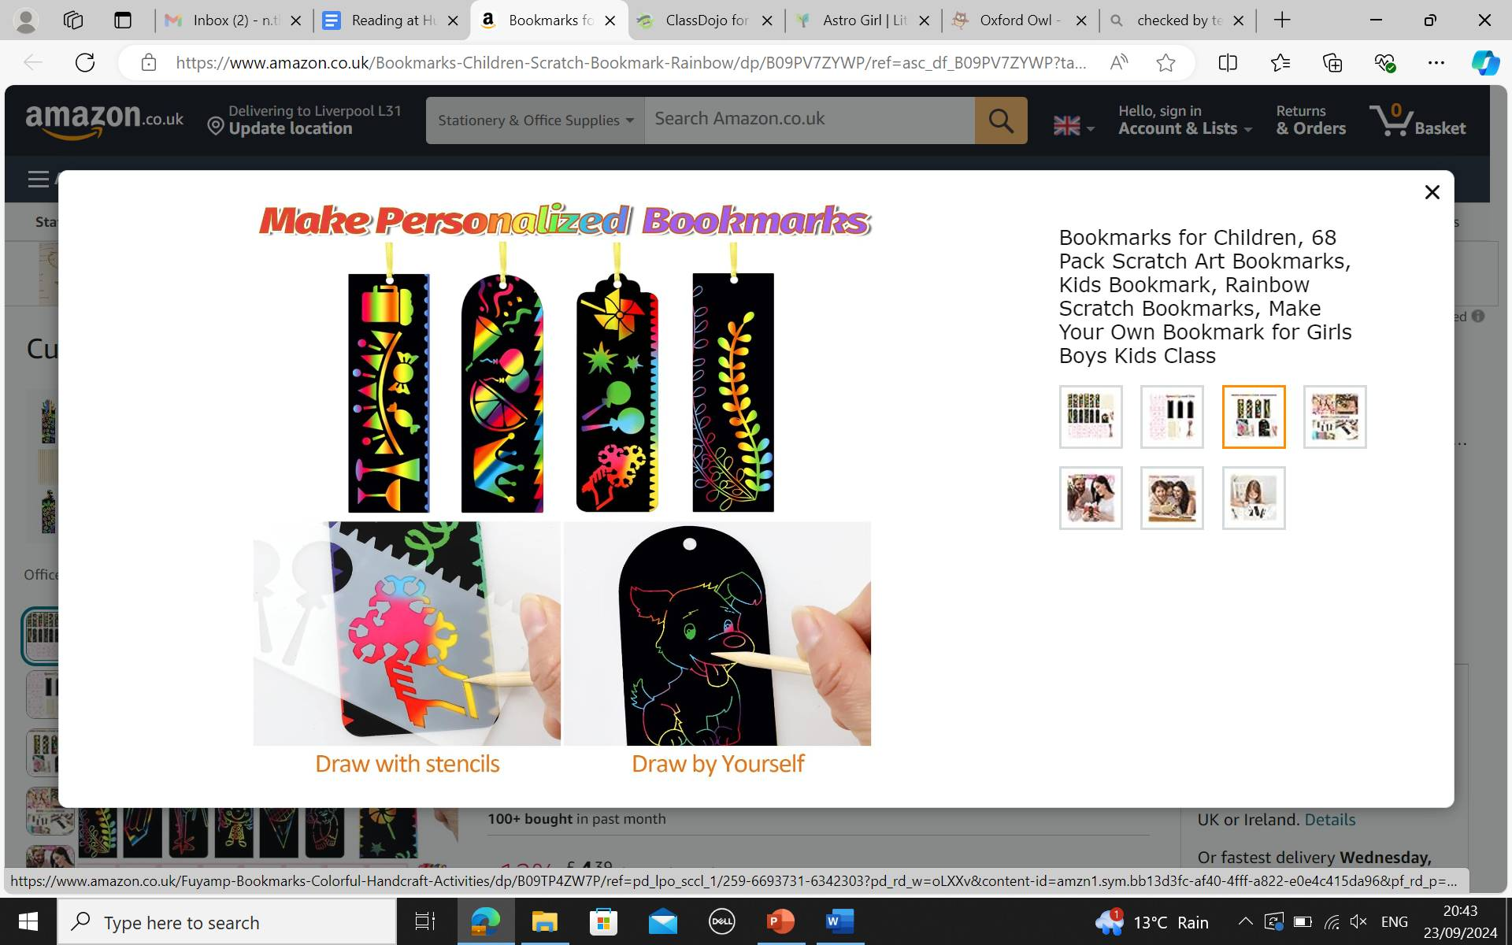
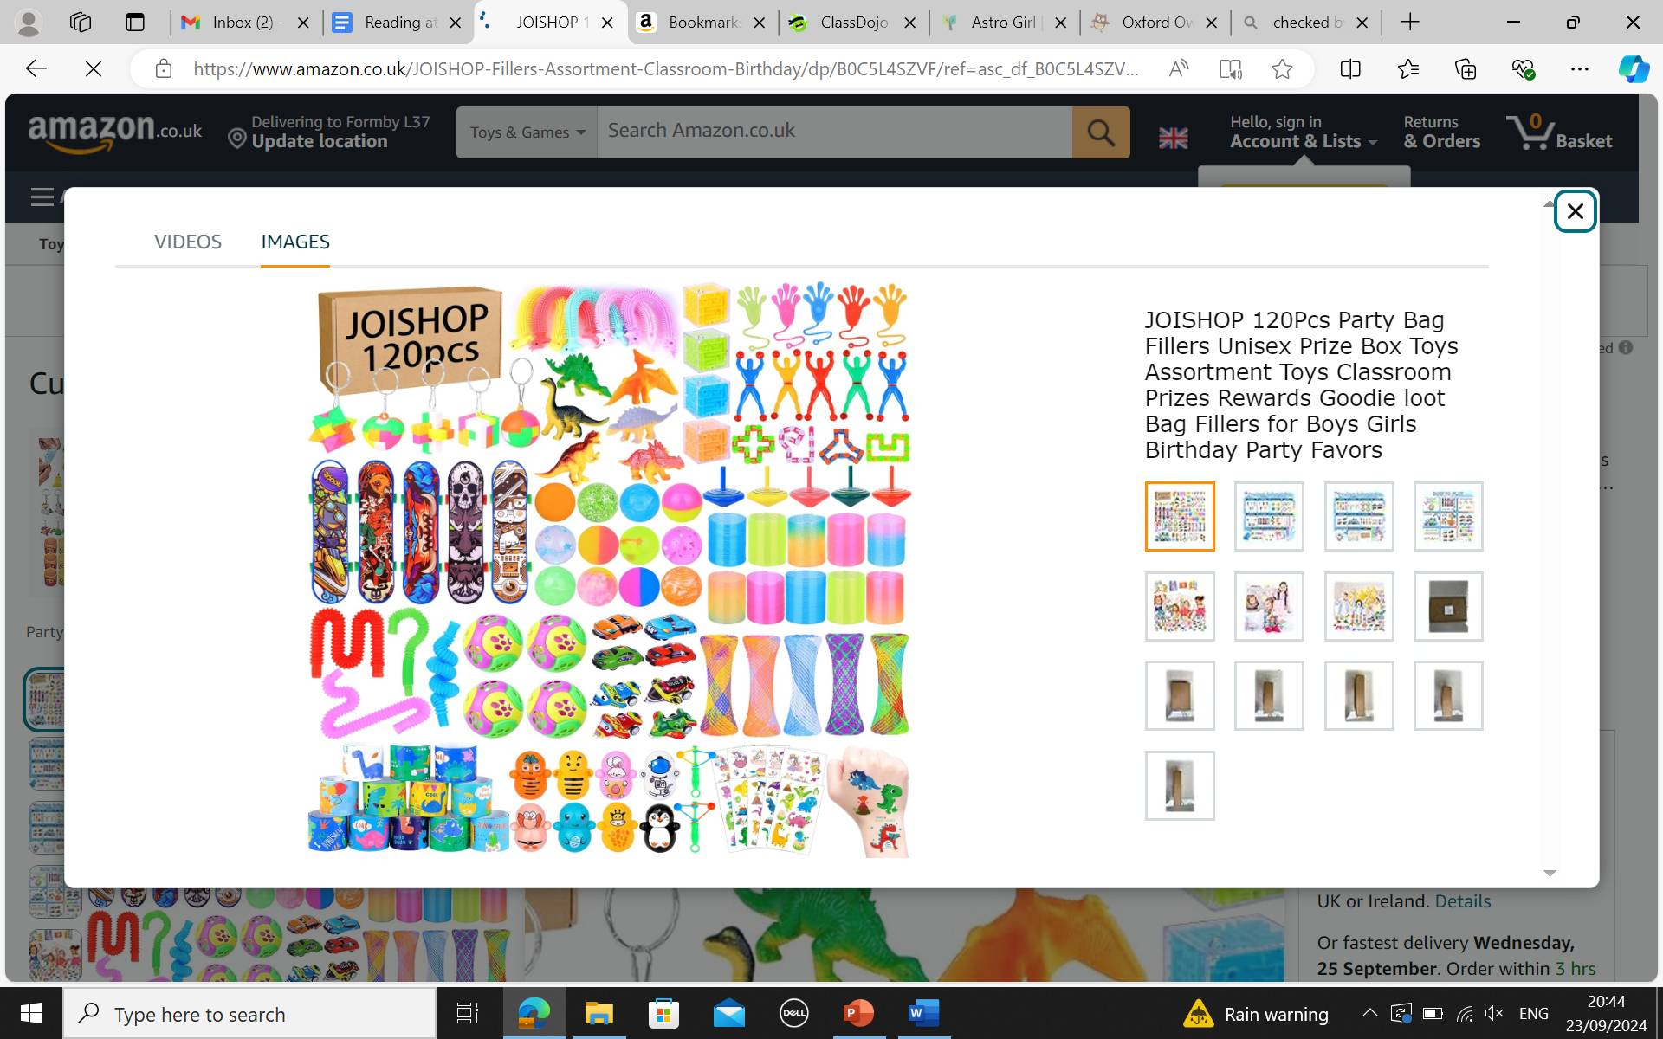
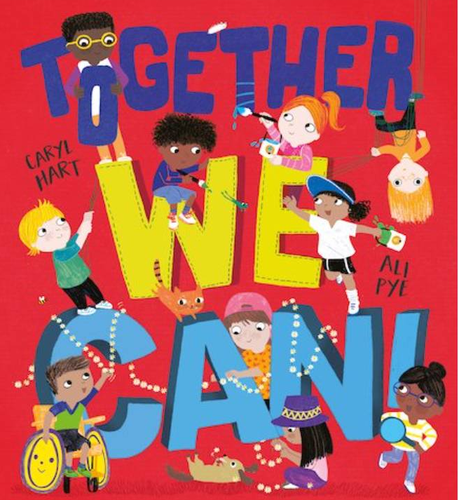
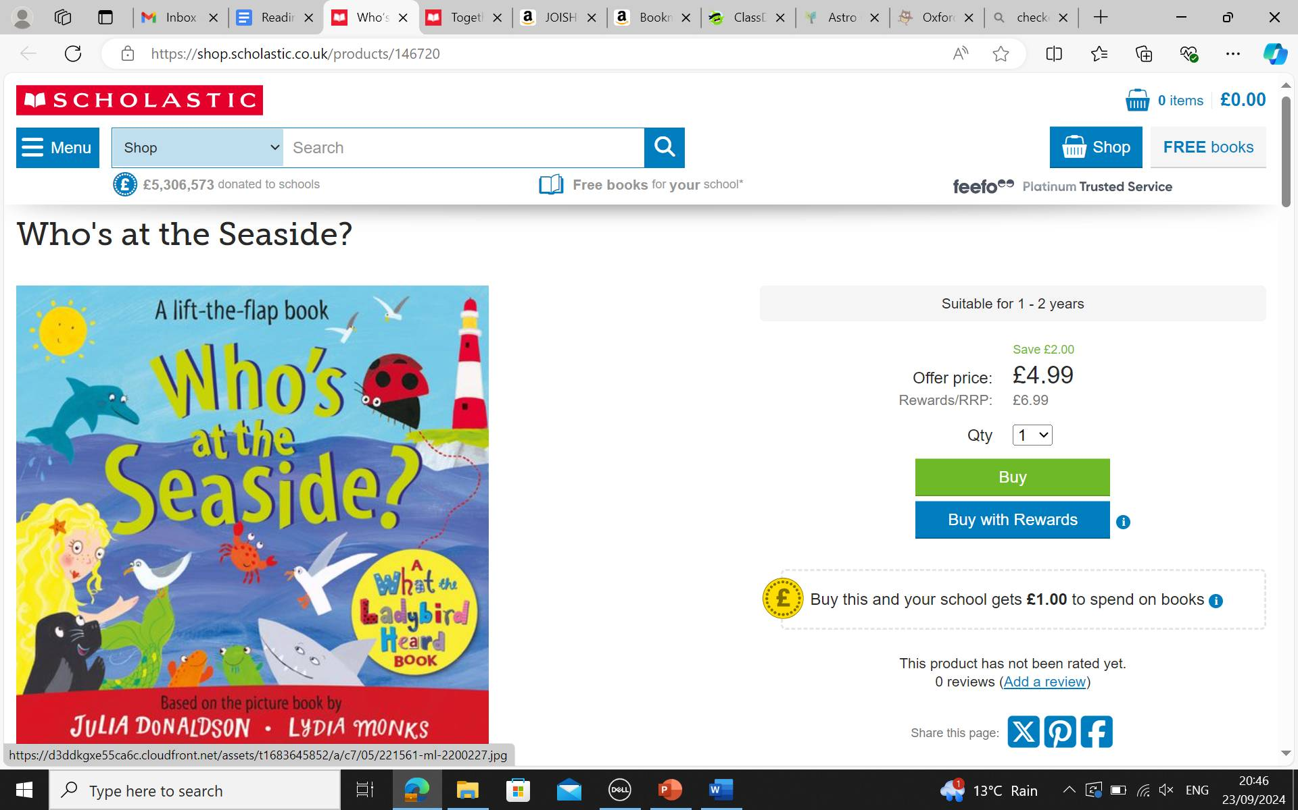
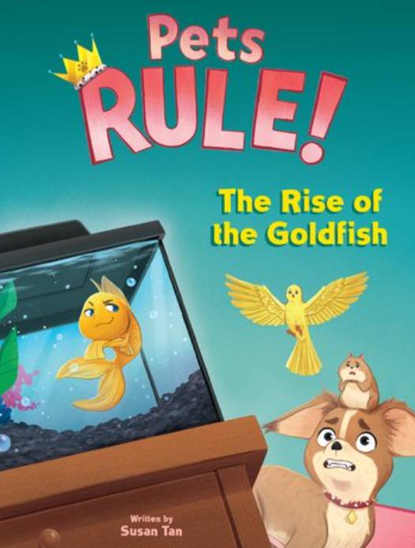
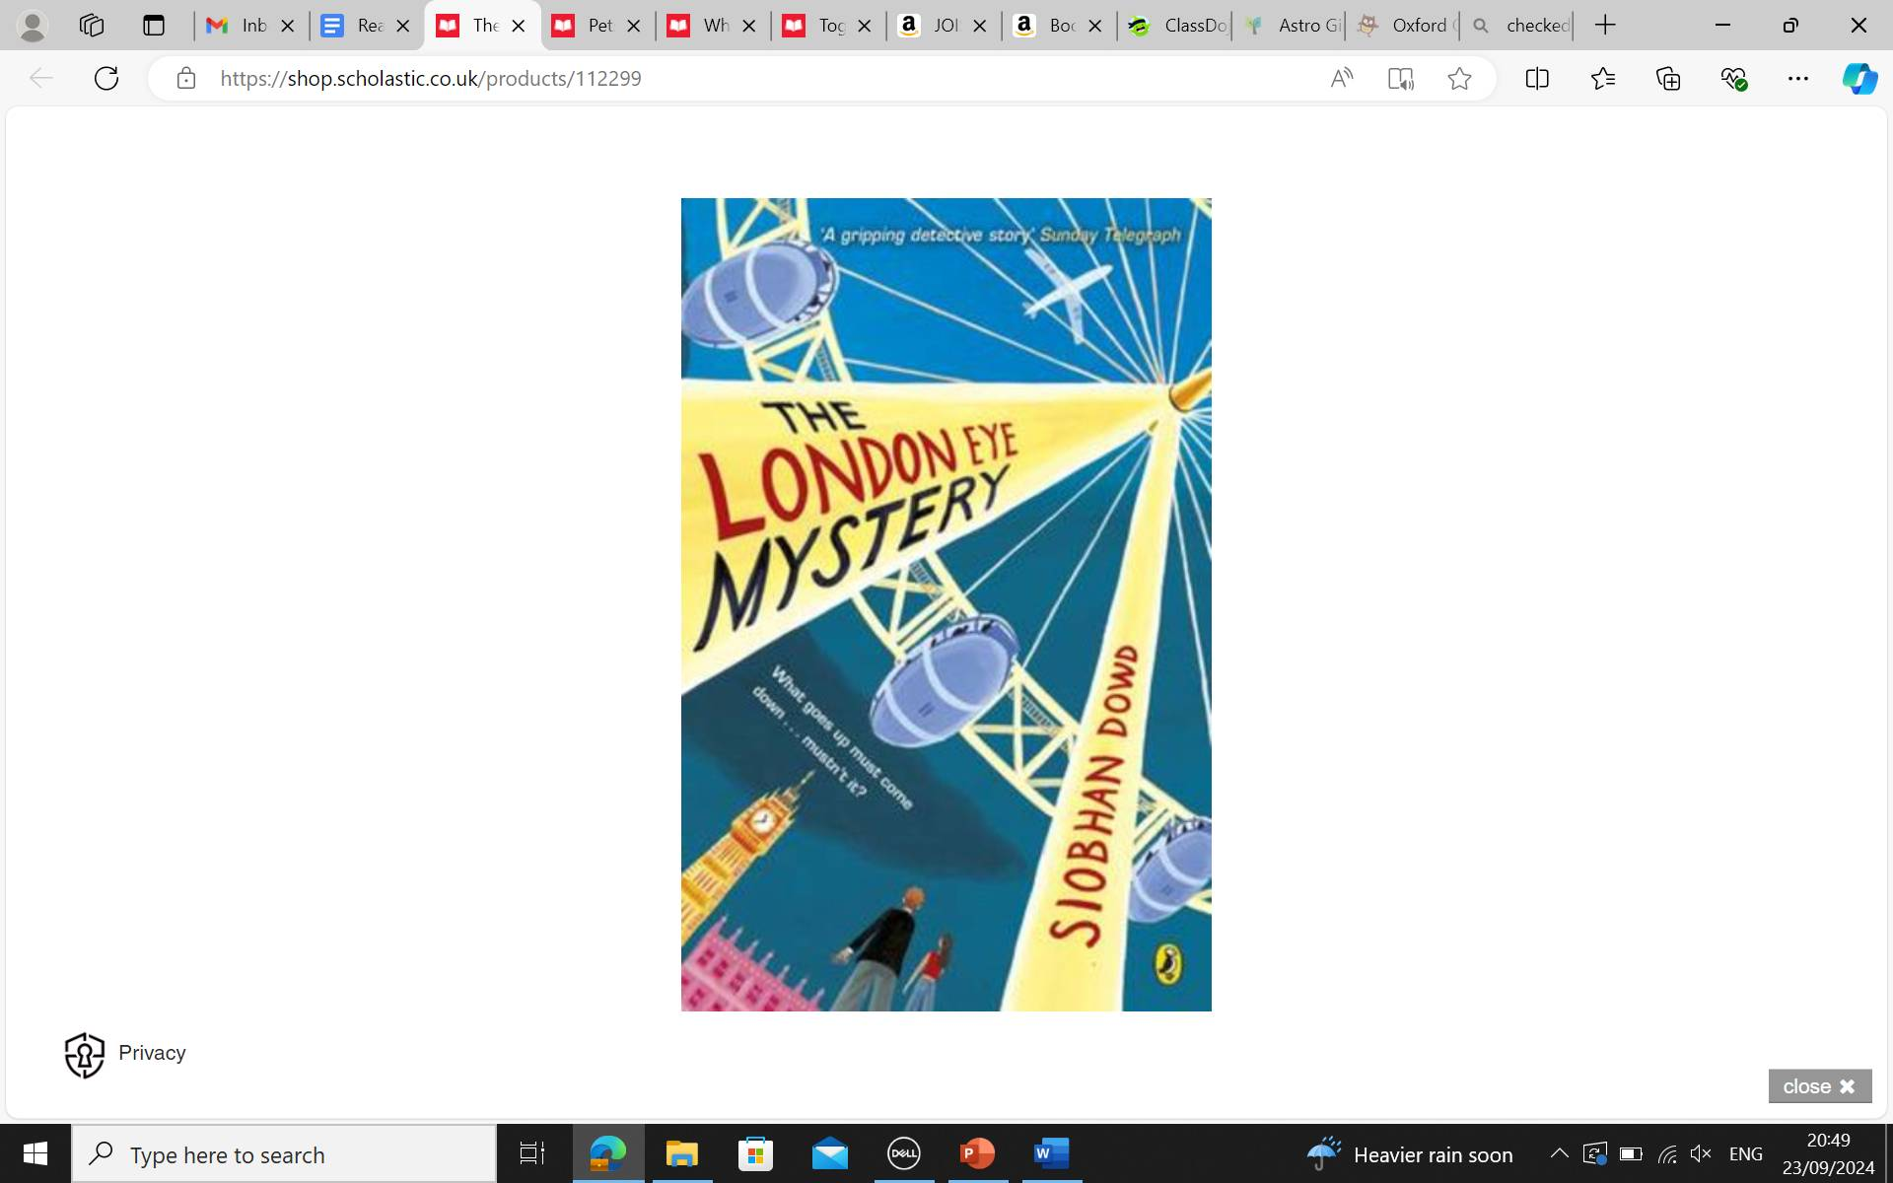
Reading for pleasure awards per class
Half Term awards-
End of Term -
Winning class end of year award – Author visit
* Children’s names will be selected at random by School Council if there are multiple winners!
Notes:
Each half term, 1 child from each class (with the most amount of stamps) will receive a small award.
At the end of each term, 1 child from each class (with the most amount of stamps) will receive a reading book to enjoy.
At the end of the school year, the class with the most stamps will receive an amazing Author visit.

Slide 17
Writing – Ways to help at home
• Practice and learn weekly spelling lists – make it fun!
• Encourage opportunities for writing such as letters to family or friends, shopping lists, notes or reminders, stories and poems.
• Write together – be a good role model for writing.
• Encourage use of a dictionary to check spelling and a thesaurus to find synonyms and expand vocabulary.
• Remember that good readers become good writers! Identify good writing features when reading (e.g. vocabulary, sentence structure and punctuation)

Slide 18
Maths – Ways to help at home
Play times tables games.
• Play mental maths games including counting in different amounts, forwards and backwards.
• Encourage opportunities for telling the time.
• Encourage opportunities for counting coins and money; finding amounts or calculating change when shopping.
• Look for numbers on street signs, car registrations and anywhere else!
• Look for examples of 2D and 3D shapes around the home.
• Identify, weigh or measure quantities and amounts in the kitchen or in recipes.
• Play games involving numbers or logic, such as dominoes, card games, darts, draughts and chess

Slide 19

Rewards
At Hudson we use class dojo to reward the children. The children can earn a dojo for a range of things such as working hard, having a calm classroom, being helpful and outstanding work
Children also have a chance to achieve either an Everyone Experiences Excellence award or a Charter Champion award every Friday in assembly
Verbal praise
Recognition

Slide 20
Communicating with families
Parents can communicate using with teachers using our designated communication lead by either emailing on enquiries@hudsonprimary.co.uk or by calling the office on - 0151 526 1568
Class dojos are uploaded every week showing some of that week’s learning and sending out any messages for that week.

Slide 21

Thank you so much!

