Slide 1


Welcome to the New School Year
Holly Nurture Class of 2025-2026
Everyone Experiences Excellence

Slide 2

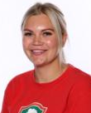
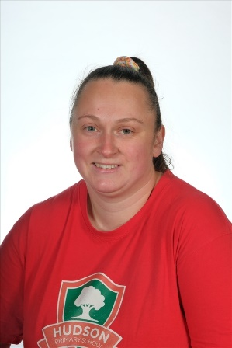
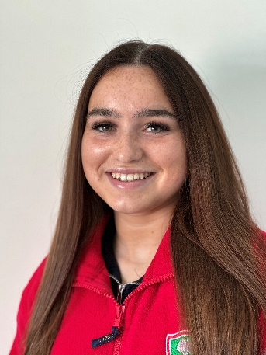
Our Holly Class Team
Mrs Spafford
Class Teacher
Mrs Williams Mrs McGrail Miss Craddock

Slide 3
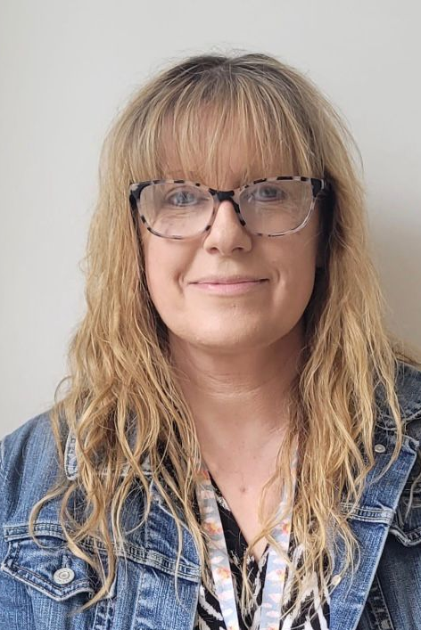
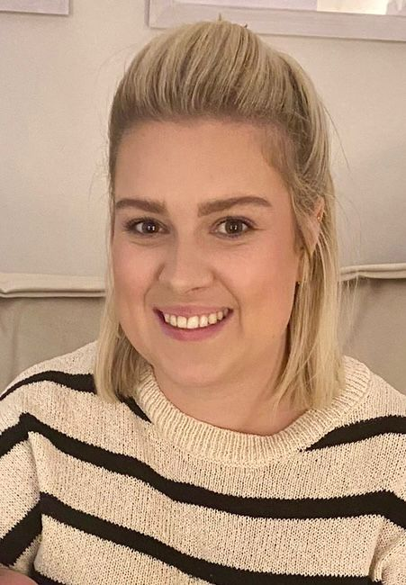

Speech and Language
Suzanne Laura

Slide 4
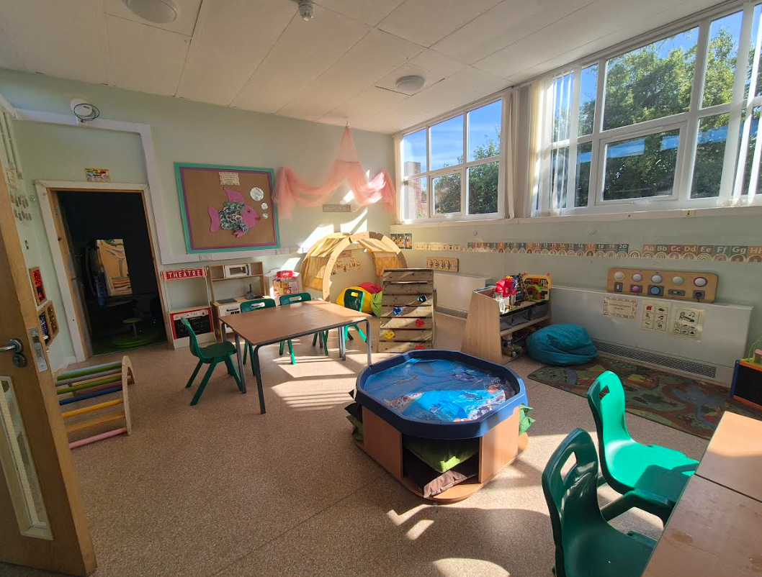
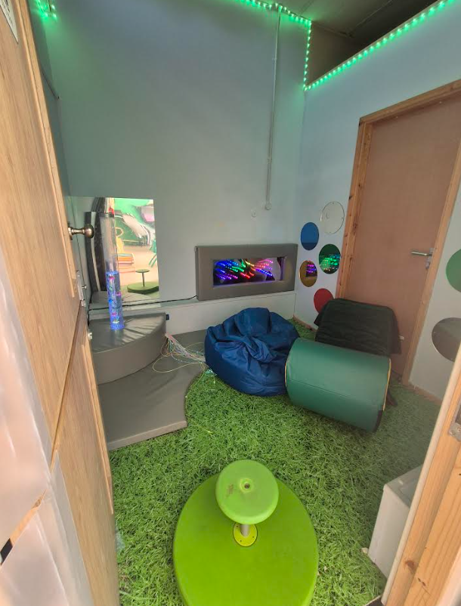
Our Classroom

Slide 5
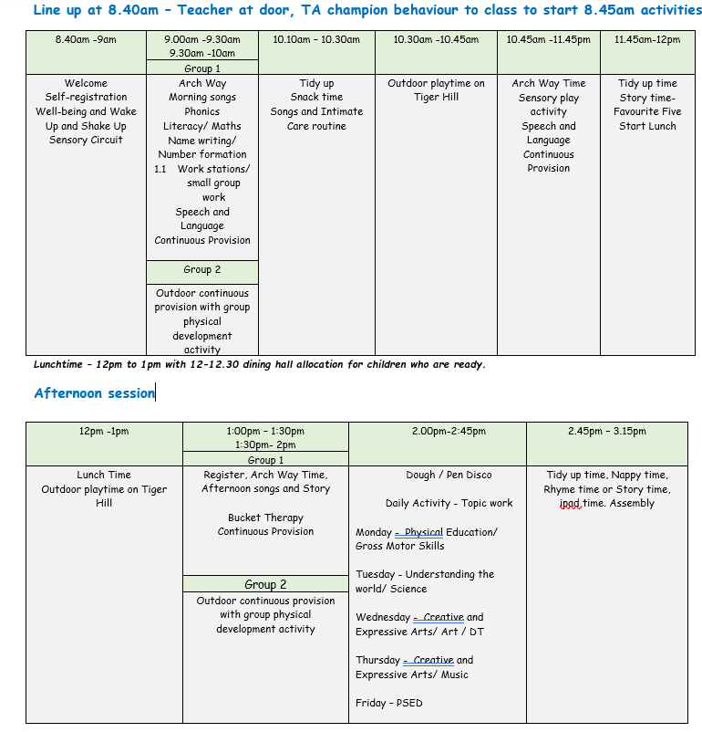
Hudson Primary School
Holly Class Timetable 2025-2026

Slide 6
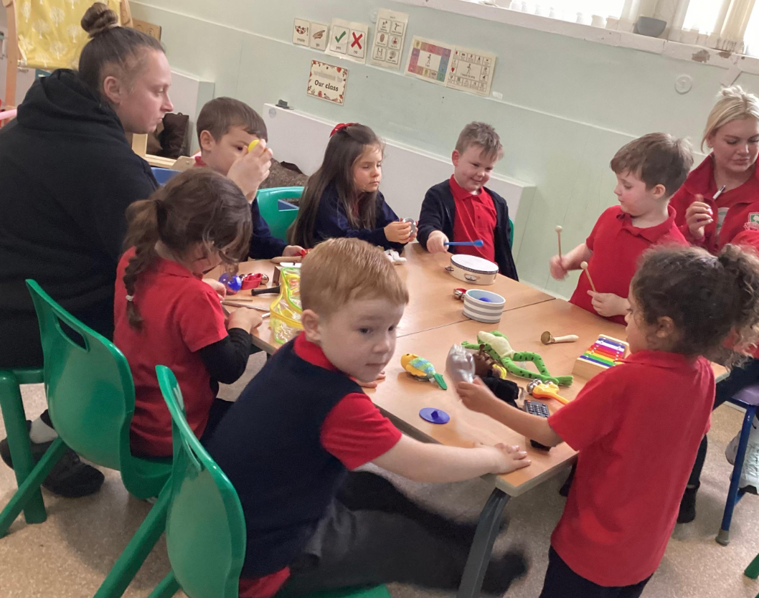
Arch Way

Slide 7
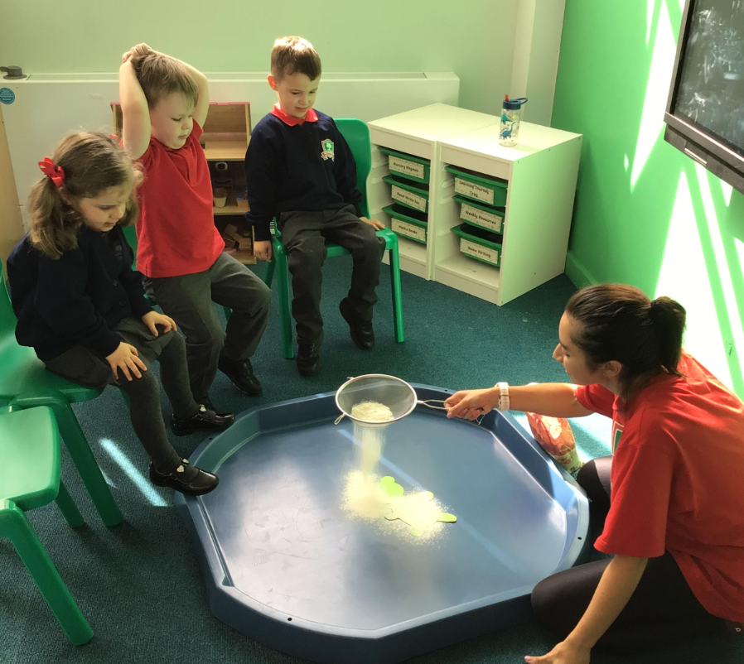
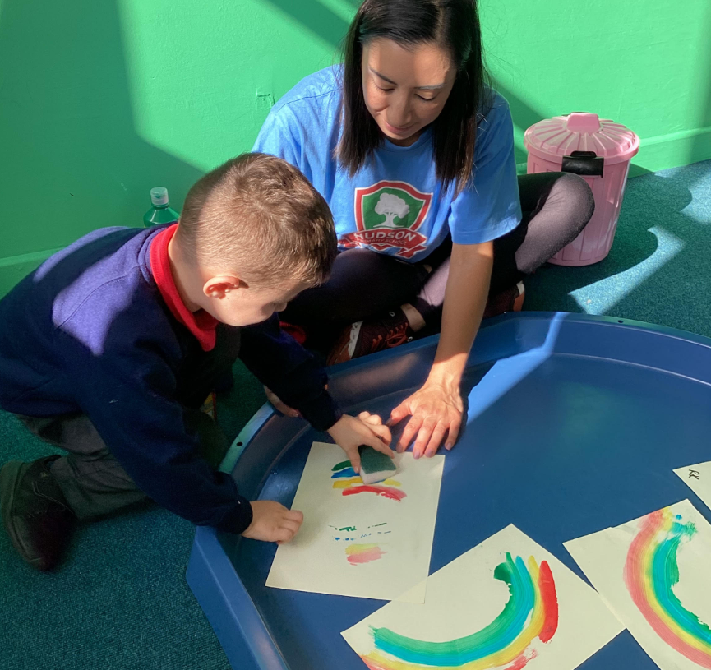
Bucket Therapy

Slide 8
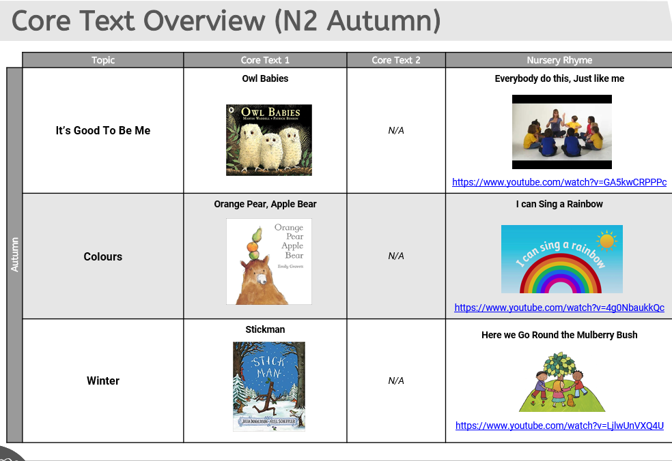
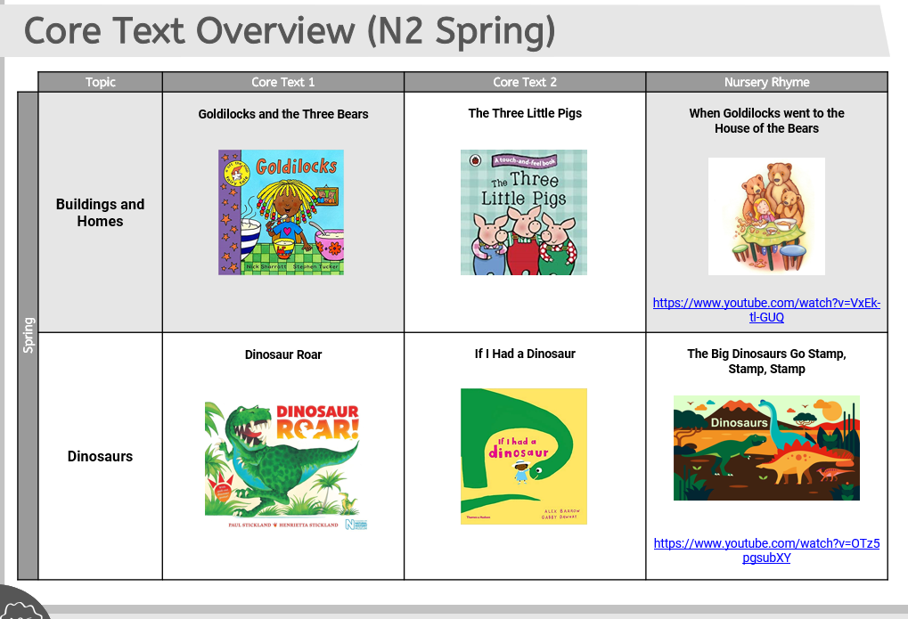
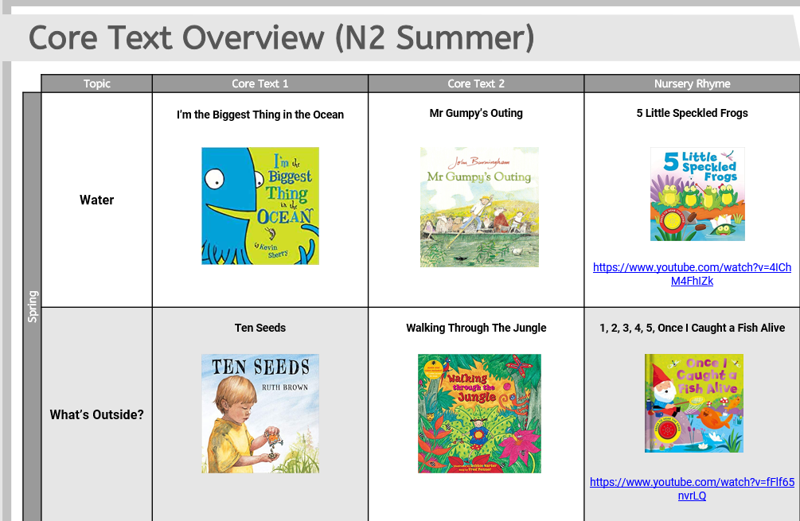
How you could help your child prepare for their projects

Slide 9
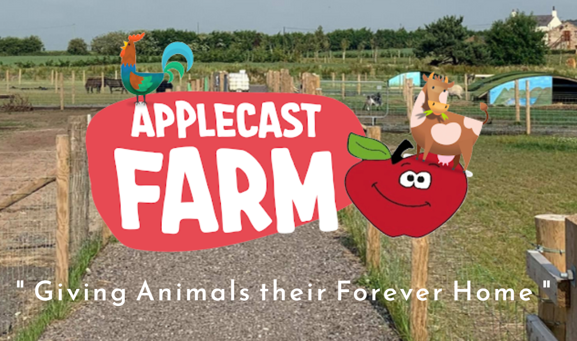
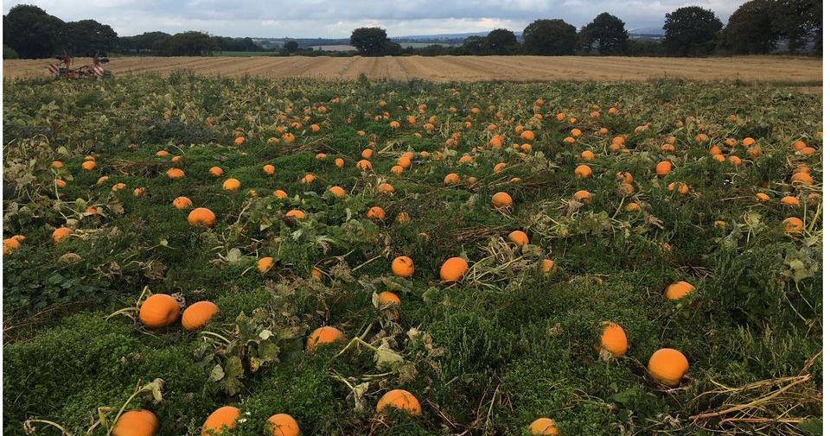

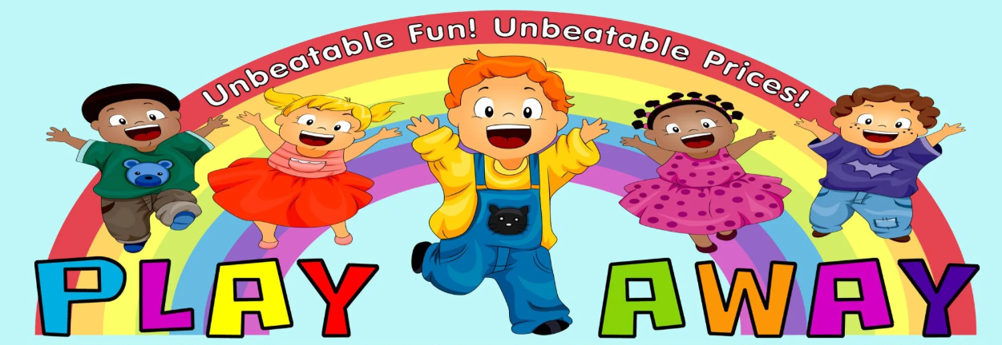
School Trips

Slide 10
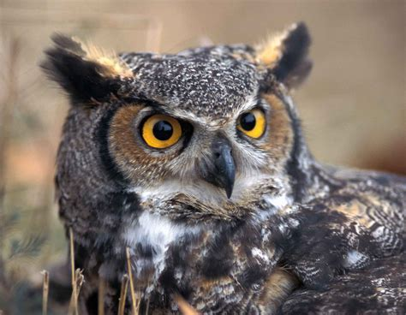
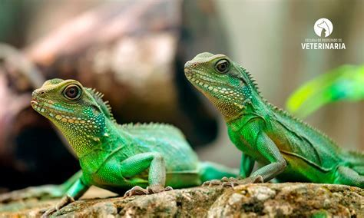
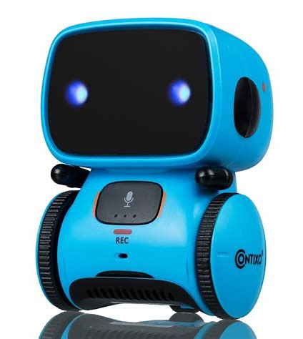
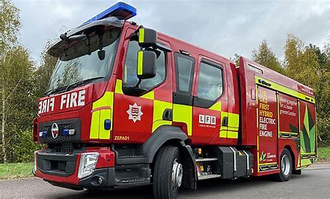
Visitors

Slide 11
Uniform
Please label EVERYTHING!
Girls
Hudson cardigan/jumper
Red polo shirt
Grey skirt/ trousers
Dark socks or tights
Black shoes
Boys
Hudson jumper
Red polo shirt
Grey trousers
Dark socks
Black shoes
PE Kit
Hudson Red PE t-shirt
Navy shorts
Black pumps
Items containing a school logo can be purchased from ‘Sefton Schoolwear’ on Dover Road.

Slide 12
Useful Information
Uniform - Wellies are also required for children's outdoor play and a set of spare clothes please.
PE – Please can your children arrive at school in their kit. Navy shorts, red t-shirt, black pumps.
Hot dinners are free for ALL Reception children (menus are available from the office)
Packed lunches - Please ensure you promote healthy eating for your child ☺
Snack – School fruit or bring your own healthy snack.
Water bottles - Labelled. These must be washed and refilled at home.
If your child wears nappies, please bring in a pack of nappies and wipes to leave in our changing area.

Slide 13
Useful Information
Medical forms must be completed and we must be aware of any changes.
If medication is required during school hours then a “permission to administer medication” must also be filled in at the school office.
Within each class there is a ‘grab bag’ which contains first aid equipment and children’s personal necessities too E.g. inhalers.
Homework - Once a week (Posted on Dojo on Fridays, returned the following Tuesday).

Slide 14
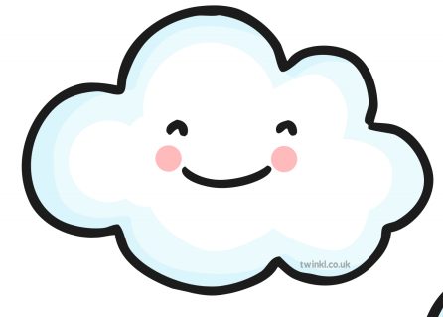
Home Learning
New homework is set each Friday, and will be based on the learning children are doing in class – the tasks set will be fun, creative and engaging. Please can homework be handed back in on a Tuesday.
Proud Cloud
A proud cloud is a way of sharing your child's achievements at home with us in school. Whatever your child has done, no matter how small, it is an achievement that you are proud of and we want to share that with everyone in class.
Achievements can be about learning to do something for the first time, being brave, being kind to family and friends. They can also be something achieved at swimming lessons, dance class, football club or any other out of school activity.
You can send a Proud Cloud into school at any time – These can be sent via Class Dojo, it may be something that your child has written, a drawing or photos! Send in any achievements and we will put them on our Proud Cloud.

Slide 15
Teams!
Johson Thompson
Jonas
Boardman
Farrel

Slide 16
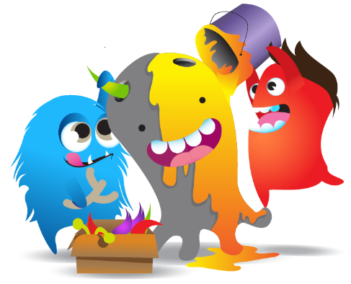
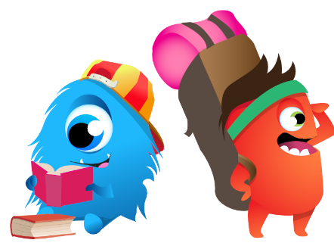
Rewards
Attendance
Good work in a lesson
Good behaviour in a lesson
Being a good friend
Homework
Stickers
Certificates
Stars of the week
Reward for behaviour in corridor
Reward for behaviour in assembly
Reward for behaviour in lunchroom
Reward for behaviour in playground

Slide 17

Communicating with families
Parents can communicate using our front office, you can contact the office either by email using the following email address:
enquiries@hudsonprimary.co.uk
Or by telephone on the following number:
0151 526 1568
Hudson Primary School is a cashless school and all charges and payment go via parentpay. Our families new to Hudson Primary School will be given a login in September.

Slide 18


