Slide 1



Welcome to the New School Year
Holly Class
Nurture Class of 2023-24
Everyone Experiences Excellence

Slide 2
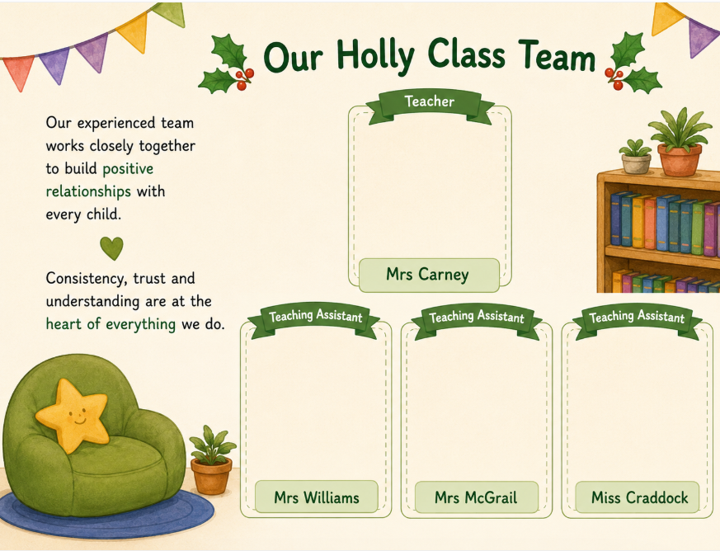




Our Holly Class Team
Mrs Spafford
Class Teacher
Mrs Williams
Teaching Assistant
Mrs McGrail
Teaching Assistant

Slide 3

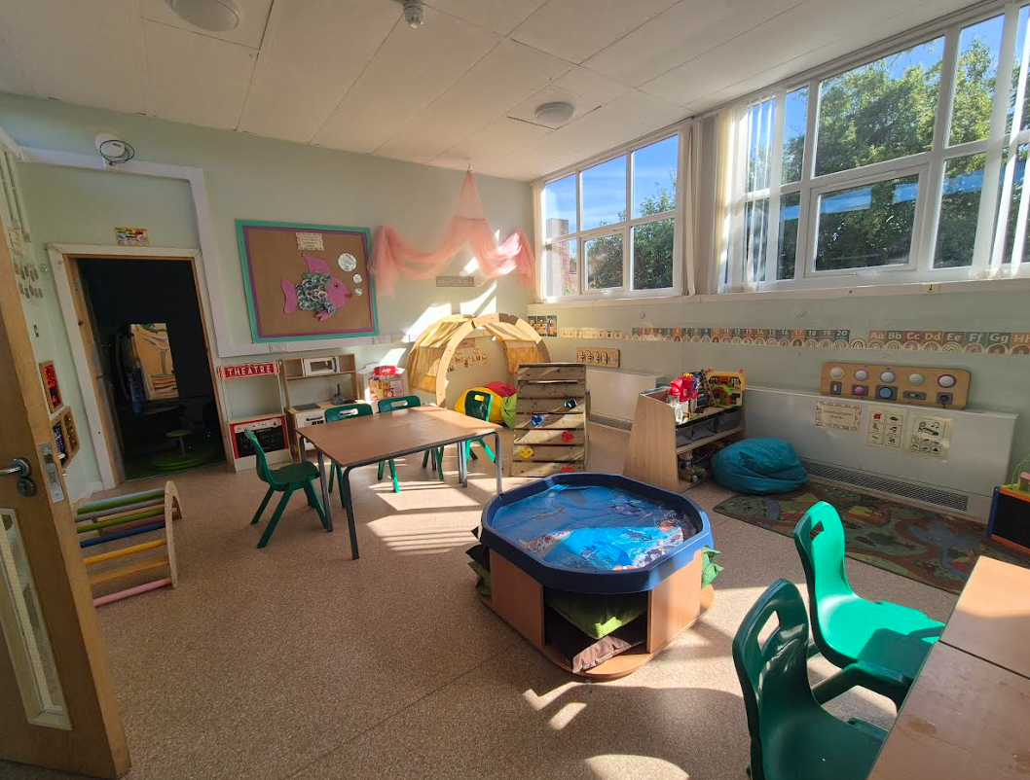
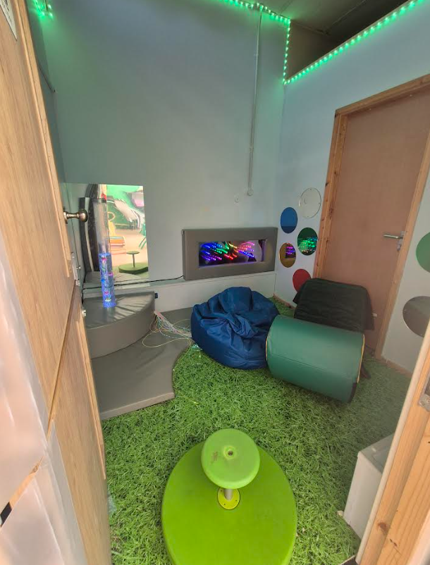


Slide 4


Hudson Primary School
Holly Class Timetable 2023 – 2024

Slide 5
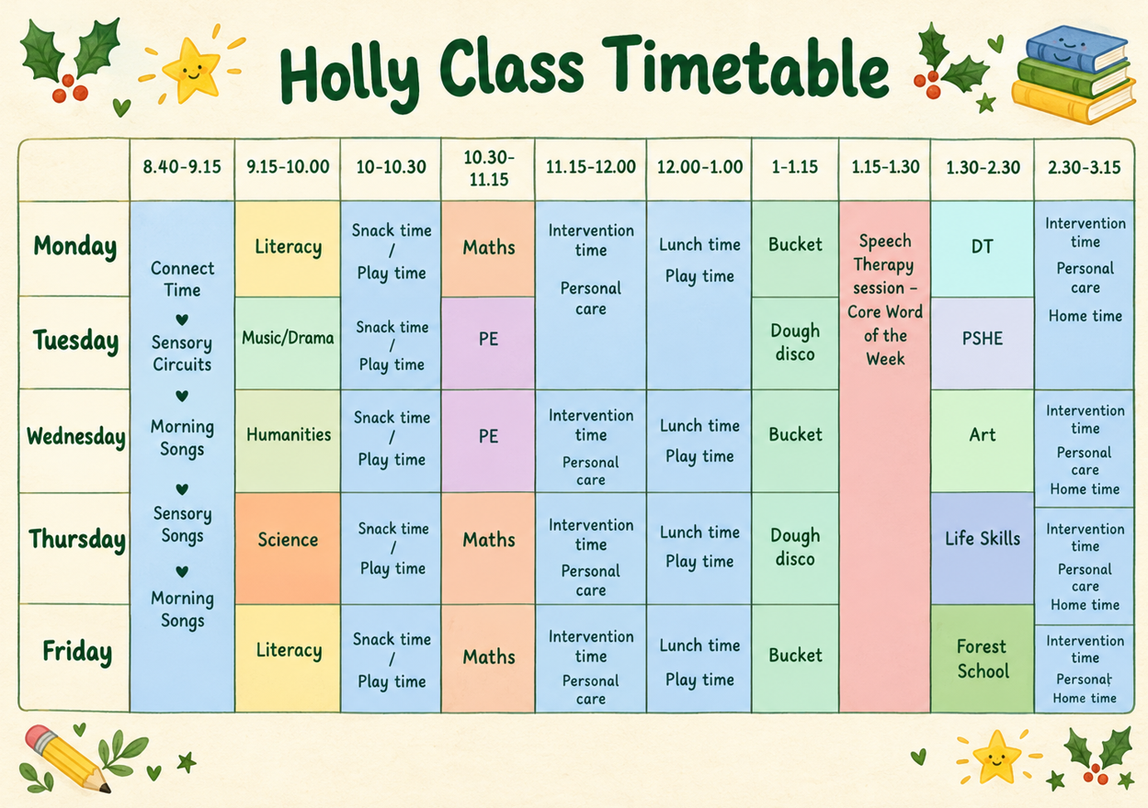

Slide 6


Slide 7

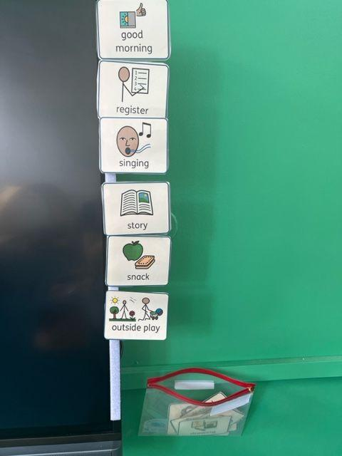
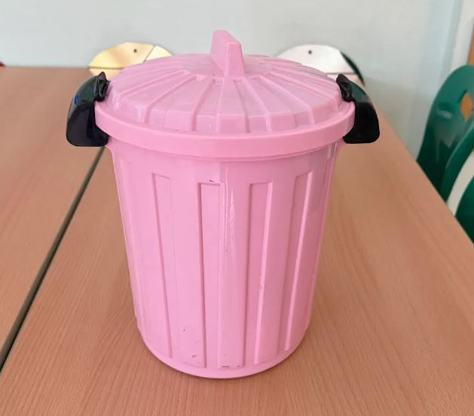
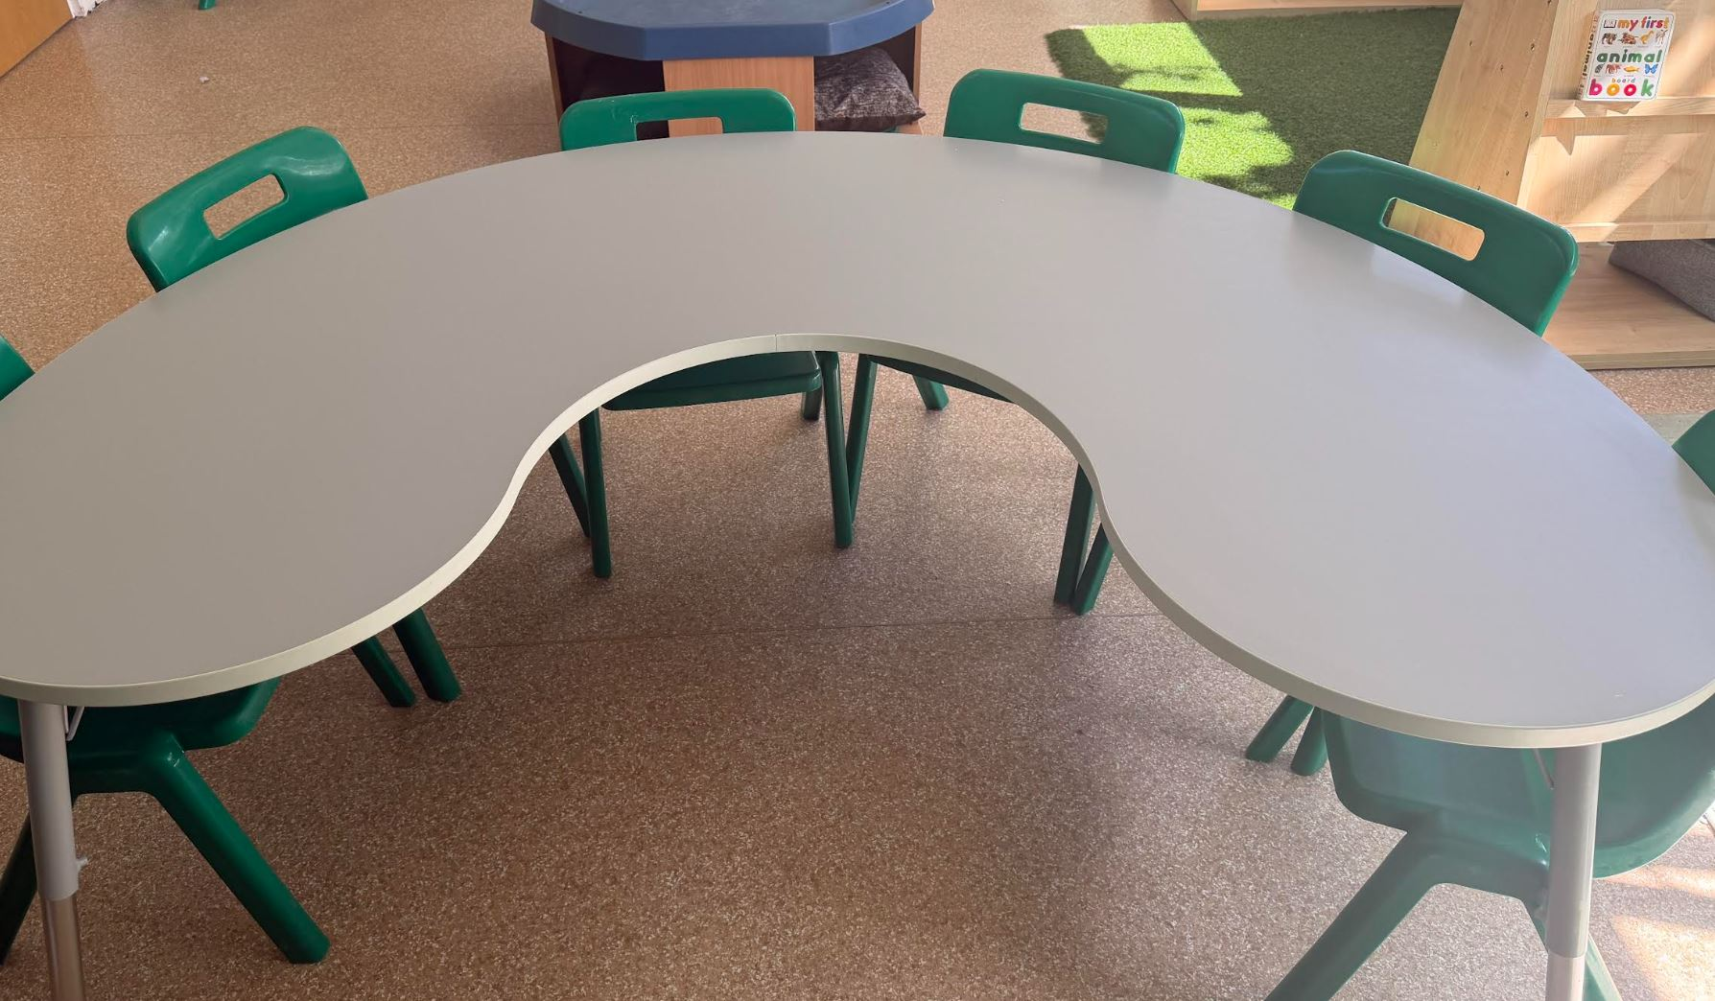
Arch Way

Slide 8


Slide 9
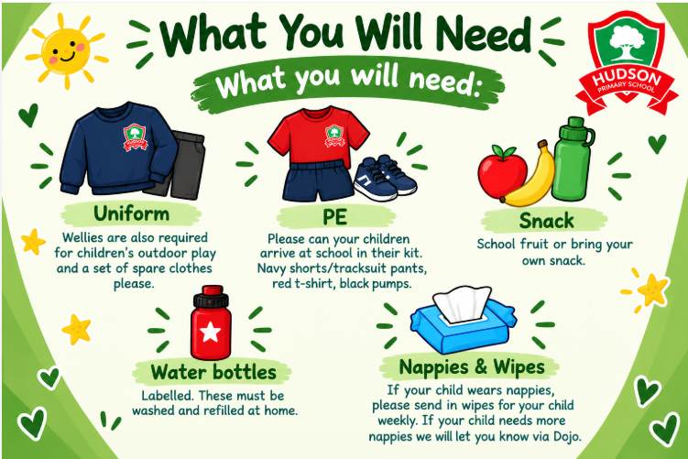

Slide 10


