Slide 1


Welcome to the New School Year
Elm Class 2026-27
Everyone Experiences Excellence

Slide 2
In this welcome session we will cover:
Meet our Team
The usual daily routine in class
Our Learning Journey themes for this year
Rewards for our wonderful children
Home learning and the expectation of a Hudson parents in this class
Communication with families
Things we are looking forward to this year
Everyone Experiences Excellence

Slide 3

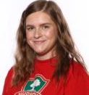
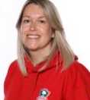
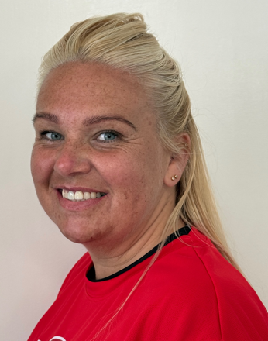
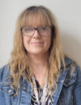
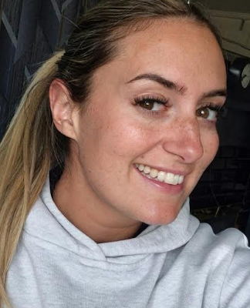
Meet the team…
I am Mrs Garry. I am the TA3 in Elm Class. I lead learning on a Friday.
I am Mrs Williams and I am the class teacher. I work in school Monday- Thursday.
I am Mrs Brown and I am a TA for Elm Class.
I am Miss Sam and I am a TA for Elm Class.
I am Suzanne. I am a Speech & Language Therapist. I work in Elm Class on Thursdays.
I am Miss Woof. I work as a TA in Elm Class on Fridays.

Slide 4
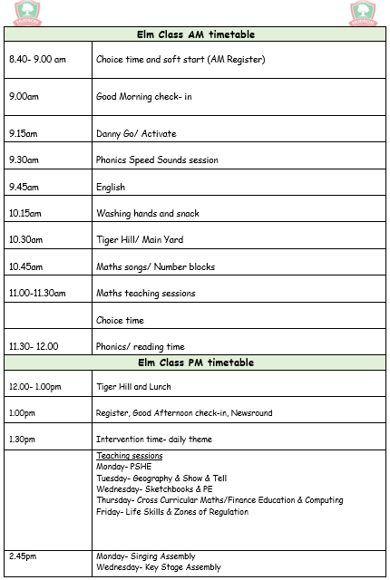
Our daily routine!

Slide 5
Our daily routine!

Slide 6
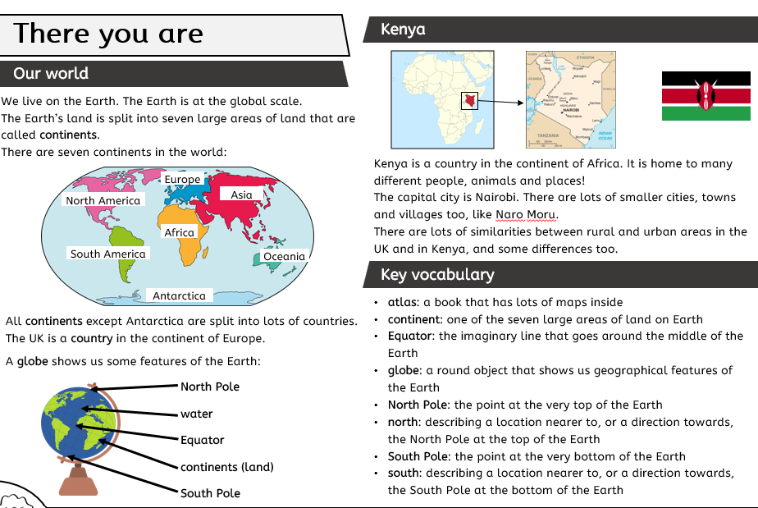
Our Learning Journey Curriculum – Autumn 1-There You Are (Geography)
Everyone Experiences Excellence

Slide 7
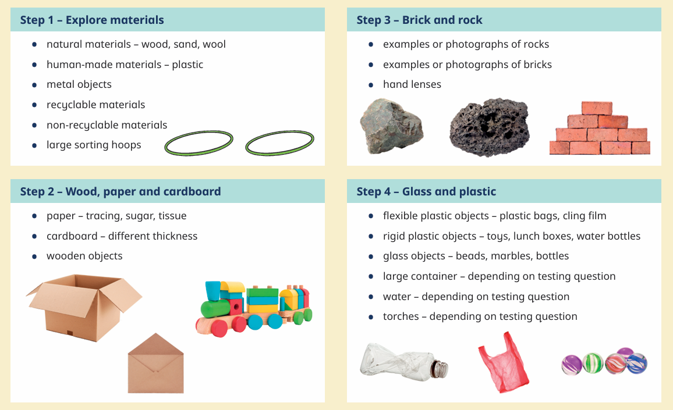
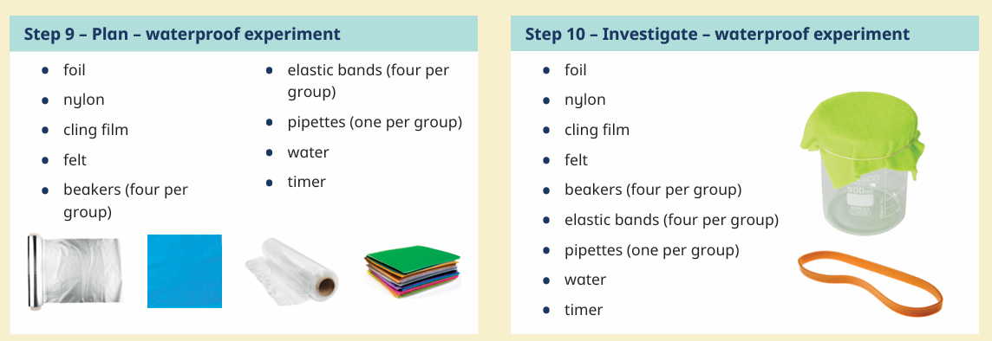
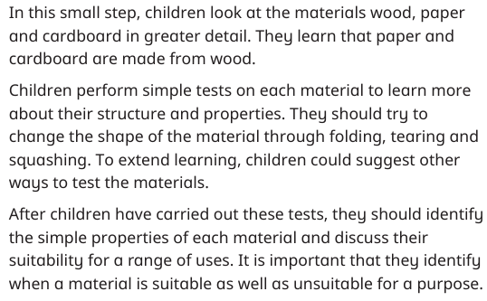
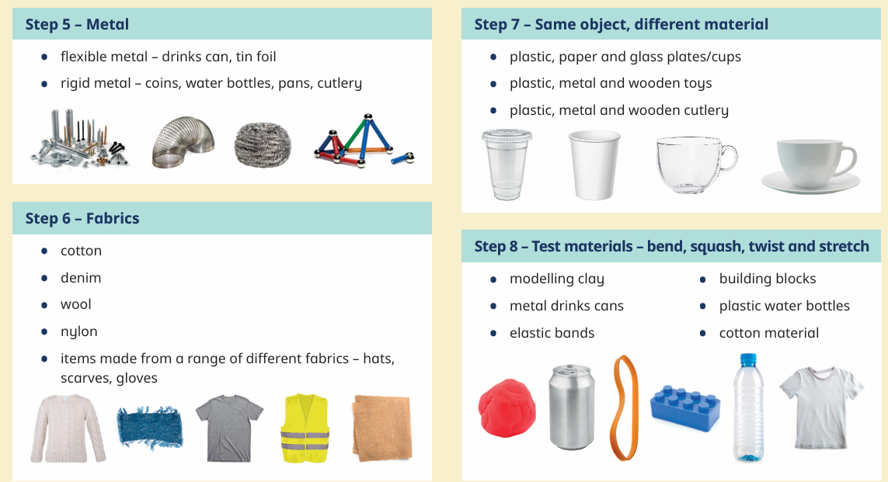
Our Learning Journey Curriculum – Autumn 2-Marvelous Materials (Science)
Everyone Experiences Excellence

Slide 8
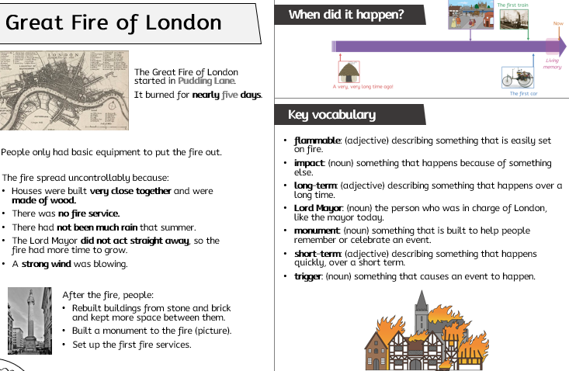
Our Learning Journey Curriculum – Spring 1-The Great Fire of London (History)
Everyone Experiences Excellence

Slide 9
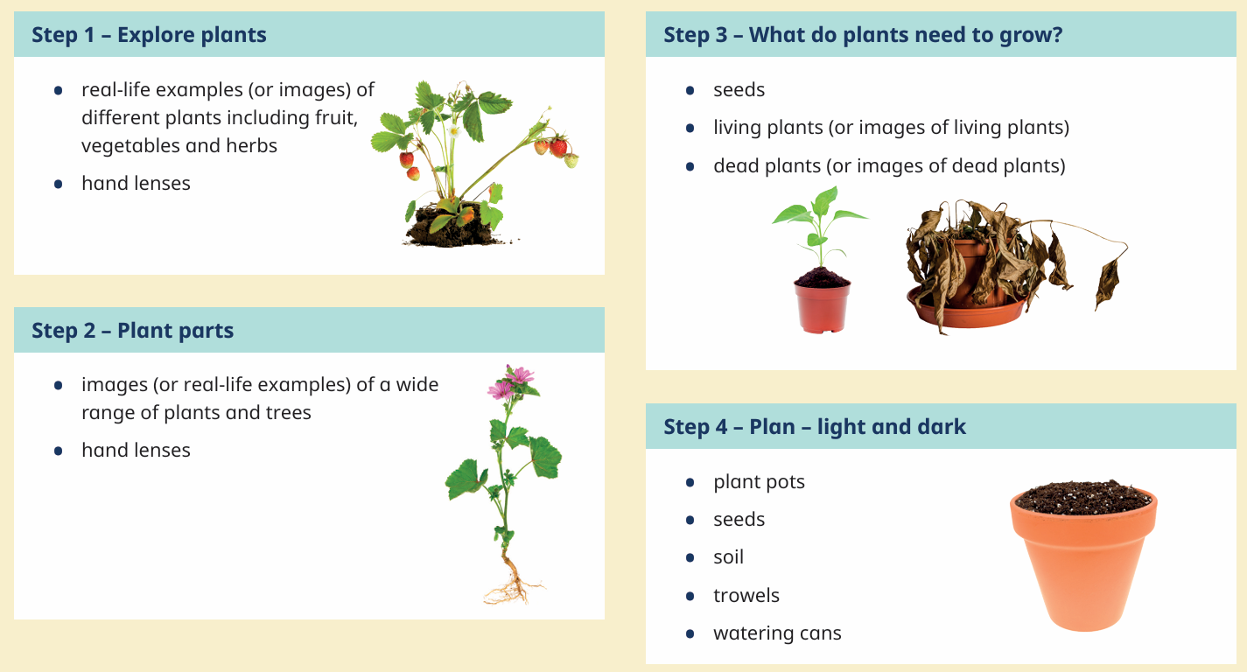
Our Learning Journey Curriculum – Spring 2- Plants (Science)

Slide 10
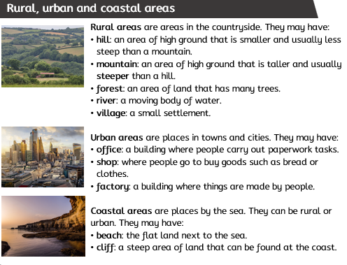
Our Learning Journey Curriculum – Summer 1- Where You Are (Geography)

Slide 11
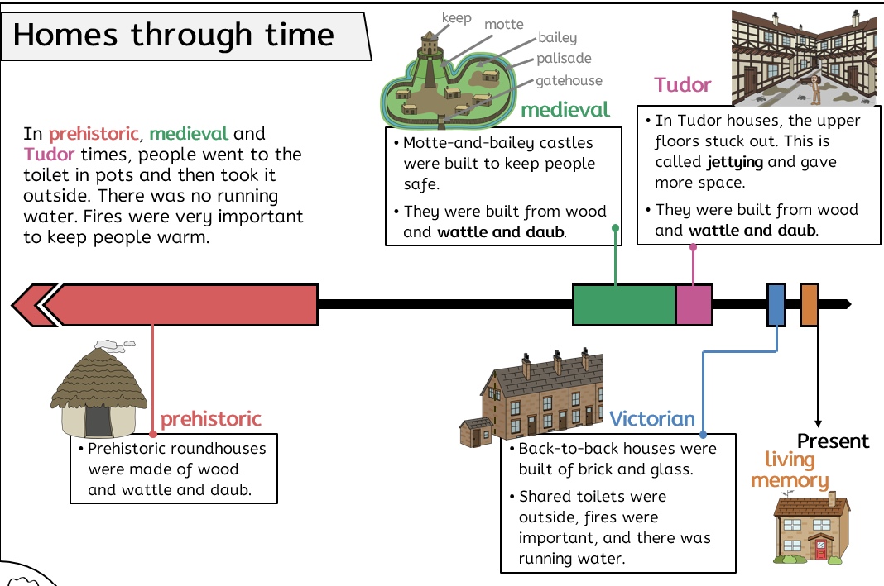
Our Learning Journey Curriculum – Summer 2- Homes Through Time (History)

Slide 12
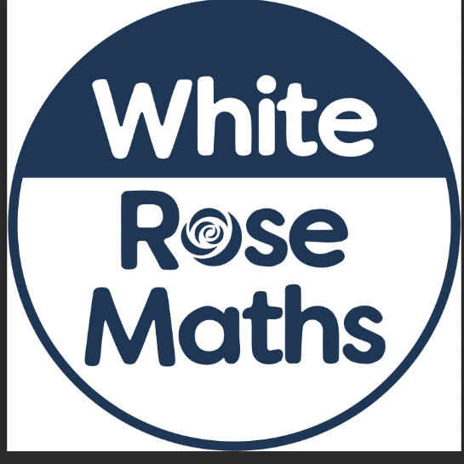
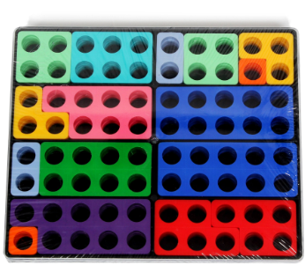
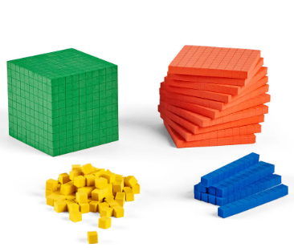
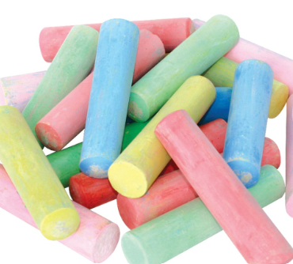

White Rose Maths – Year 2 & 3
Monday, Wednesday & Friday
Flashback 4
Recap
Guided
Independent
Tuesday & Thursday
Messy Maths!
Everyone Experiences Excellence

Slide 13
Rewards
At Hudson we use class dojo to reward the children. The children can earn a dojo for a range of things such as working hard, having a calm classroom, being helpful and outstanding work
Sticker for every 10 points earned!
Children also have a chance to achieve either an Everyone Experiences Excellence award or a Charter Champion award every Friday in assembly
Verbal praise
Recognition

Slide 14
Home Learning
For children on our Read, Write Inc. scheme, they may have a weekly reading book to bring home and read with their families.
Reading for pleasure books- weekly
With support from families, children are invited to share photos/videos with class during our weekly Show & Tell sessions.

Slide 15

Communicating with families
Parents can communicate with school using class dojo.
The app can be downloaded onto all androids and iPhones.
Class dojos are uploaded to show learning
Everyone Experiences Excellence

Slide 16
Things Elm class are looking forward to…
Making new friends
Class trips
School performances
School talent shows

