Slide 1
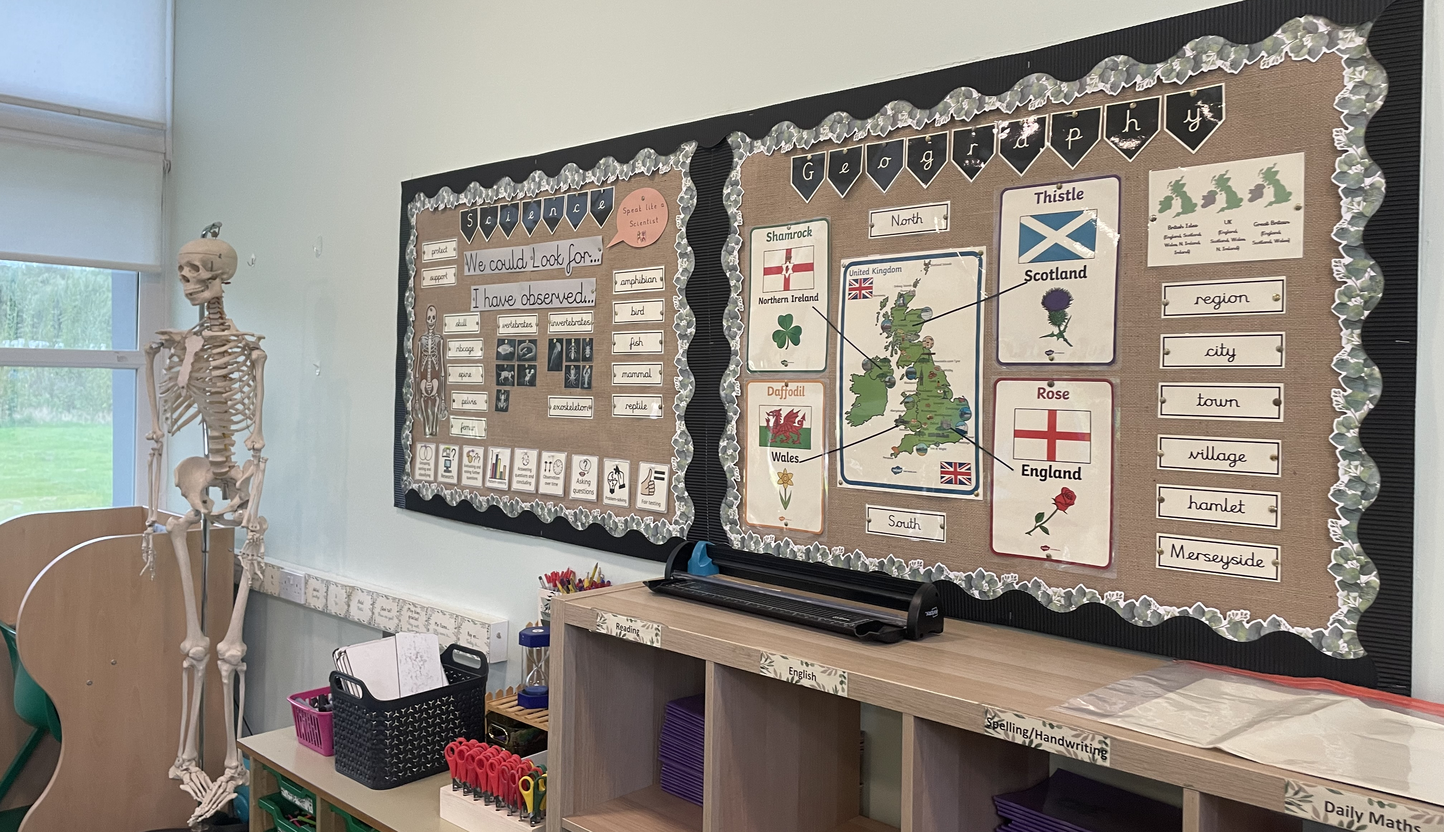
Welcome to the New
School
Year
Everyone Experiences Excellence

Slide 2

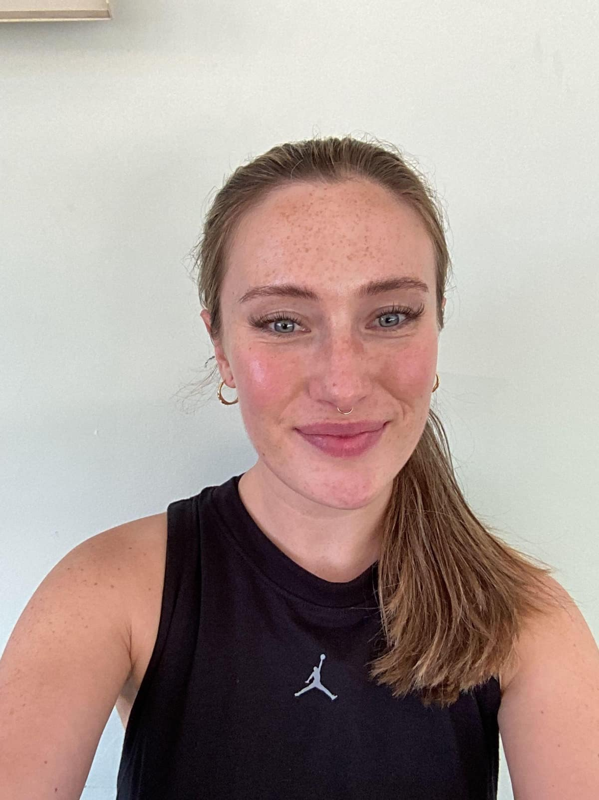
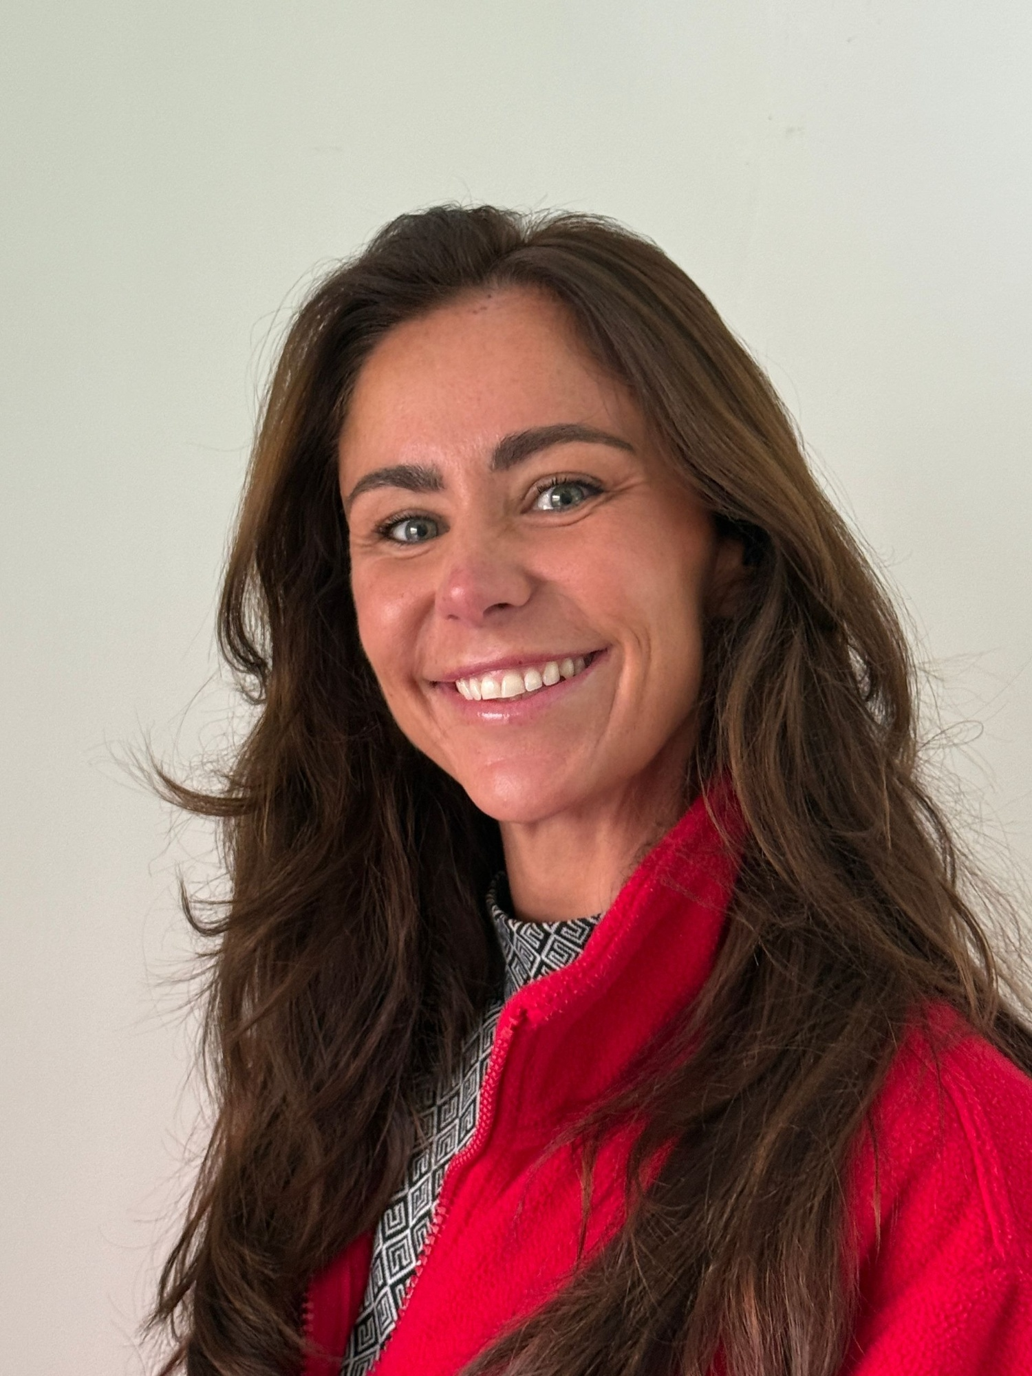
Meet your Chestnut team
Teacher: Mrs Kilpatrick
Learning Support: Mrs McKenna
Additional Support: Miss Parle

Slide 3
In this welcome session we will cover:
The usual routine in class
Our themes and adventures
Settling in information – how the year has gone so far (in general)
Rewards for our wonderful children
Home learning and the expectation of a Hudson parent in this class
Communication with families
The curriculum expectation for the end of year
Things we are looking forward to this year

Slide 4
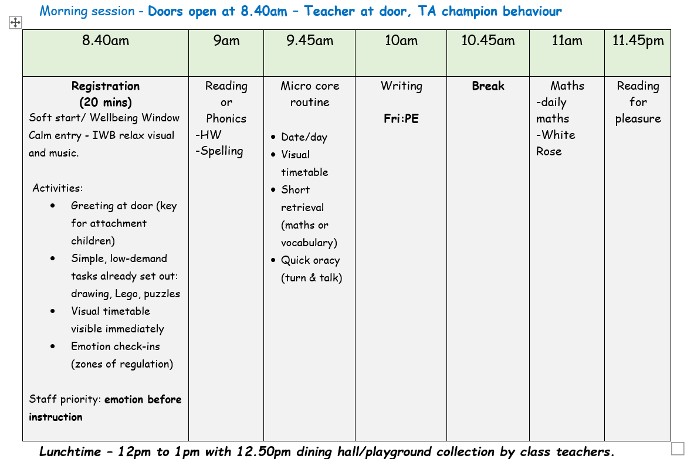
Chestnut Class Routine (AM)

Slide 5
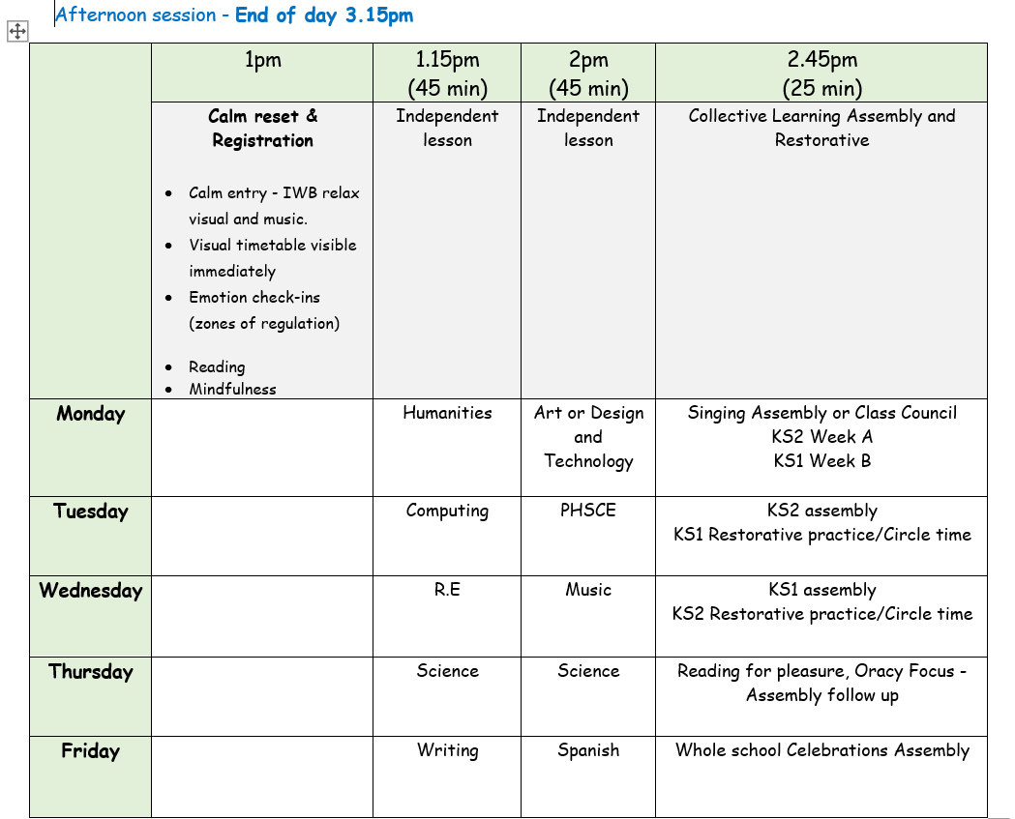
Chestnut Class Routine (PM)

Slide 6








Our English Units

Slide 7
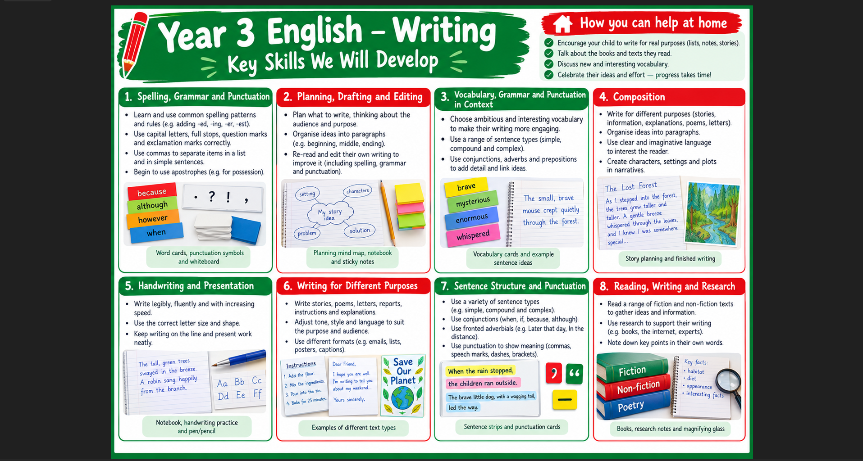
Writing – end of year 3 expectations
  Uses capital letters and full stops to demarcate simple sentences correctly, generally using question marks, exclamation marks and commas for lists without prompting
  Checks for spelling and basic punctuation errors, and suggests alternative vocabulary choices to enhance meaning/description
  Demonstrates attempt to follow plan and organise writing into basic paragraphs, but may add superfluous detail/plot movements

Slide 8



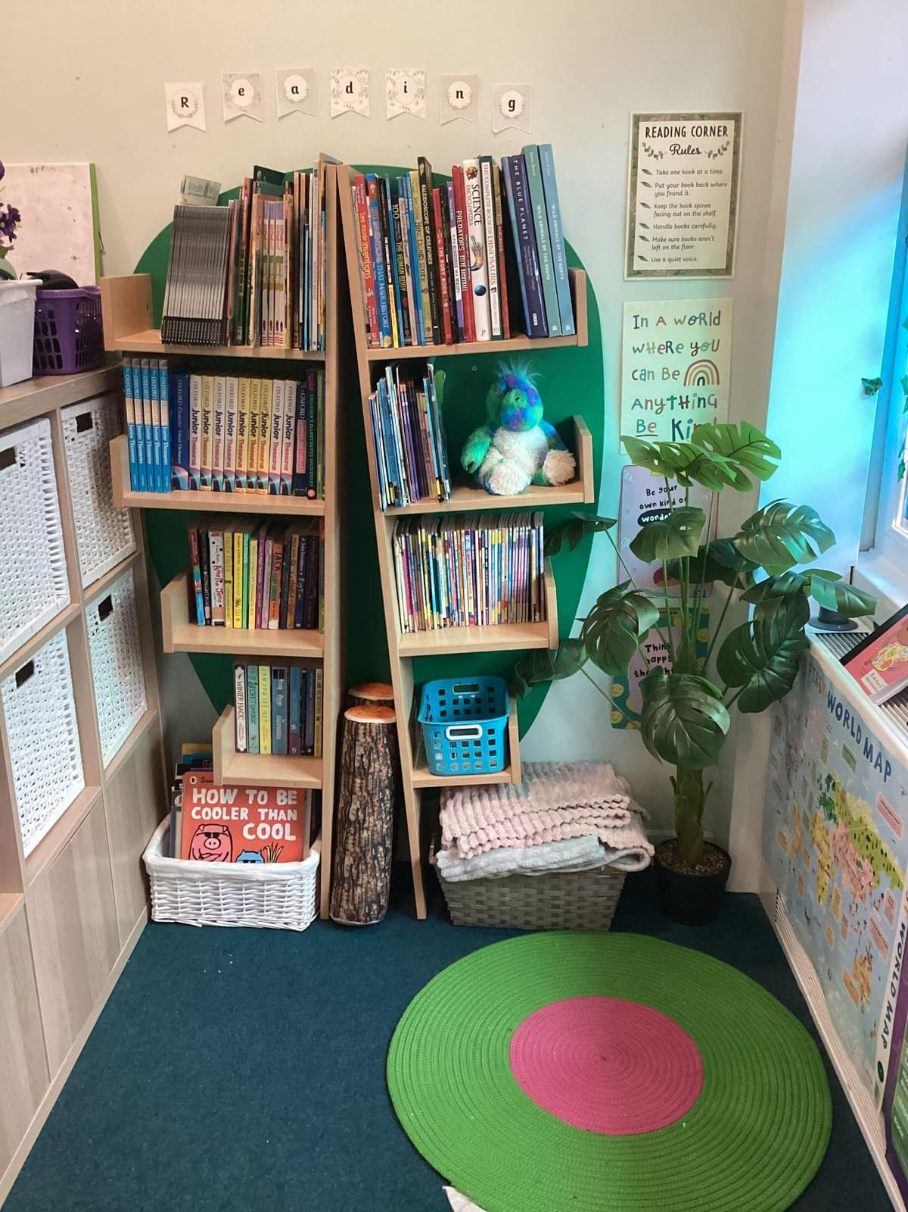



Whole-Class Reading

Slide 9
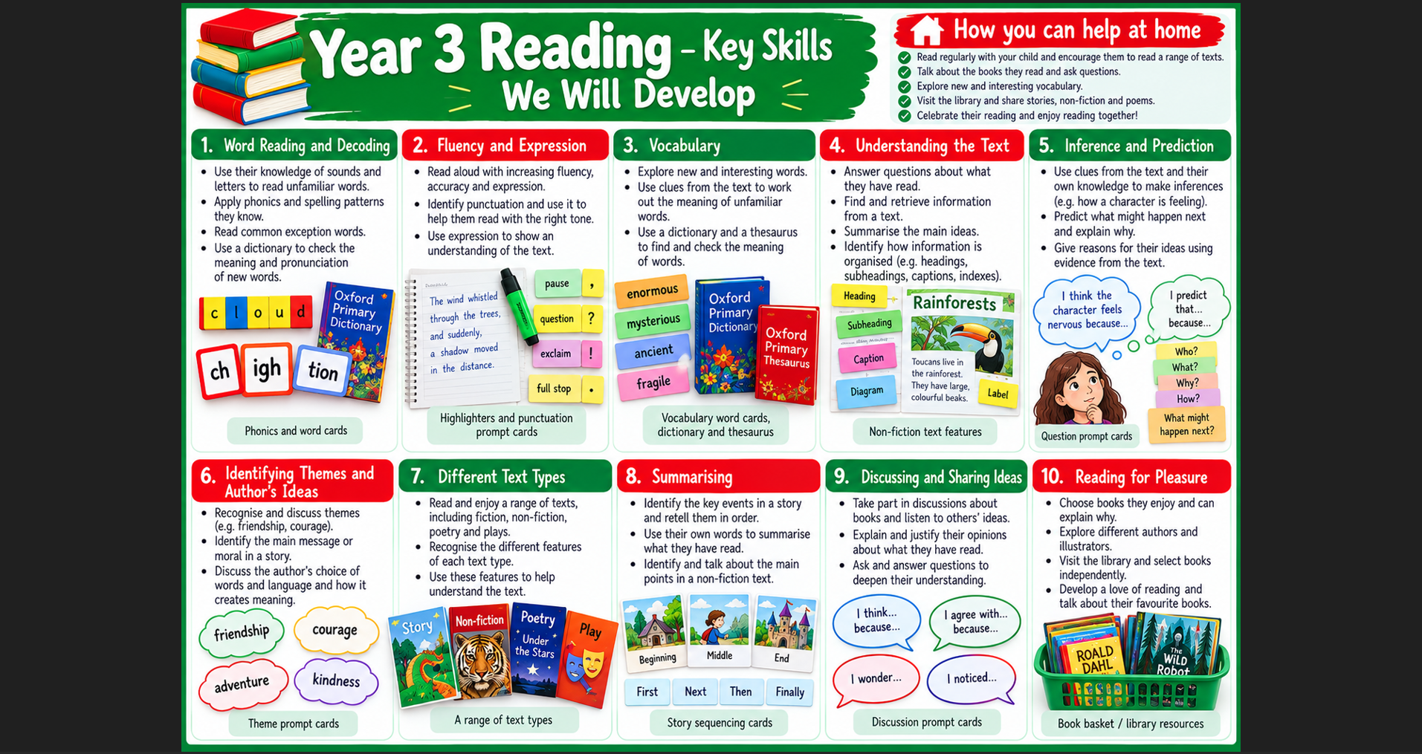
Reading – end of year 3 expectations
  Reads adhering to punctuation, using some appropriate expression when reading dialogue
  Discusses what they have read/heard with others, listening to their opinions and stating their own
  Retells a story orally

Slide 10
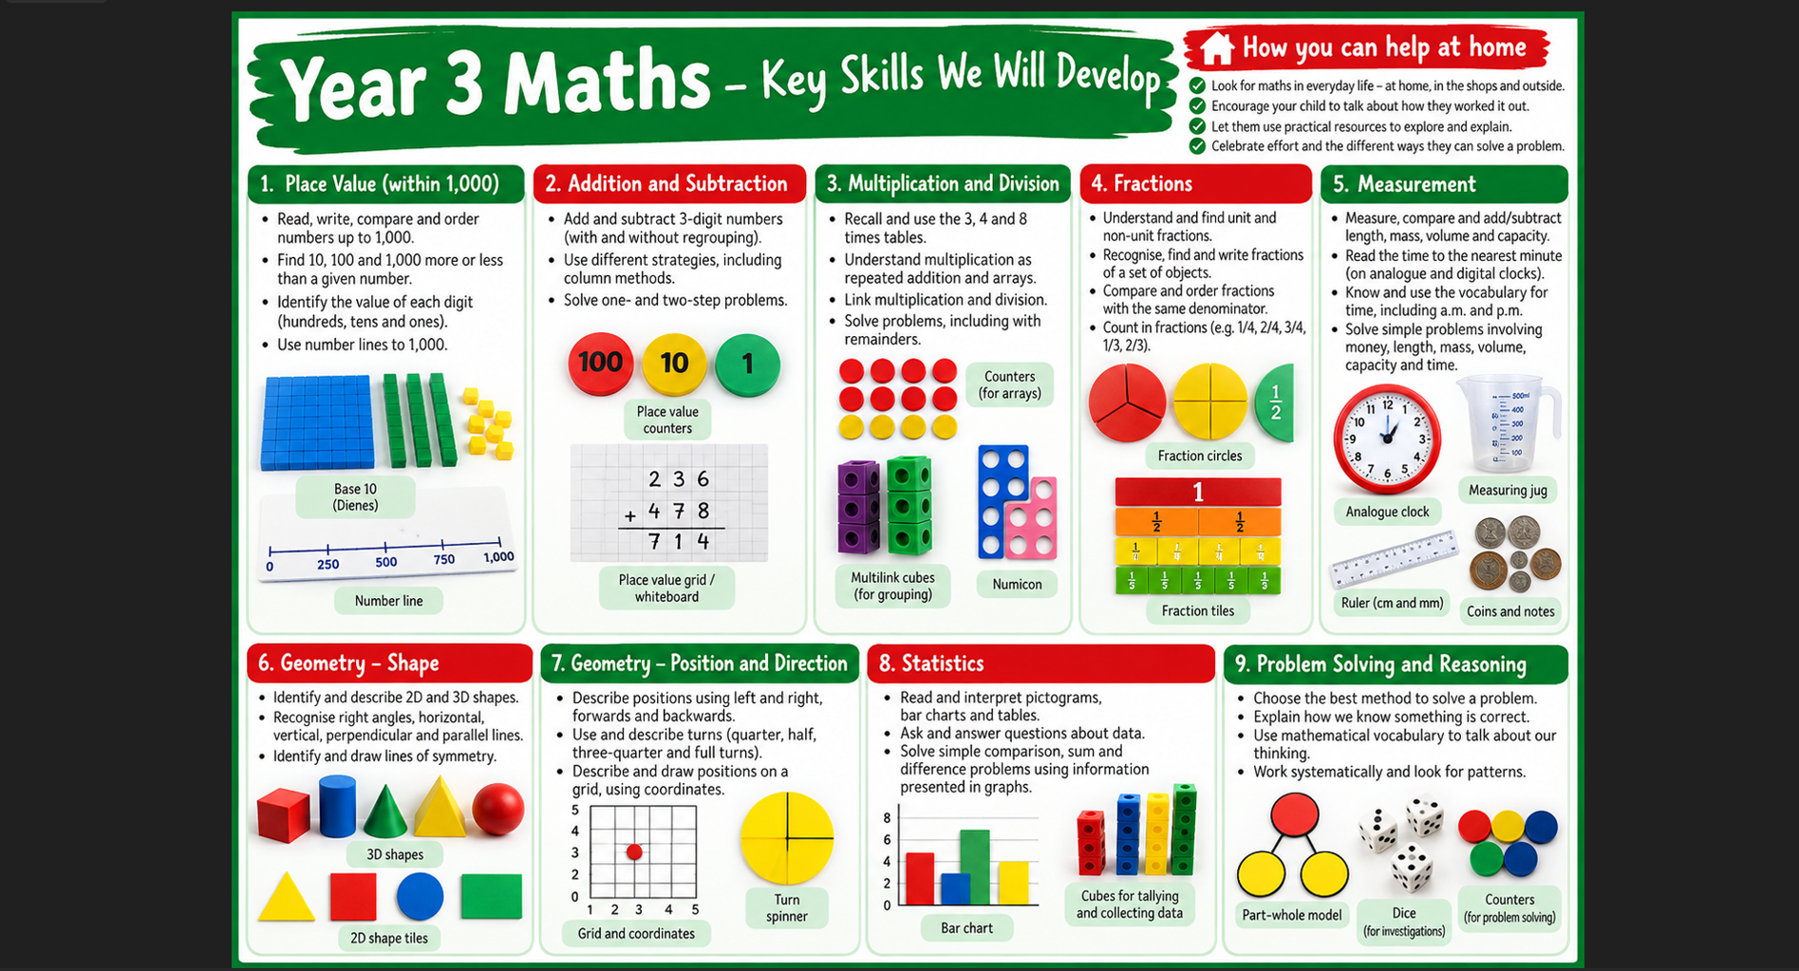

Slide 11

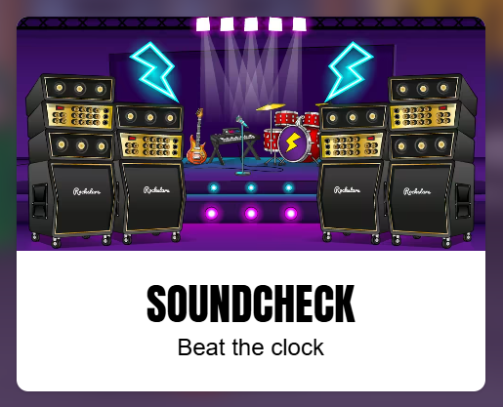
Times Tables in Year 3
Year 3 children should already have a secure knowledge of their 10, 2, and 5 times tables.
Year 3 children should be developing fluency in their 3s.
Year 3 children will develop secure knowledge of their 4s and 8s by the end of year 3.
Why?
Times tables fluency is used throughout the curriculum for mathematics, and the wider curriculum.
It is a life skill.
Less pressure for the MPT in year 4.

Slide 12
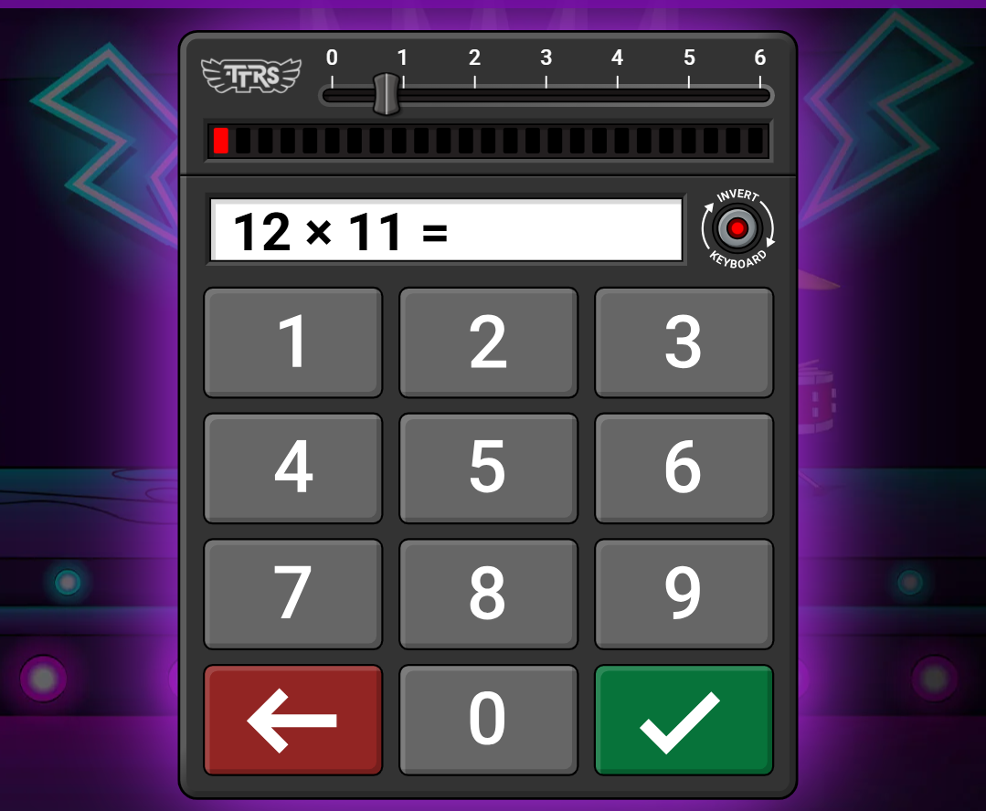
TOP TIP!
Use the ‘Soundcheck’ resource in Times Tables Rockstars, BUT…
DON’T PRESS ENTER

Slide 13

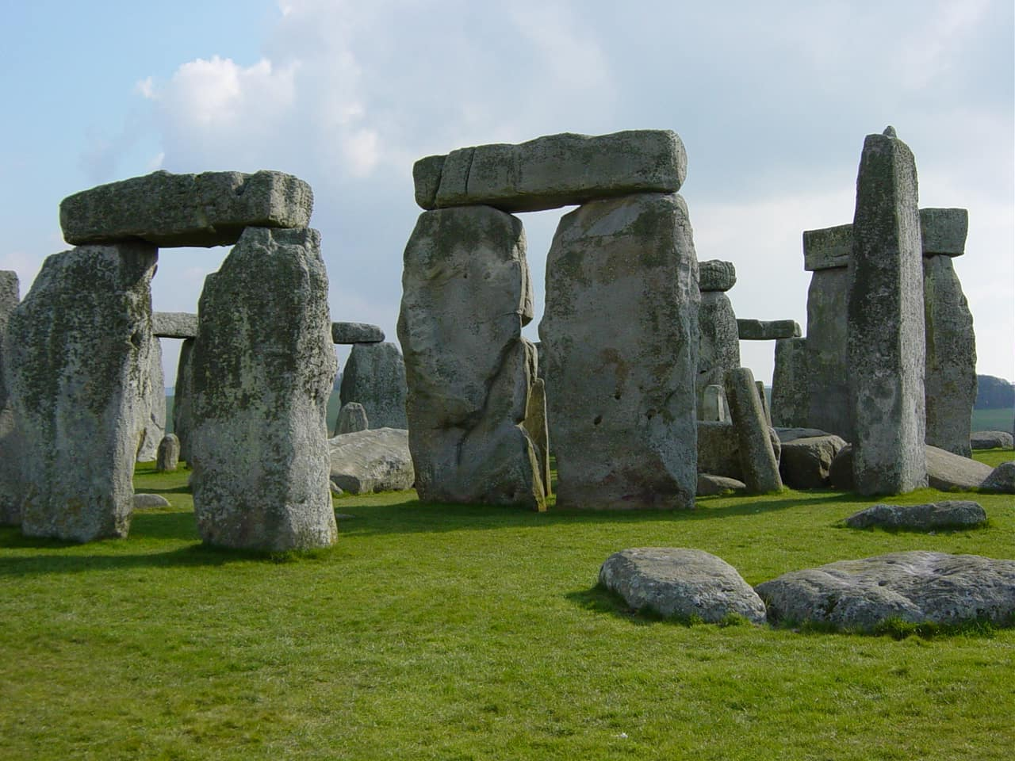
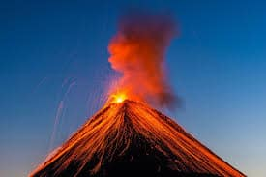
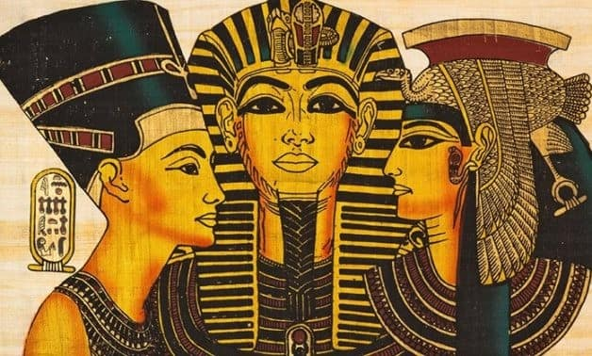
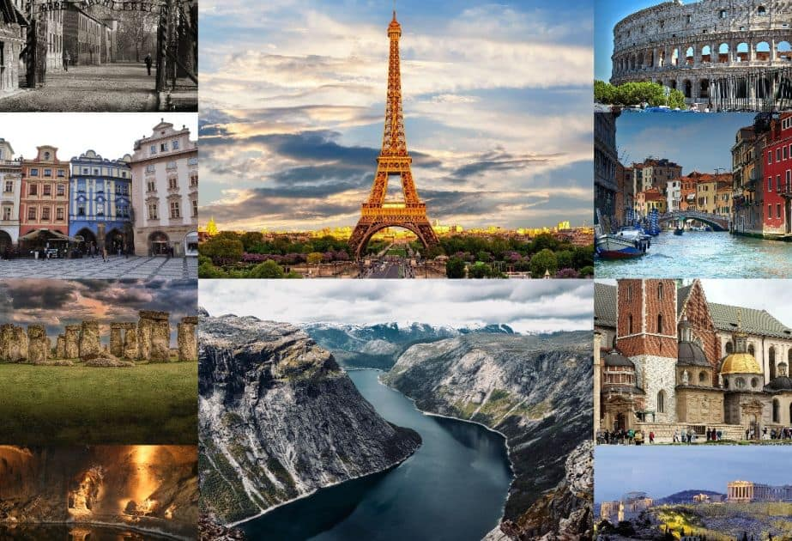

Humanities Projects
Autumn 1 | Autumn 2 | Spring 1
Geography: The United Kingdom | European History: Prehistoric Britain | Geography: Volcanos + Mountains
Spring 2 | Summer 1 | Summer 2
African History: Ancient Egypt | Looking at Europe and Tourism | European History: Ancient Greece

Slide 14
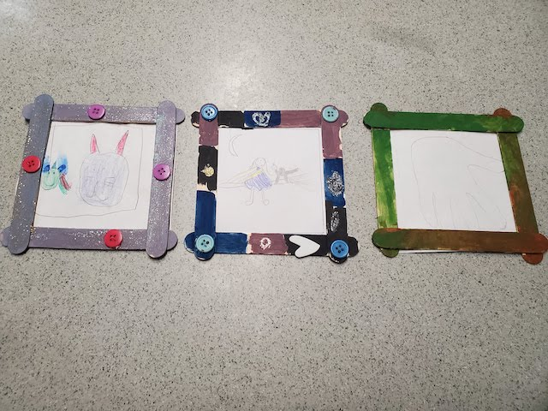
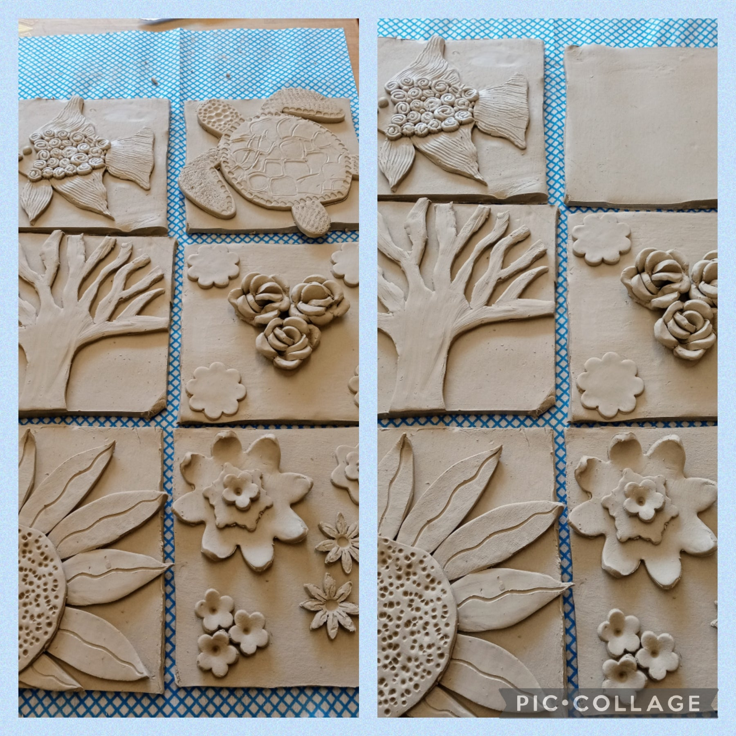
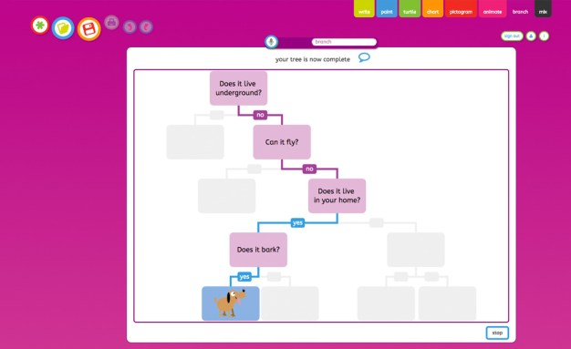

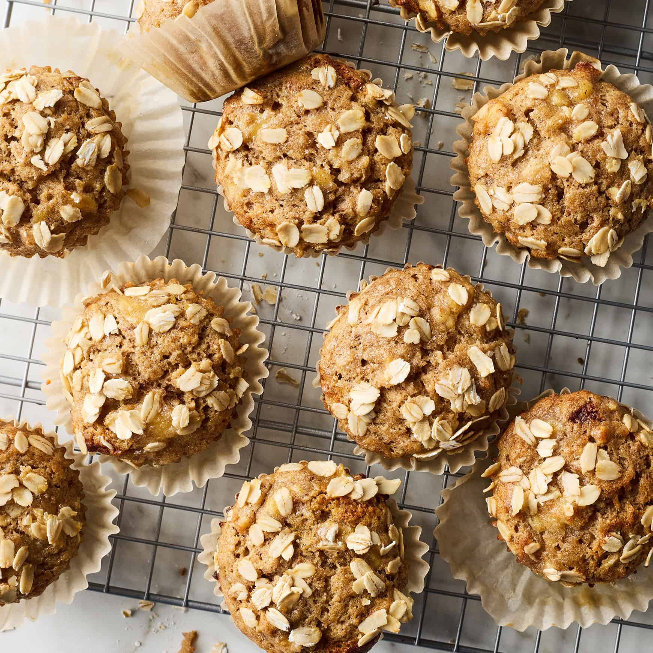
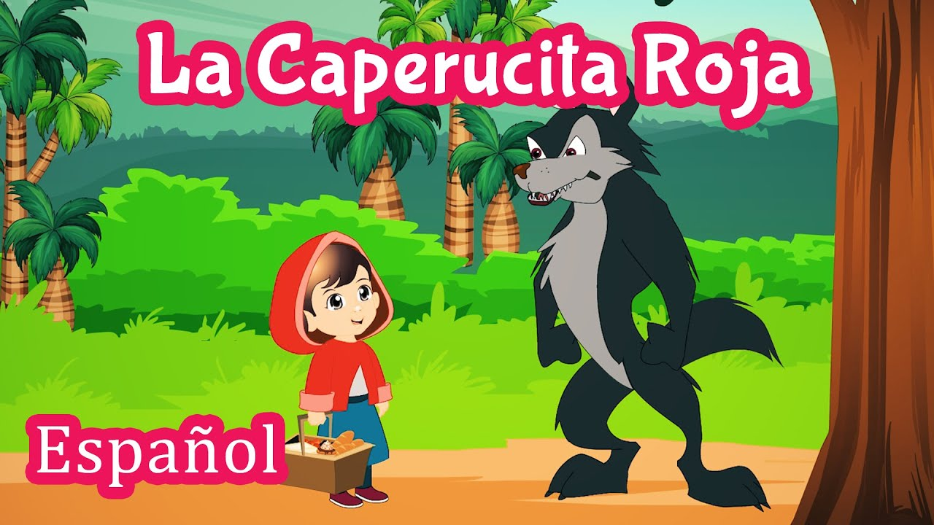

Other Projects/Activities

Slide 15

Behaviour Expectations
READY
Good attendance and punctuality,
Come to school with the correct equipment,
Magnet eyes on the teacher,
Putting your hand up to share your ideas,
Heads down straight away,
Trying your best.
RESPECTFUL
Use your manners,
Ask relevant questions,
Be thoughtful and caring towards others,
Share equipment,
Look after school property,
Tidy up,
Good listening.
SAFE
Follow instructions straight away,
Legendary lining,
Wonderful walking,
Quiet corridors,
Looking for silent signals,
Ask an adult before leaving the room,
Kind hands.

Slide 16
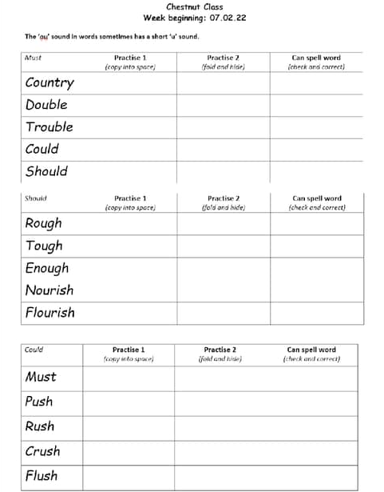




Home Learning

Slide 17
Communicating with families
Parents can communicate through the office for attendance/pick up information.
Dojo is still used to share learning and happy moments!
The app can be downloaded onto all androids and iPhones.
Active hours between 8am-4:30pm
Class dojos are uploaded every week showing some of that week’s learning and homework points.

Slide 18
Questions

