Slide 1


Welcome to the New School Year
Yew Class
2026-2027
Everyone Experiences Excellence

Slide 2
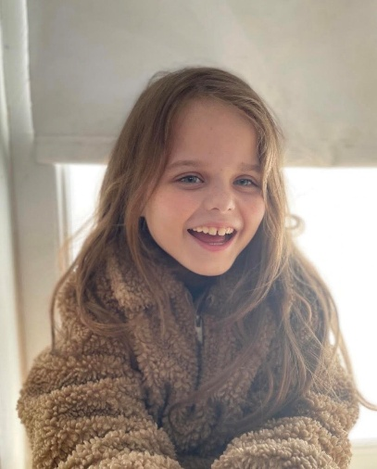
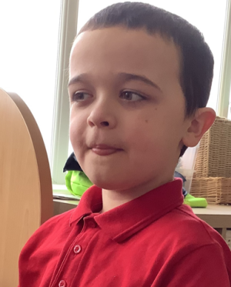
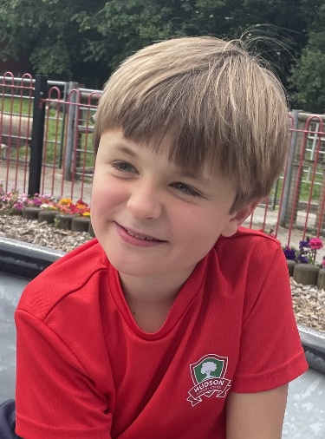
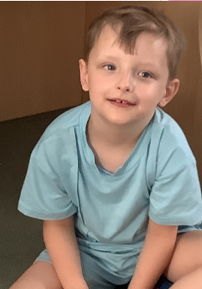
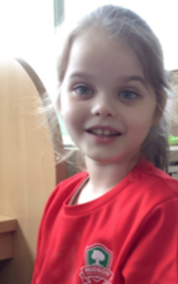
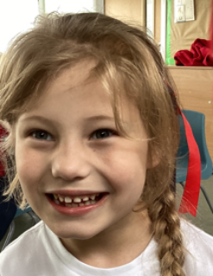
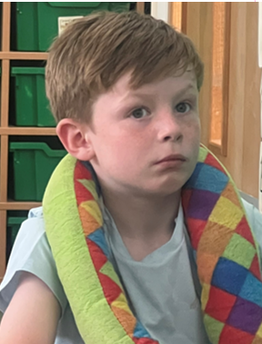
Yew Class 2026-2027

Slide 3

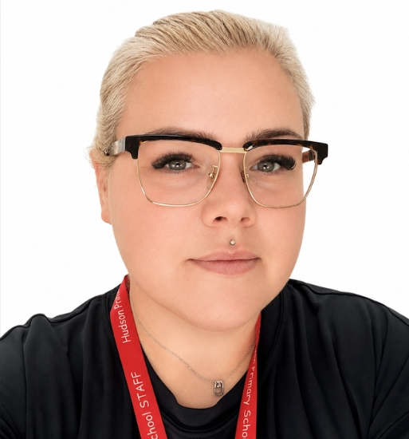
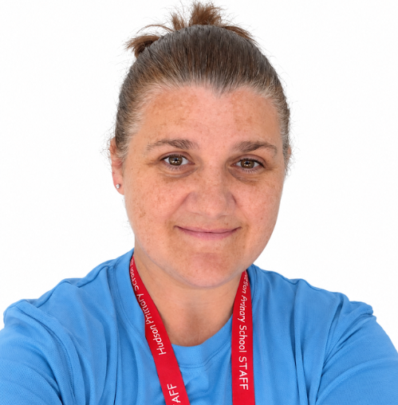
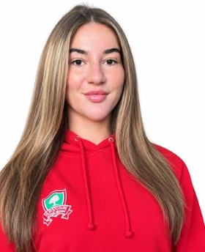
Our Yew Class Team
Mrs Rose Mrs McNally Mrs Duffell
Miss O’Keefe

Slide 4
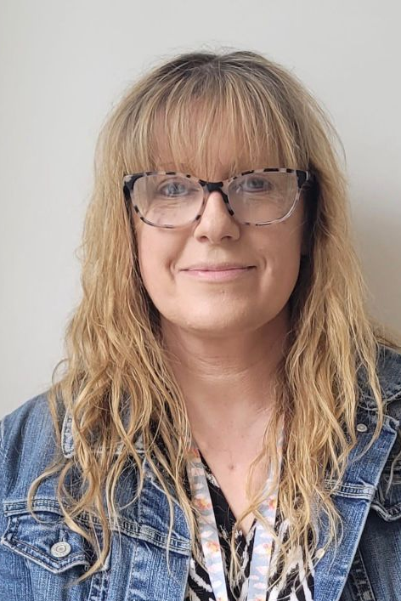
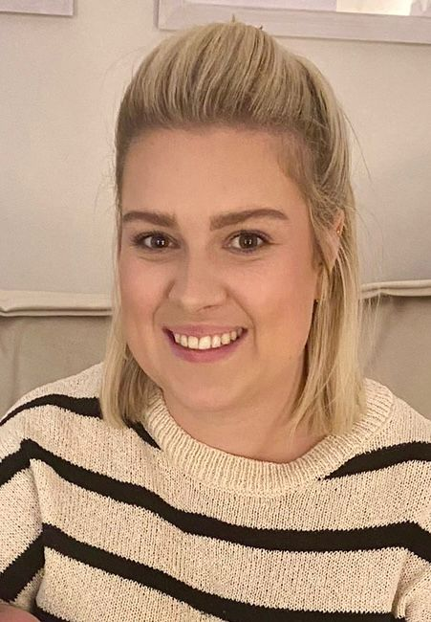

Speech and Language
Suzanne Laura

Slide 5


Slide 6
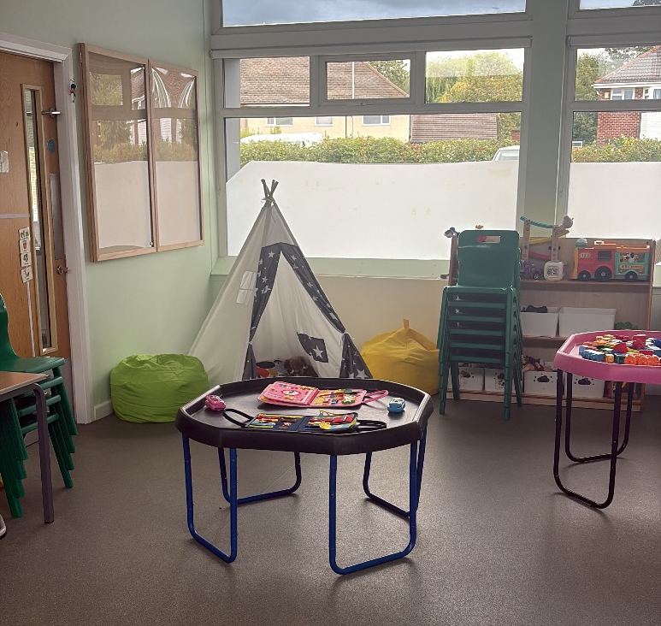
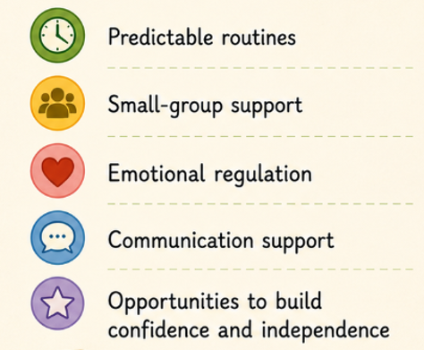
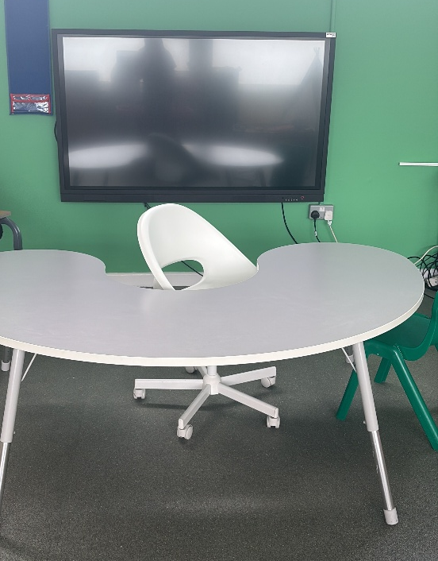
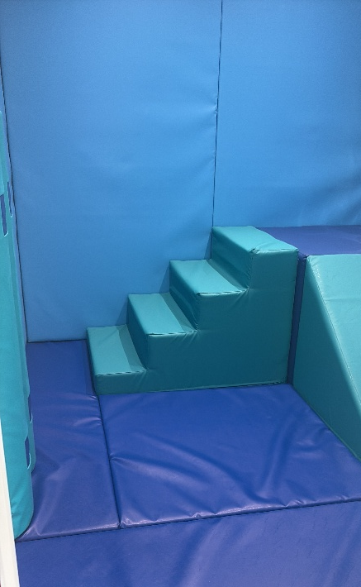
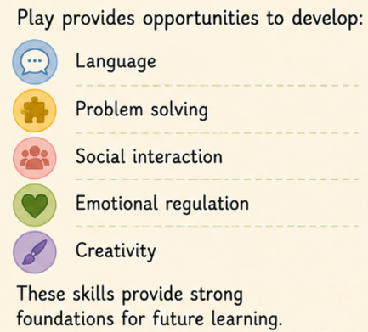
Our Classroom

Slide 7
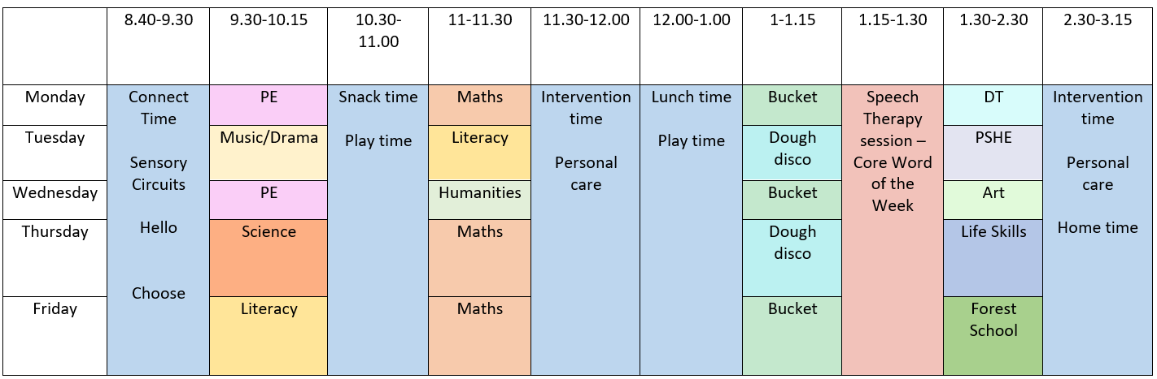
Hudson Primary School
Yew Class Timetable 2026-2027

Slide 8

Curriculum

Slide 9
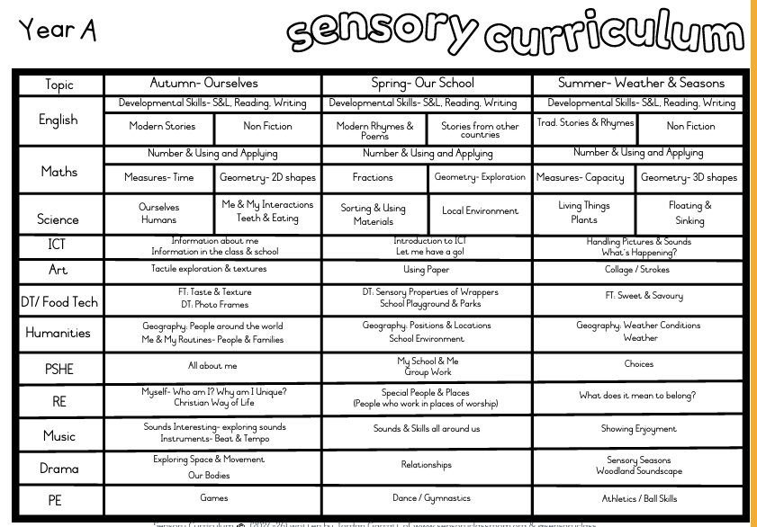
Curriculum

Slide 10
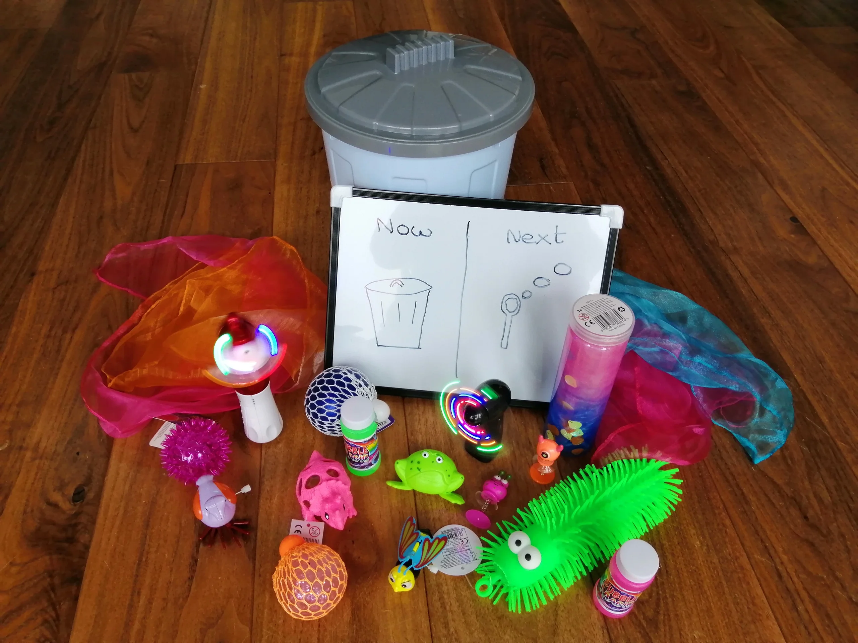
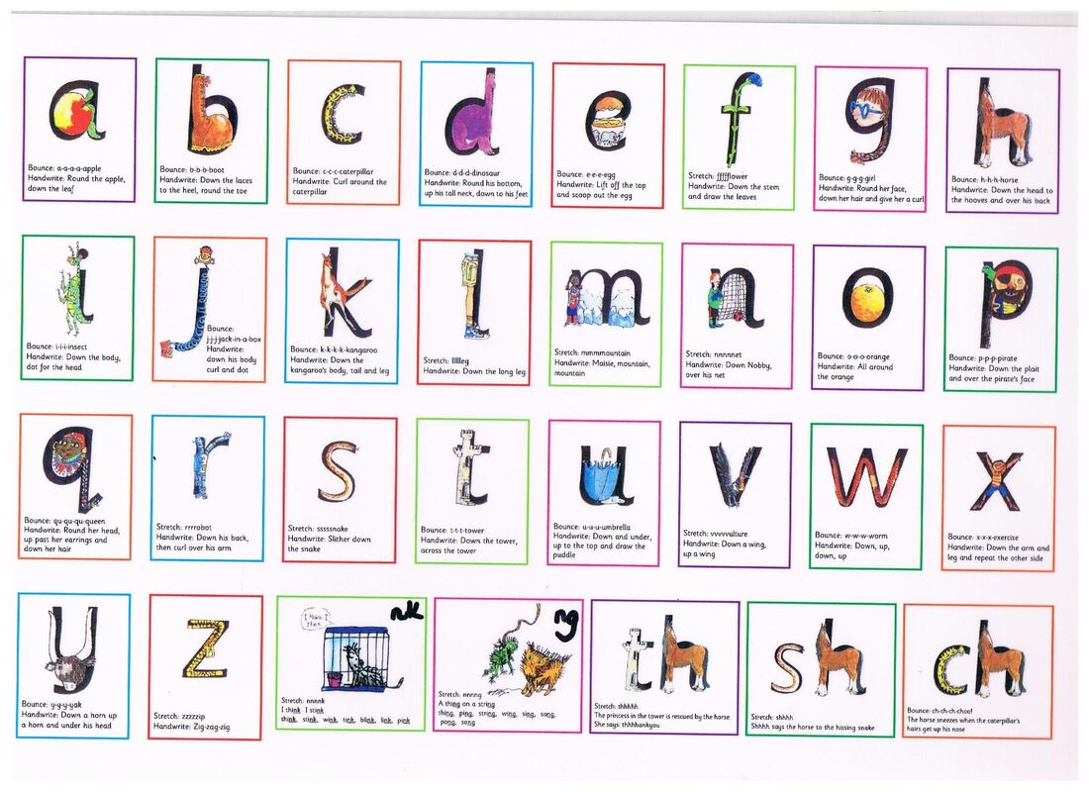
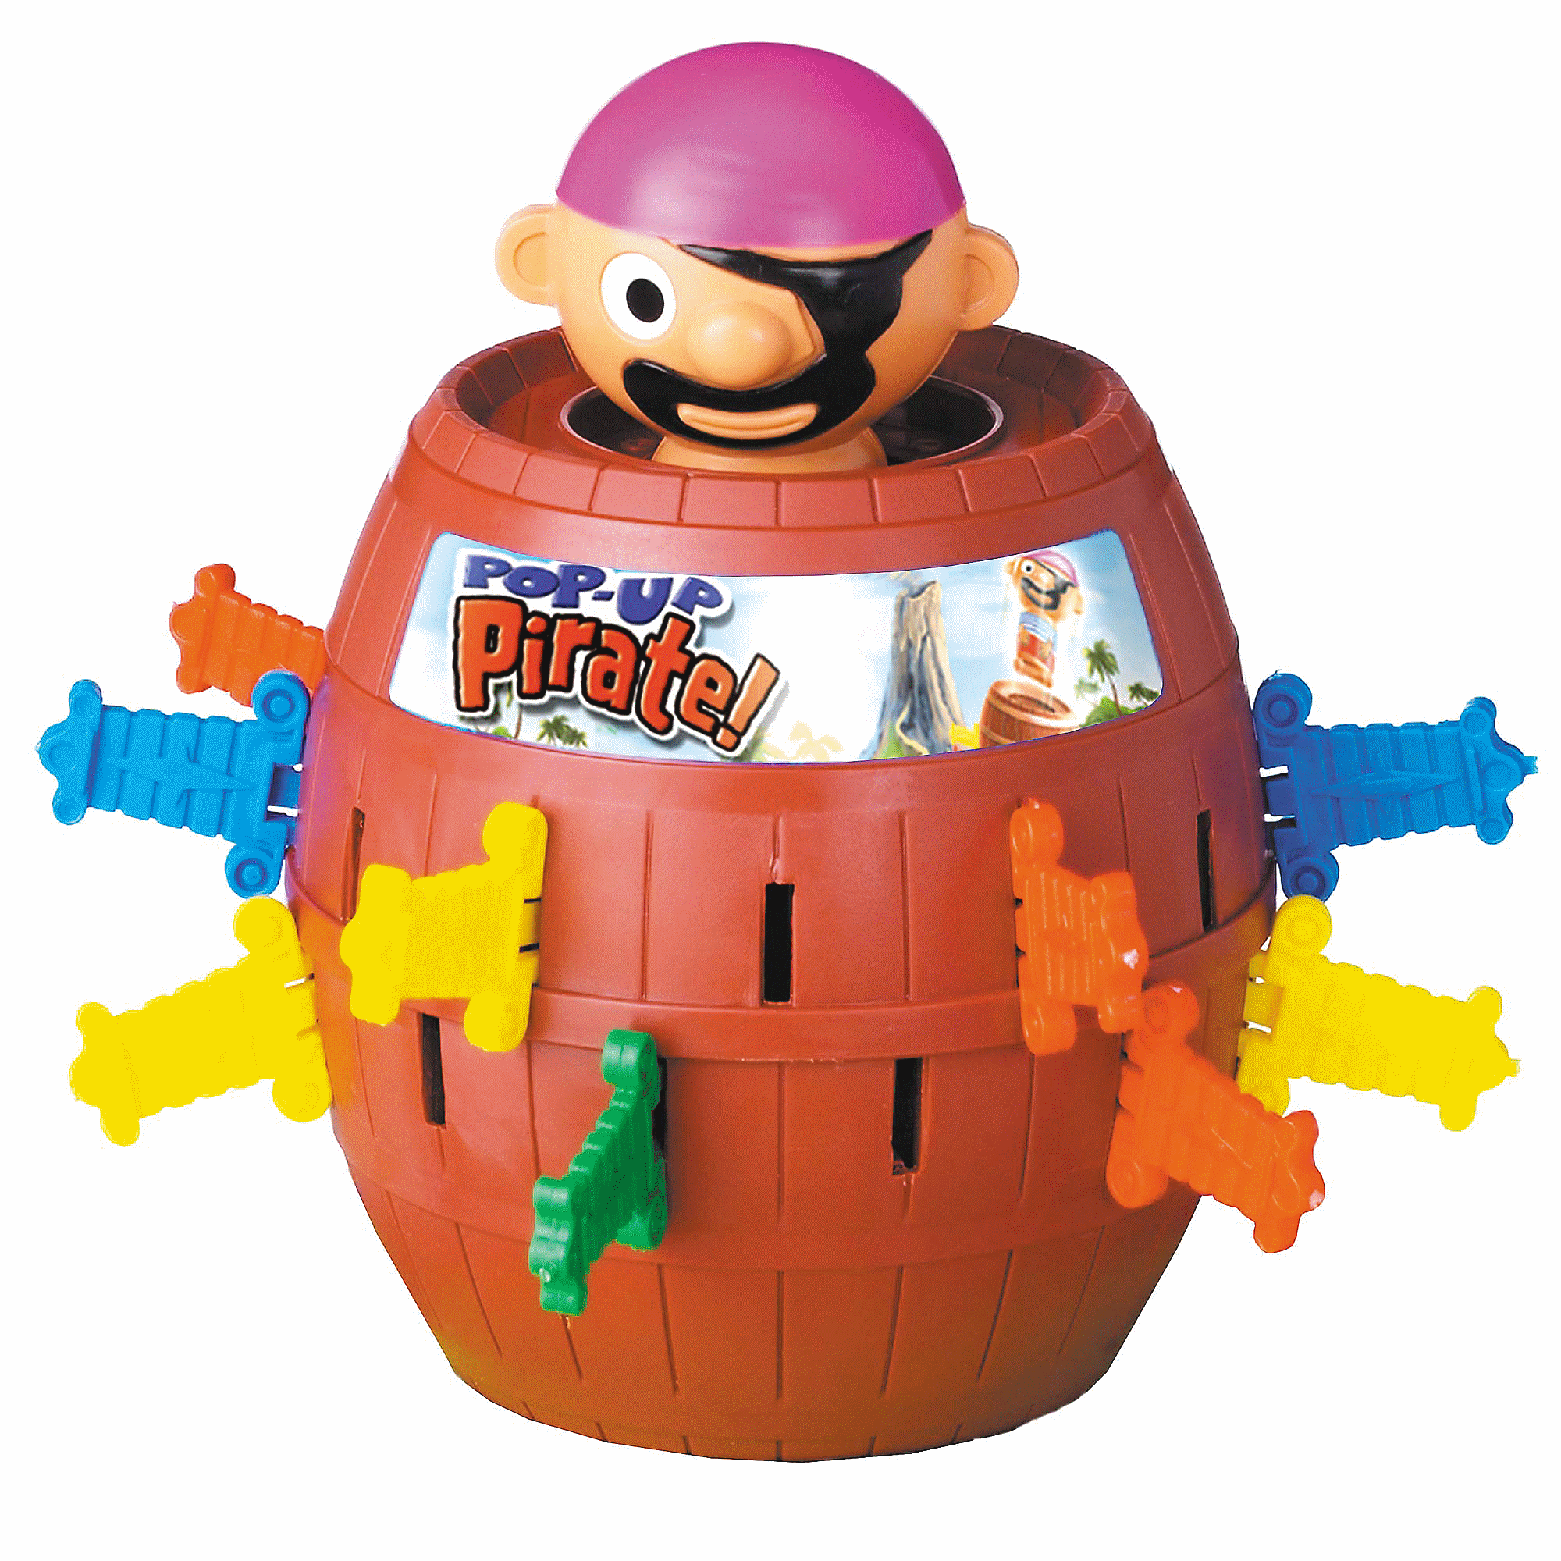
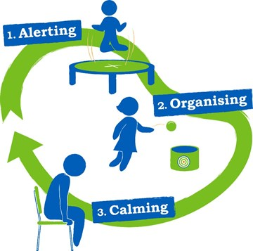

Interventions

Slide 11




School Trips

Slide 12
Uniform
Please label EVERYTHING!
Boys
Hudson jumper
Red polo shirt
Grey trousers
Dark socks
Black shoes
Girls
Hudson cardigan/jumper
Red polo shirt
Grey skirt/ trousers
Dark socks or tights
Black shoes
PE Kit
Hudson Red PE t-shirt
Navy shorts
Black pumps
Forest School Kit
Wellies
Puddle suits
Change of clothes
Items containing a school logo can be purchased from ‘Sefton Schoolwear’ on Dover Road.

Slide 13
Useful Information
Uniform - Wellies are also required for children's outdoor play and a set of spare clothes please.
PE – Please can your children arrive at school in their kit. Navy shorts/tracksuit pants, red t-shirt, black pumps.
Snack – School fruit or bring your own snack. (This can include toast – please send in bread/bagels and butter).
Water bottles - Labelled. These must be washed and refilled at home.
If your child wears nappies, please send in wipes for your child weekly. If your child needs more nappies we will let you know via Dojo.

Slide 14
Useful Information
Medical forms must be completed and we must be aware of any changes.
If medication is required during school hours then a “permission to administer medication” must also be filled in at the school office.
Within each class there is a ‘grab bag’ which contains first aid equipment and children’s personal necessities too e.g. inhalers.

Slide 15
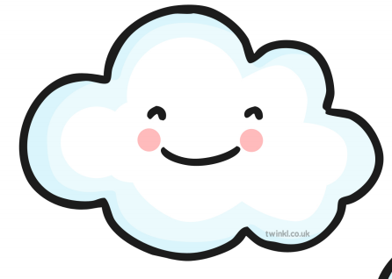
Home Learning
Learning Journey Homework – Posted on Dojo. Activities to enjoy together at home, based on our school topics.
Reading for pleasure books go home on Fridays. We love sharing stories in class and this is an opportunity for you to do this at home too ☺
Proud Cloud
A proud cloud is a way of sharing your child's achievements at home with us in school. Whatever your child has done, no matter how small, it is an achievement that you are proud of and we want to share that with everyone in class.
Achievements can be about learning to do something for the first time, being brave, being kind to family and friends. They can also be something achieved any out of school activity.
You can send a Proud Cloud into school at any time – These can be sent via Class Dojo, it may be something that your child has written, a drawing or photos! Send in any achievements and we will put them on our Proud Cloud.

Slide 16
Teams!
Johnson Thompson
Jonas
Boardman
Farrell

Slide 17

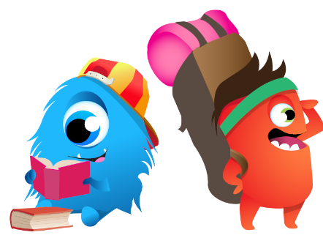
Rewards
Attendance
Good work in a lesson
Good behaviour in a lesson
Being a good friend
Homework
Stickers
Certificates
Stars of the week
Reward for behaviour in corridor
Reward for behaviour in assembly
Reward for behaviour at lunchtime
Reward for behaviour in playground

Slide 18

Communicating with families
Parents can communicate using our front office, you can contact the office either by email using the following email address:
enquiries@hudsonprimary.co.uk
Or by telephone on the following number:
0151 526 1568
Hudson Primary School is a cashless school and all charges and payment go via ParentPay. Our families new to Hudson Primary School will be given a login in September.

Slide 19

Any questions?

