Slide 1



Welcome to the New School Year
Holly Class
Nurture Class of 2023-24
Everyone Experiences Excellence

Slide 2
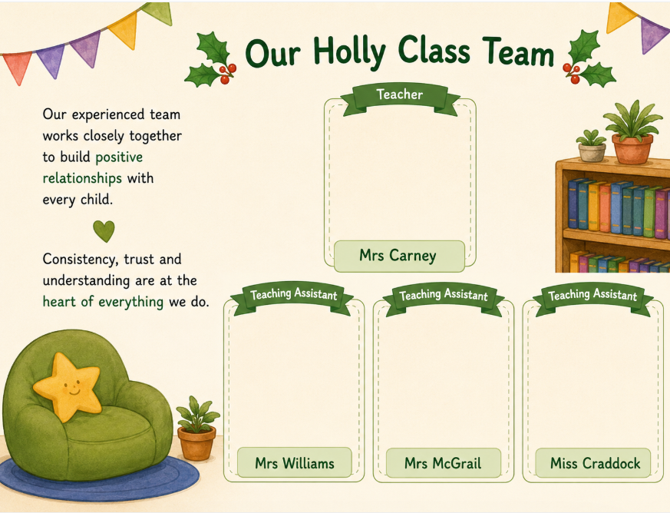

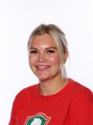


Our Holly Class Team
Mrs Spafford
Class Teacher
Mrs Williams
Teaching Assistant
Mrs McGrail
Teaching Assistant

Slide 3
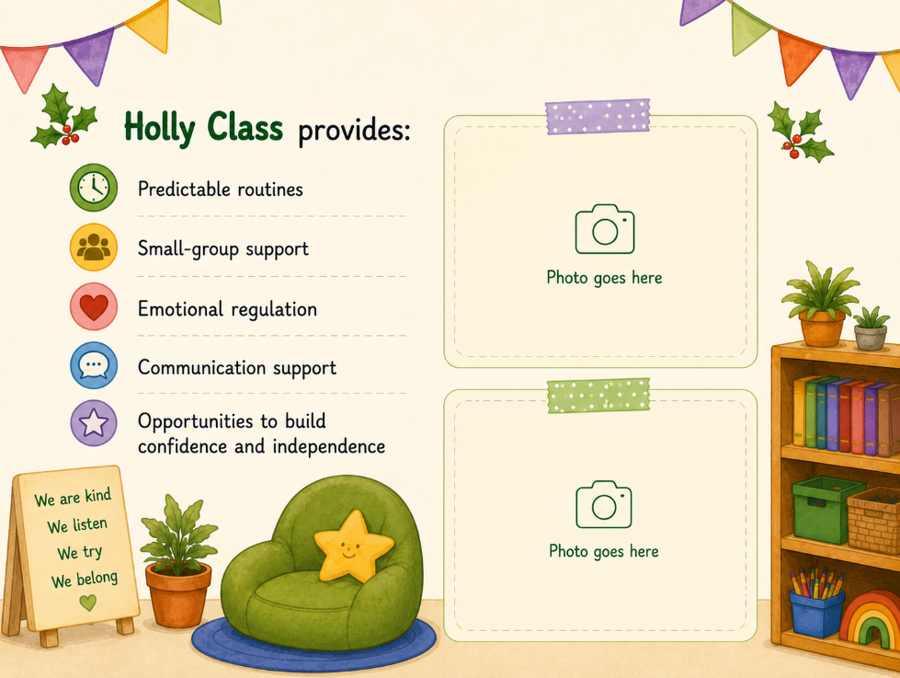
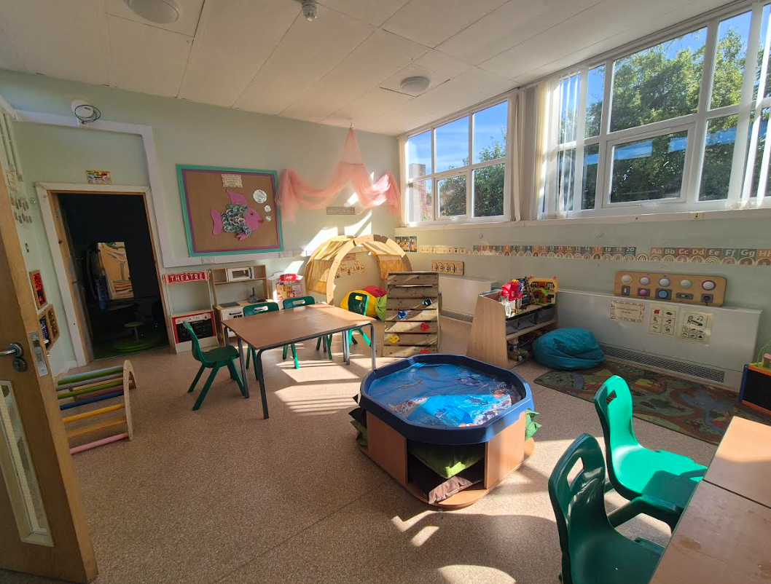
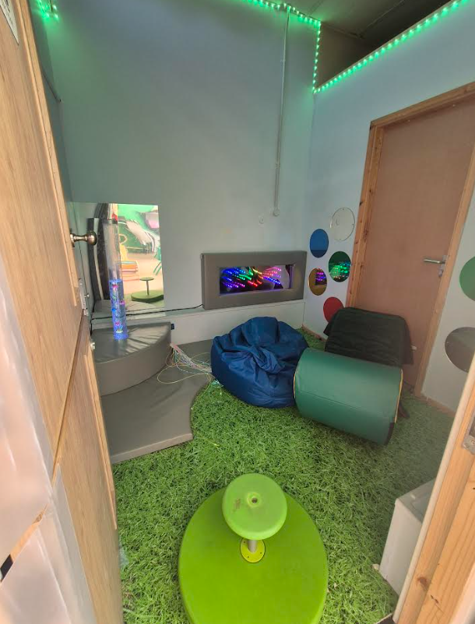


Slide 4


Hudson Primary School
Holly Class Timetable 2023 – 2024

Slide 5
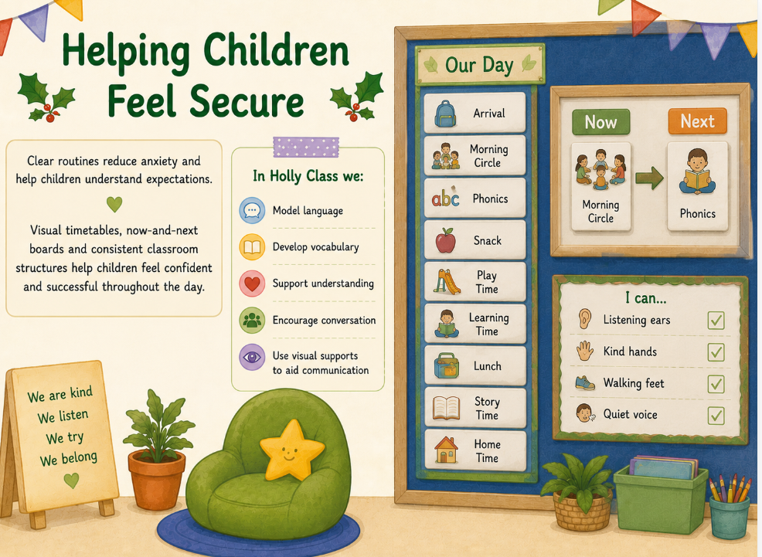
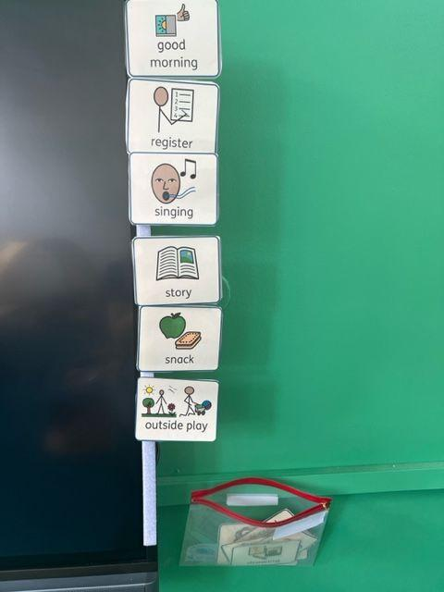
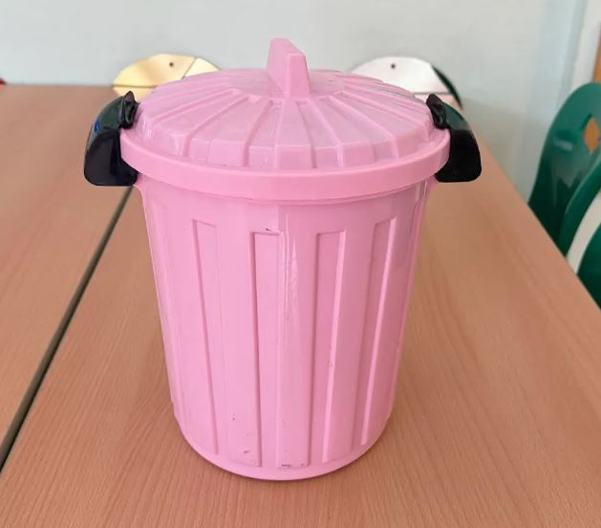
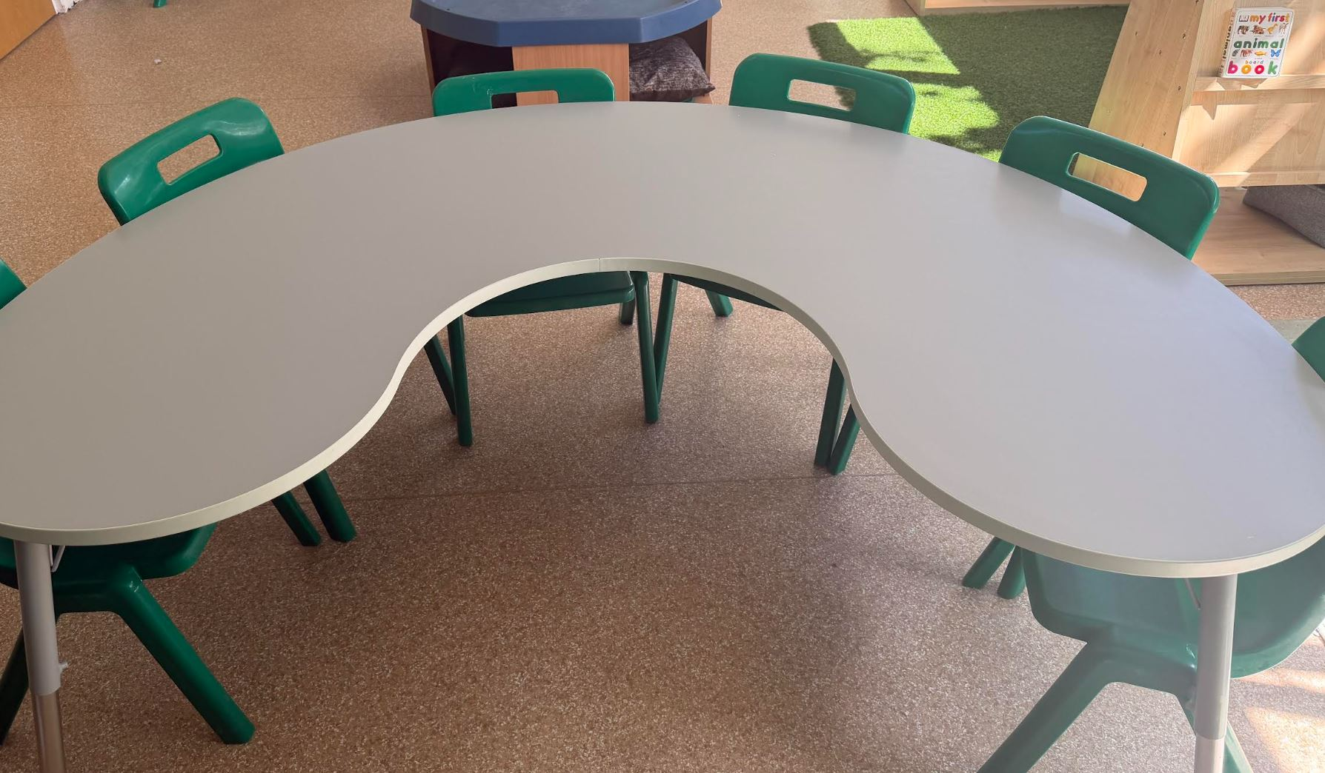
Arch Way

Slide 6
Yearly overview

Slide 7
School trips

Slide 8
Uniform
Please label EVERYTHING!
Girls
Hudson cardigan/jumper
Red polo shirt
Grey skirt/ trousers
Dark socks or tights
Black shoes
Boys
Hudson jumper
Red polo shirt
Grey trousers
Dark socks
Black shoes
PE Kit
Hudson Red PE t-shirt
Navy shorts
Black pumps
Items containing a school logo can be purchased from ‘Sefton Schoolwear’ on Dover Road.

Slide 9
Forest School Kit
Kit List
Warm thick socks
Long Trousers
Layers for the top of the body:
T-shirt & Long armed top
Fleece
Waterproof Coat
Long trousers (plus waterproof trousers if possible)
Hats, gloves, scarf in cold weather/ or sunhat in sunny weather
Wellingtons are best (No sandals please!)
Long armed tops and long pants are needed in all weather to protect your child from the woodland environment.
Forest School Day:
Your child comes into school wearing their Forest School Kit with trainers or pumps to wear in the morning and their boots to change into.
If you have any problems providing any items on the kit list then please see the class teacher.
Activities:
Environmental art
Shelter building
Story telling
Playing games
Plant identification
Outdoor cooking

Slide 10
Useful Information
Uniform - Wellies are also required for children's outdoor play and a set of spare clothes please.
PE – Our PE day is on a Thursday – Please can your children arrive at school in their kit. Navy shorts, red t-shirt, black pumps.
Hot dinners are free for ALL Reception children (menus are available)
Packed lunches - Please ensure you promote healthy eating for your child ☺
Snack – School fruit or bring your own healthy snack.
Water bottles - Labelled. These must be washed and refilled at home.
If your child wears nappies, please bring in a pack of nappies and wipes to leave in our changing area.

Slide 11
Useful Information
Medical forms must be completed and we must be aware of any changes.
If medication is required during school hours then a “permission to administer medication” must also be filled in at the school office.
Within each class there is a ‘grab bag’ which contains first aid equipment and children’s personal necessities too E.g. inhalers.
Homework - Once a week (Handed out on Fridays, returned the following Tuesday).

Slide 12
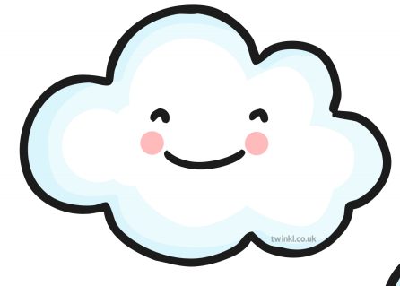
Home Learning
New homework is set each Friday, and will be based on the learning children are doing in class – the tasks set will be fun, creative and engaging. Please can homework be handed back in on a Tuesday.
Proud Cloud
A proud cloud is a way of sharing your child's achievements at home with us in school. Whatever your child has done, no matter how small, it is an achievement that you are proud of and we want to share that with everyone in class.
Achievements can be about learning to do something for the first time, being brave, being kind to family and friends. They can also be something achieved at swimming lessons, dance class, football club or any other out of school activity.
You can send a Proud Cloud into school at any time – These can be sent via Class Dojo, it may be something that your child has written, a drawing or photos! Send in any achievements and we will put them on our Proud Cloud.

