Slide 1


Little Acorns Nursery Class
2025-2026
Welcome to a new school year
Everyone Experiences Excellence

Slide 2

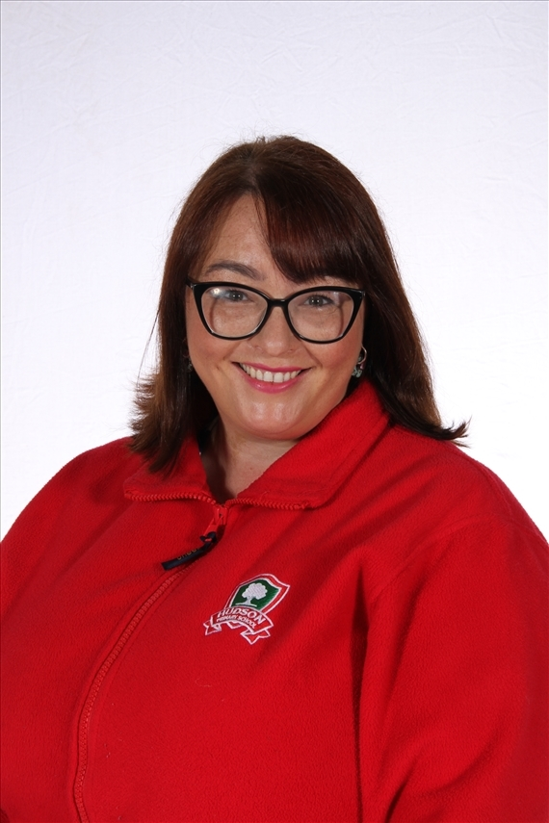
Meet the Teacher
Hello my name is Mrs Kelly,
I am so excited to be your Nursery teacher this year! Nursery is so exciting!
It is your first time at school, and we love helping you to settle in and welcoming you to our Hudson family.
I will be working hard with our dedicated team to plan a fun filled Nursery experience that will encourage you to make friends, ask questions, be confident and independent and solve problems.
When you come to Nursery you will have your own ’key person’. All of the grownups in Nursery will always help you if you need it but your key person is very special! They will be there to keep a special eye on you and help you with your learning, and make sure you feel happy and safe at Hudson.
Our Nursery team are Mrs Kelly, Mrs. Sealey, Mrs Wilson and Mrs Hoyles. We are really looking forward to meeting you all in September and beginning our learning journey together!
Mrs Kelly

Slide 3
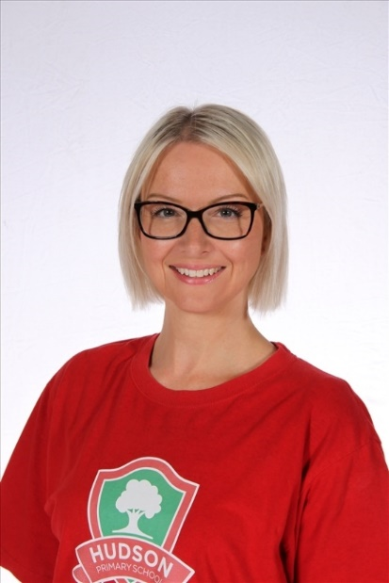
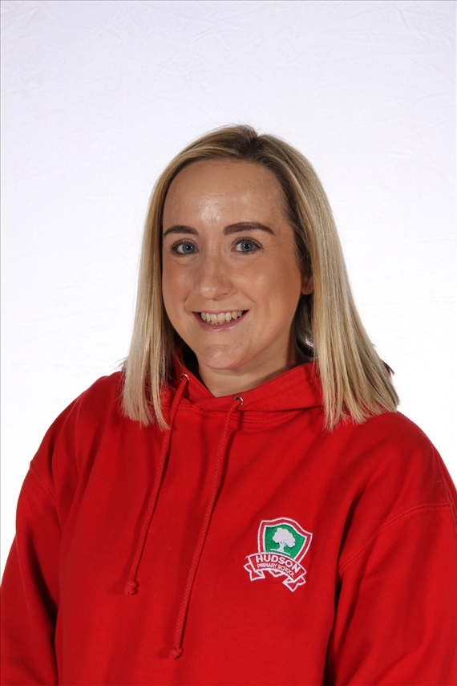
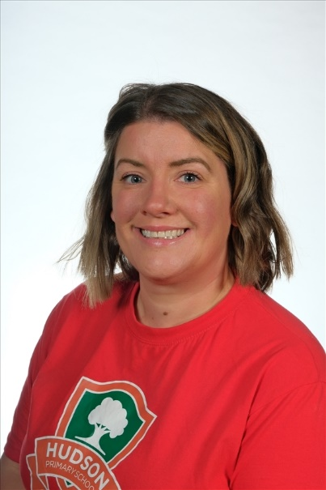
Meet Our Team
Mrs Sealey
Mrs Wilson
Mrs Hoyles

Slide 4

A typical day
The Nursery doors open at 8;40am for the children to come in, find their peg and hang their coat up and then find their names and self register by putting it in one of our feelings boxes.
Lunchtime begins at 11:45am during which children are supported by familiar staff from the Nursery Team. The morning session finishes at 12:15pm and the Cinder Path gate (Grosvenor Road entrance) will be open for parents to collect their children.
The afternoon session begins at 12:15pm and again the Cinder Path gate will be open for parents to drop their child off. The afternoon session finishes at 3:15pm. (both entrances to the playground will be open)
Our timetable in Nursery is flexible and we follow the needs and interests of the children but below is an example of a typical Nursery day.
Nursery Morning Flexible Timetable
8.50am | 9am | 9.10am | 9.20 | 9.30am | 10.15am | 10:30am | 10:45am | 11am | 11.30am
Self Registration Wellbeing Wake Up | Morning Welcome time with Key Person | Gross and Fine motor – Squiggle while you wiggle/ funky fingers/ dough disco Name writing | Phonics | Discovery Time (Continuous and enhanced provision) | Focus Learning Maths/ CLL/ UTW/ EAD/ PSED/ PD | Snack Time | Focus Learning Maths/ CLL/ UTW/ EAD/ PSED/ PD | Discovery Time (Continuous and enhanced provision | Story and Rhyme time
Nursery Afternoon Flexible Timetable
12.15pm | 12.50pm | 1pm | 1.30pm | 2.45pm | 3pm
Discovery Time (Continuous and enhanced provision) | Afternoon Welcome time | Focus Learning Maths/ CLL/ UTW/ EAD/ PSED/ PD | Discovery Time (Continuous and enhanced provision) | Tidy up time | Story time

Slide 5

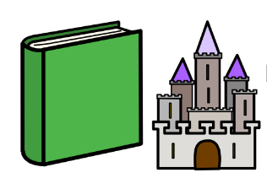
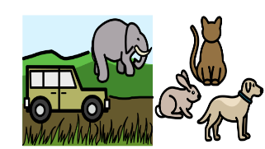
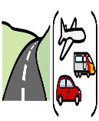
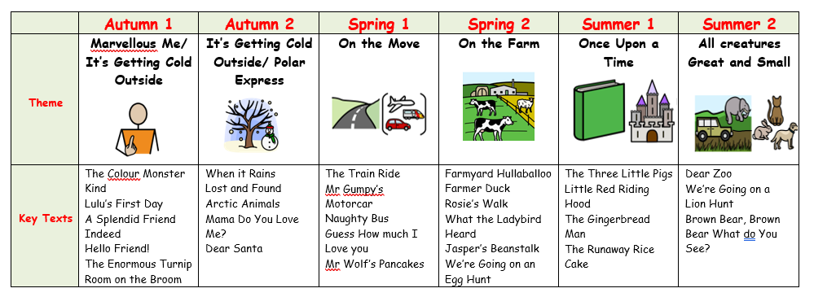
Our Nursery Learning Journey Topics

Slide 6
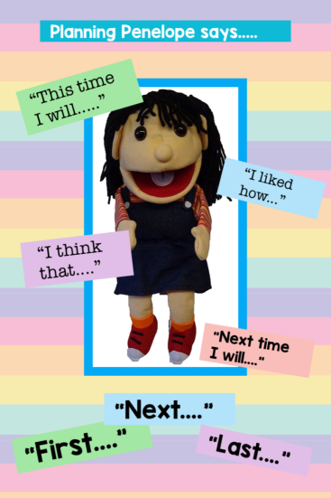
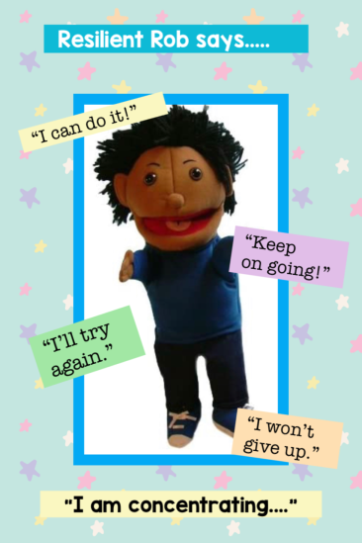
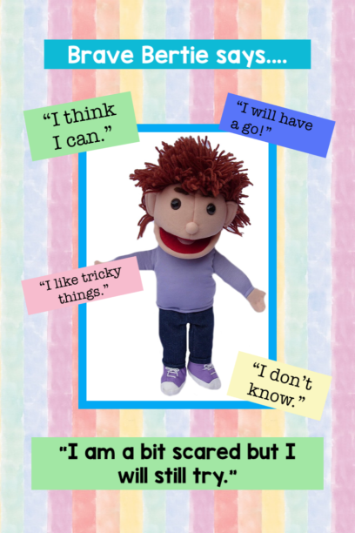
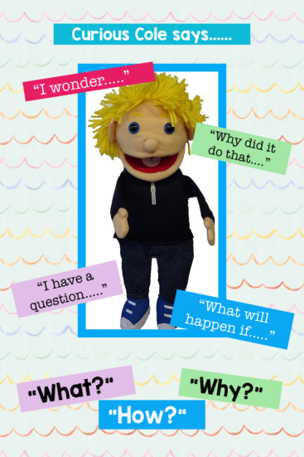
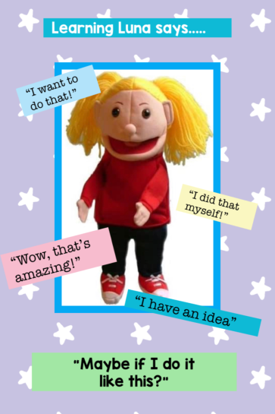
The Nursery Curriculum
All of the children at Nursery follow the Early Years Foundation Stage curriculum. This is a play– based curriculum that has seven areas of learning: Personal Social and Emotional Development, Physical Development, Communication and Language, Literacy, Mathematics, Understanding the World and Expressive Arts and Design.
The children take part in lots of fun and engaging activities to support these areas of learning, linked to our Learning Journey Topics. Throughout the year we also take part in special events and celebrations such as Bonfire Night, World Nursery Rhyme Week, Diwali, Christmas, Chinese New Year and World Book Day to name but a few!
At Hudson we assess how children learn through using the Characteristics of Effective Learning. These characteristics support the children to become motivated and independent learners. The Characteristics of Effective Learning are the ways the children engage with the people around them and their environment. In Nursery the children will meet our ‘Fantastic Five!’ Five characters who show the children how to use the Characteristics of Effective learning.
The Fantastic Five Curious Cole, Planning Penelope, Brave Bertie, Learning Luna and Resilient Rob are all looking forward to meeting the children!

Slide 7
School Uniform
Children wear a red polo top, navy leggings or jogging bottoms, a grey pinafore dress or skirt and a school cardigan or jumper.
Please clearly label everything your child brings into school with their name; even shoes!
Please send your child into school with a clearly labelled water bottle.
We go outside whatever the weather so would ask for a pair of labelled wellies to keep in nursery. We also go into Forest School once a week so a labelled puddle suit for your child to wear would be ideal.
As we are encouraging the children to be as independent as possible a pair of Velcro fastening shoes is ideal.
If the weather is sunny please send in a bottle of suncream and a sun hat for your child each clearly labeled.
We would be grateful if you could send a bag of spare clothes (including socks) into school as we do take part in a lot of messy play activities and sometimes accidents do happen! If your child is toilet – training, please send plenty of spare underwear, clothes and socks.
If your child is still in nappies please send in a clearly labelled pack of nappies and wipes. We will let you know in plenty of time if we are running low.

Slide 8
Lunch time
Children who are staying for lunch eat in Nursery with familiar adults on hand to help them if needed.
Children can either bring in a packed lunch or parents can purchase a hot meal for them. (All payments now go through parent pay.)
Snack time
We do offer a mid-morning and mid-afternoon healthy snack. This is a choice of fruit.
Water Bottles
We ask that all children bring their own clearly labelled water bottle into Nursery each day.
Nappies and Wipes
If your child is in nappies or toilet training, please provide plenty of nappies, wipes and changes of clothes.

Slide 9
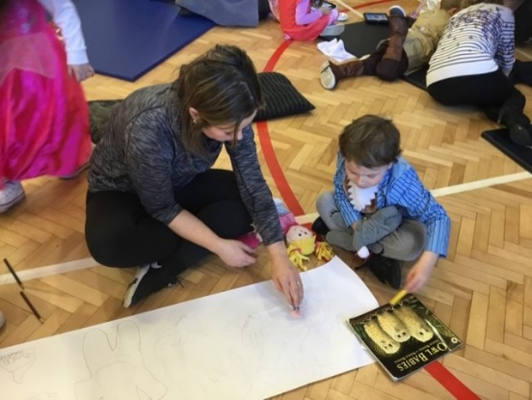


Parents as Partners
At Hudson we welcome both our new children and parents into our ‘Hudson Family.’ We recognise and value that parents are their children’s first educator and work hard to establish a partnership based on two way sharing of information.
We will ask you to share good news or any proud moments your child has for our Nursery ‘Proud Cloud’ and will invite you to our family conference twice a year to discuss your child’s progress.
At various times during the year, we may invite parents or grandparents in to take part in special activities with the children and showcase the children’s wonderful learning!
Parents can communicate with us using Class Dojo. The app can be downloaded onto all androids and iPhones. Messages from Dojo will not reach teachers after 4pm or before 8am. Class dojos are uploaded every week showing some of the week’s learning. Parents are welcome to add to their child’s portfolio on dojo to share news from home!

Slide 10

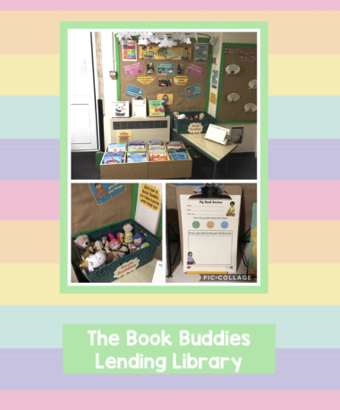
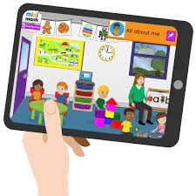

Home Learning- how you can help
Weekly, Class Dojo will be updated with the book focus for the week. There will be suggested vocabulary that you can use at home with your child, and more complex vocabulary if you would like to step things up.
Your child will be given a login for Purple Mash which is a fun online learning space. Children can explore ‘Mini Mash’ freely but each half term we will add some ‘2dos’ to enhance our learning.
One of the most important things you can do with your child is to read with them. In the cloakroom look out for our ‘Book Buddies’ Lending Library! You can take a book and a buddy home to share a bedtime story with then bring it back and choose another!
Look out on Class Dojo for a selection of fun and easy to do home learning challenges for you to take home to try with your child!
Look out for our Nursery Rhyme Challenge and Number Ninjas. These are both easy ways you can enhance your child’s learning at home; they can even gain certificates!

Slide 11

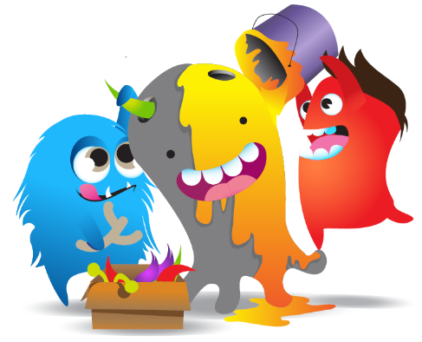
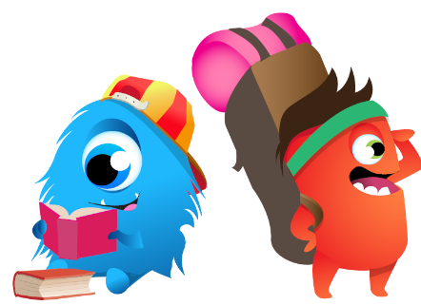
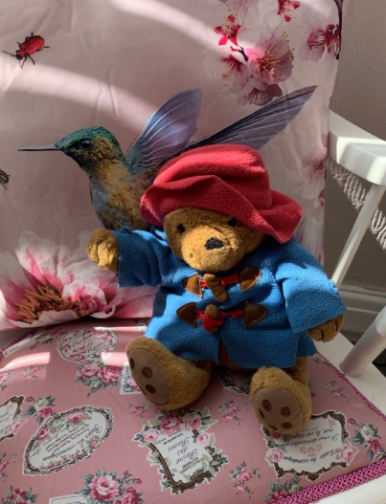
Rewards
Class Dojo
We use Class Dojo to reward the children. Parents you will be able to see when
your child has received a dojo point and what it is for!
You can earn dojo points for lots of different things and showing you are Ready, Respectful and Safe.
Points mean prizes
10individual points- small reward
100 individual points- small treat
Whole class target set each term: dojo party!!
Excellent Worker and Behaviour Champion
Each week a child will be chosen for their excellent learning or behaviour
to receive a certificate. Their name will be mentioned in the School
Newsletter and the winner of EEE will get to take Paddington Bear home
for the weekend.

Slide 12

So, stay safe, be good and we’ll see you soon!

